Slide 1
ME759 High Performance Computing for Applications in Engineering [Fall 2022]
Lecture Summary
Dan Negrut, 2022 ME759 UW-Madison

Slide 2
The Hardware-Software Interplay [Big Segment]

Slide 3
The ISA. The FDX cycle. Microarchicture aspects

Slide 4
Computing requires instructions and data
An instruction: stored in memory as string of 0 & 1 bits (often 32 or 64 bits, you don’t have a say)
A piece of data: stored in memory as string of 0 & 1 bits (8 bits, or 16, or 64, etc. – can be even user defined)
In terms of storage and movement, there is no distinction between instructions and data
Instructions are fetched & decoded & executed
Data is used to produce results according to rules specified by the instructions
NOTE: the “data & instructions share same storage and pathways” paradigm formalized by von Neumann in late 1940s
The “von Neumann model” (also known as the Princeton model)
Memory Data
Instructions
Data
[Cache] Memory
Processor
(Chip)
instructions flow
Control Unit (CU)
Arithmetic Logic Unit (ALU)
data flow
internal commands (uops)
internal consumption data
Notes:
Also known as Princeton model
Harvard model (architecture): separate storage and pathways for data and instructions
This model relies on the FDX cycle
The process of processing instructions (FDX) intermediated by the processor’s CU

Slide 5
The CPU’s Control Unit (CU)
The CU controls the “datapath” (i.e., the hardware collection of functional units + registers + data buses)
CU has several duties, such as
Bringing in the next instruction from memory
Decoding the instruction (possibly breaking it up into uops)
Engaging in actions to enable “instruction level parallelism” (ILP)
CU manages/coordinates based on information encoded in the specific instruction it works on
Notes:
The CU controls the DATAPATH (the functional units + registers + buses)

Slide 6
The CPU’s Arithmetic Logic Unit (ALU)
Made up of a bunch of so called “execution units” or “functional units”
In charge of executing arithmetic and load/store operations
Examples:
Arithmetic multiply/add unit (for integers)
Arithmetic multiply/add unit (for floats)
Special function unit
Called upon to compute sin, cos, exp, log, etc.
Etc.

Slide 7
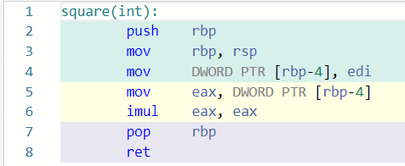
Instruction Set Architecture (ISA)
There is a limited number of prompts that the CU understands and thus act upon
This set of commands/prompts makes up the Instruction Set Architecture (ISA)
The same line of C code can lead to a different set of instructions on two different processors (CPUs)
This is so because two CPUs might implement two different ISAs
ISA: defines a “vocabulary” subsequently used by the compiler to specify the actions of a processor
Two more important schools of thought
RISC: fixed set of bits coded by instructions (used to be 32, now it’s 64), simpler
CISC: various lengths instructions (usually broken down to uops), more expressive, need more power to decode

Slide 8
FDX Cycle
Each instruction goes through the Fetch-Decode-Execute (FDX) cycle
FDX is what keeps the CU and ALU busy
FDX is done for instruction after instruction until program completes
Fetch: an instruction is fetched from memory
Might look something like this (on 32 bits, MIPS, lw $t0, 12($s2)):
10001110010010000000000000001100
Decode: this string of 1s and 0s are decoded by the CU
Instruction type is baked into the operation code (opcode) for CU to refer to
Execute: once all data (operands) available, instruction is executed
The execution can take several cycles of the CPU
Notes:
Whatever ISA is used, at execution time these instructions need to be:
fetched (brought over from memory)
decoded (interpreted, to some extent “undoing” what the compiler did which was an encoding into ISA)
executed (dispatched to the ALUs)
All these are performed by the CU

Slide 9
Decoding: Instruction Type I - immediate (MIPS ISA)
The first six bits encode the basic operation to be completed (opcode)
The next group of five bits: in which register the first operand is stored
The subsequent group of five bits: the target register, rt, where the result is written
The 16 bit stores the “immediate” value, usually used as the offset value in various instructions
“Immediate” like in “immediate value”: no need to read other registers, we know all we need
op (6 bits)
rs (5 bits)
rt (5 bits)
constant or address (16 bits)
32 bits
Notes:
For I instructions, the operation is completely defined by the opcode
addi $t,$s,C $t = $s + C (signed) 001000 sssss ttttt CCCC CCCC CCCC CCCC

Slide 10
Decoding: Instruction Type R - register (MIPS ISA)
Type R has the same first three fields op, rs, rt like I-type (note: now, rt is the second source register)
Packs three additional fields:
Five bit rd field (register destination)
Five bit shamt field (shift amount, only used for “shift” instructions)
Six bit funct field, which is a function code that further qualifies the opcode
op (6 bits)
rs (5 bits)
rt (5 bits)
rd (5 bits)
shamt (5 bits)
funct (6 bits)
32 bits
Notes:
DAN: see http://courses.cs.washington.edu/courses/cse378/09au/lectures/cse378au09-04.pdf for a nice discussion of I and R type instructions

Slide 11
Decoding: Instruction Type J - jump (MIPS ISA)
op (6 bits)
address (26 bits)
Execution
instructions
32 bits
Type J has an op field and an address field
Jump instruction has a word address, not an offset
A 26-bit address field allows for jumps to any address between 0 and 2²⁶-1
Longer jumps use the “jump register” instruction: jr $ra # jump to address in register $ra
Procedure called
first time here
Procedure called
second time here
[http://www.divms.uiowa.edu/~ghosh/1-24-06.pdf]$→$
Notes:
For J instructions, the operation is completely defined by the opcode.
Just two J-type instructions (j and jal). These set the PC register!
Can jump to an address less than 256 MB
jr is R-type

Slide 12
FDX Cycle – The Execution Part: It all boils down to transistors…
How does the FDX magic happen?
Transistors are organized into complex logical units capable of performing simple operations
With lots of transistors come opportunities for building/implementing in silicon additional functional/control units that can operate at the same time towards a shared goal
Transistors:
Step 1: used to perform tasks (tied to CU and ALU use)
Step 2: used to store data and instructions
Notes:
A transistor (when used in a CPU) is essentially a switch, like a light switch except that you don't have to turn it on or off manually. Rather, it is controlled by an electrical current. The most important thing to understand is that modern computers are two-state devices: the only thing that really matters is whether a wire has a current or not.

Slide 13
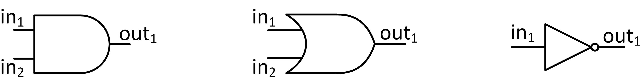
Transistors at work: AND, OR, NOT
Truth tables for bitwise AND, OR, and NOT
AND and OR logical ops require two transistors
The NOT logical operation is implemented using one transistor
AND | in₂=0 | in₂=1
in₁=0 | 0 | 0
in₁=1 | 0 | 1
OR | in₂=0 | in₂=1
in₁=0 | 0 | 1
in₁=1 | 1 | 1
NOT
in₁=0 | 1
in₁=1 | 0
AND
OR
NOT
Notes:
Functional completeness: NAND + NOR
Also: AND + NOT

Slide 14
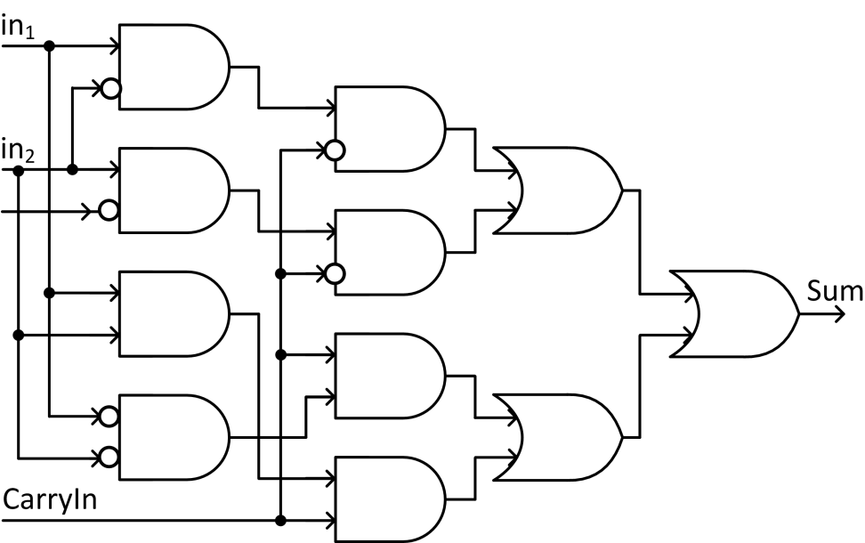
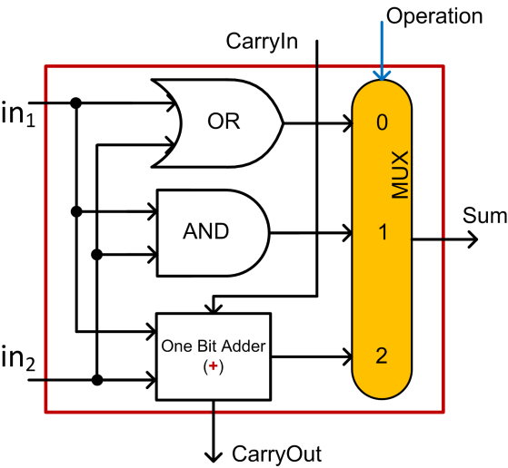
Integrated Circuits-A One Bit Combo: OR, AND, 1 Bit Adder
1 Bit Adder, the Sum part
A One Bit Combo: OR, AND, 1 Bit Sum
Controlled by the input “Operation”
result
Notes:
Main idea: combine simpler blocks to get a more complex block
Throw in a multiplexor (a “selector”) and you can build a more complex “LEGO brick”, a COMBO

Slide 15
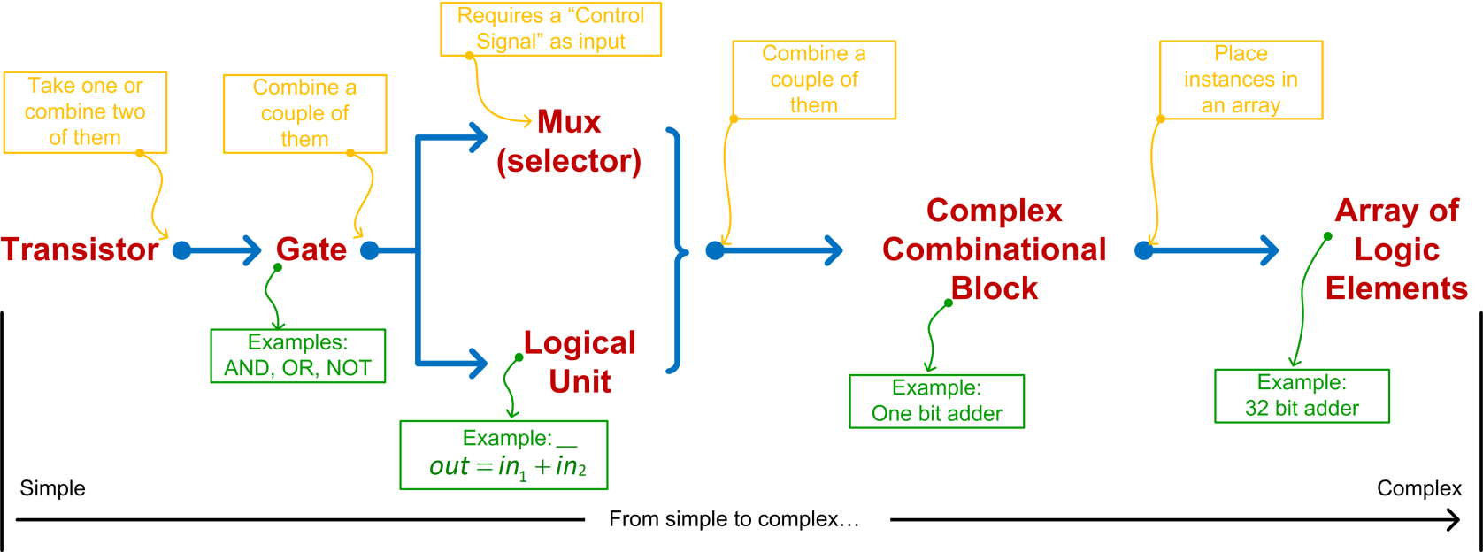
Integrated Circuits: From Transistors to Chip Microarchitecture
Notes:
Trend: simple to complex

Slide 16
Registers

Slide 17
Registers, quick facts
A register is a hardware asset whose role is that of information storing
Information: data value or instruction
A register is the storage type with shortest latency – part of the CU & ALU combo
Latency – can be of the order of hundreds of picoseconds
The size and number of registers are specific to an ISA
To start off, the size of the register is 32 bits (used to be, now 64 bits)
Number of registers: Back in the day, for the MIPS ISA, there were 32 registers (no more, no less)
Notes:
Typically, an n-bit register might require 4n … 8n transistors
Note: MIPS64 also uses 32 registers
Don’t expect to see too many registers: precious commodities which are located on prime real-estate

Slide 18
Register Types (1/2)
Current Instruction Register (CIR) – holds the instruction that is executed
Sometimes known as “instruction register” IR
Program Counter (PC) – holds address of the instruction executed next
NOTE: unlike CIR, PC contains *address* of the instruction, not actual instruction
Sometimes called IAR: Instruction Address Register
Memory Data Register (MDR) – holds data read in from memory or, alternatively, produced by the ALU and waiting to be stored in memory
Memory Address Register (MAR) – holds address of RAM memory location where input/output data is supposed to be read in/written out
NOTE: unlike MDR, MAR contains *address* of a mem location, not actual data
Return Address (RA) – the address where upon finishing a sequence of instructions, the execution should jump and commence with the execution of subsequent instruction
Notes:
An utility that monitors the program counter can tell you what the hot spots of your executable are
PC is used by profilers to see which instructions are hot-spots

Slide 19
Register Types (2/2)
There are several other registers common to many chip designs
These are encountered in different numbers (also depending on ISA)
Since they come in larger numbers they don’t have an acronym
Registers for Subroutine Arguments (4) – a0 through a3
Registers for Temporary Variables (10) – t0 through t9
Registers for Saved Temporary Variables (8) – s0 through s7
Saved between function calls
Several other registers are involved in handling function calls
Summarized below, their meaning only apparent in conjunction with the organization of the virtual memory
Stack Pointer (sp) – a register that holds an address that points to the top of the stack
Global Pointer (gp) – register that holds on to a global pointer that points into the middle of a 64KB block of memory in the heap that holds constants and global variables (these objects can be quickly accessed with a single load or store instruction)
Frame Pointer (fp) - a register that holds an address that points to the beginning of the procedure frame (for instance, the previous sp before this function changed its value)
Notes:
Virtual memory – at the end of this segment

Slide 20
Pipelining
“Nothing is particularly hard if you divide it into small jobs.”
--Henry Ford, founder of Ford Motor Company [1863 –1947]

Slide 21
Clock Cycle: time before the assembly line move again
The processor
“clock cycle”: the amount of time between two ticks of the internal clock of the microprocessor (chip)
Microprocessor clock speed typically measured in Hertz (pulses per second): number of pulses per second
FDX “Generic” process -- these stages can represent any instruction (though not all needed):
Stage 1: Fetch an instruction
Stage 2: Decode the instruction
Stage 3: Data access
Stage 4: Execute the operation (e.g., might be a request to calculate an address)
Stage 5: Write-back into register file
Tasks can be worked upon simultaneously when they are in different stages (at most 5)

Slide 22
Rules of thumb: costs to eXecute an operation > 1 clock cycle [refers to older MIPS ISA; cost of X in FDX]
Eg. 4 clock cycles for SW, 5 clock cycles for LW, 4 clock cycles for add, etc.
Each stage takes a certain number of cycles
A stage has substages
This sequence of substages present the opportunity to pipeline
22
Notes:
The numbers for the X86 family of chips is usually different

Slide 23
Pipelining Benefits: faster execution & no code rewrite
Benefit 1: faster execution, owing to simultaneously working on multiple instructions
Assume that you have
A very large number of instructions
Balanced stages
A pipeline that is larger than or equal to the number “$p$” of stages associated with the typical ISA instruction
If 1 through 3 above hold, in a first order approximation, speed-up you get out of pipelining is approximately “$p$”
Benefit 2: no code rewrite required on the user’s part; no effort needed to reap benefits
This kind of parallel processing of stages is transparent to the user
Unlike GPU or multicore parallel computing, you don’t have to do anything to benefit from it
Notes:
Ideally: at each cycle you complete one instruction
This ignores the need to “prime” the pipeline and to pipeline shutdown.
This ignores hazards (see next)
NOTE: this is not parallel programing, but rather parallel execution (it’s out of the programmer’s hands)

Slide 24
Pipelining, Good to Remember
Balanced pipeline: each of pipeline stage takes the same amount of time to complete
Non-balanced: will be stations that wait for the laggard station at every single cycle
Common sense: If there is a station that takes a significantly longer time since it does significantly more than other stations, it should be broken into two and the length of the pipeline increases by one station
Leads to deeper pipelines
Typical pipeline depth today: 12-15 stages
The amount of time required to complete one stage of the pipeline: one clock cycle
Pipelined processor: one instruction retired at each clock cycle
Non-pipelined processor: no overlap when executing instructions
Important Remark:
Pipelining does not decrease the time to complete one instruction but rather it increases the throughput of the processor by overlapping different stages of processing of different instructions
Notes:
NOTE: an individual instruction may take longer to complete (because some stages are delayed to fit the common tick)
The issue here is so-called INSTRUCTION HETEROGENEITY
Ford solved this problem by limiting the number of options:
“Any customer can have a car painted any color that he wants so long as it is black.”
But the benefit is THROUGHPUT

Slide 25
Deep Pipelines Plagued by Pipelining Hazards
Structural hazards: the possibility of having a combination of instructions in the pipeline contending for the same hardware asset
Data hazards [very common]: value used in the instruction is unavailable
Control hazards: a corresponding machine instruction decides the program flow
[Patterson, 4th edition]→

Slide 26
Pipeline Structural Hazards
Solution 1: perhaps a register can be commandeered somehow, for temporary use
Fortuitous, a matter of serendipity
Increase number of registers?
Brute force solution; expensive and consequential (requires a chip design change, perhaps even ISA)
Note that “needing one extra register” is just one possible scenarios; there are might be other contention scenarios lurking
Solution 2: serialize the access, basically introduce a bubble in the pipeline so that there is no contention
“bubble in the pipeline” – think of it as a skipped issue slot (the scheduler can’t issue anything)
Introducing bubbles into the pipeline at run time slows down the execution
Solution 3: Out of order execution (OOOE) done statically (at compile time) or dynamically (at run time)
Good compromise
Notes:
Analogy: we finished eating well before the dinner table is clean, the plates are in the dishwasher, and the floor is swept

Slide 27
Pipeline Data Hazards (2/2)
Pipeline Data Hazards
[very common]
Resolution [less than ideal]: Put bubbles in the pipeline to wait for the first instruction to fully complete
Alternative [the good] Resolution: use “forwarding” or “bypassing”
Key observation: the value that will eventually be placed in $t0 is available after stage 3 of the pipeline (where the ALU actually computes this value)
Analogy: we finished eating well before the dinner table is clean, the plates are in the dishwasher, and the floor is swept
Provide the means for that value in the ALU to be made available to other stages of the pipeline right away
Avoids bubbling - don’t have to wait several cycles before the value made its way into $t0
This process is called “intermediate result forwarding”
Supporting forwarding does not guarantee resolution of all scenarios
Occasionally the pipeline ends up with bubbles for a couple of cycles
OOOE helps (insert unrelated instruction, wedged between two instructions that depend on each other)
Notes:
Analogy: we finished eating well before the dinner table is clean, the plates are in the dishwasher, and the floor is swept

Slide 28
Pipeline Control Hazards: Branch Prediction
Should we bubble the pipeline while this instruction is fully processed and branching decision becomes clear?
If yes: strategy always works, but slows down execution
If no: rely on branch prediction and proceed fast but cautiously
Static Branch Prediction :
Several heuristics for proceeding: for instance, for a do-while construct it makes sense to always be jumping back at the beginning of the loop
Similar heuristics can be produced in other scenarios (a “for” loop, for instance)
Dynamic Branch Prediction :
At a branching point, the branch/no-branch decision can change during the life of a program based on recent history
In some cases, branch prediction accuracy hits 90%
Use with if-then-else statements
Note: when your prediction is wrong you have to discard the [micro]instruction[s] executed speculatively and take the correct execution path
Notes:
Dynamic branch prediction: requires more hardware to implement the logic (keep track of previous paths)

Slide 29
[New topic]Pipelining vs. Multiple-Issue
Multiple-issue: In sequential computing, a multiple-issue processor core has the hardware chops to issue more than one instruction per cycle
Pipelining different than “Multiple-Issue,” which is another way of speeding up execution
Pipelining: the next step is dependent on the previous step
Multiple-Issue: the steps next to each other are independent (see code snippet below)
On average, more than one instruction is processed by the same core in the same clock cycle
Multiple-Issue can be done statically or dynamically
Static multiple-issue:
Predefined, doesn’t change at run time
Who uses it: Intel, in AVX512 (but not only)
Dynamic multiple-issue:
Determined at run time, the chip has dedicated hardware resources that can identify and execute additional work
Who uses it: Intel, AMD, IBM, NVIDIA, etc.
int a, b;
float c, d;
//some code setting up a, b, c, d
a += b;
c += d;
Notes:
Depart from the “assembly line” analogy. Here, think of a car manufacturing plant where more car models are produced simultaneously, by sharing common available resources (stations).
It’s actually good here to have very different “car models”: it’s less likely to have competition for same resources (stations).

Slide 30
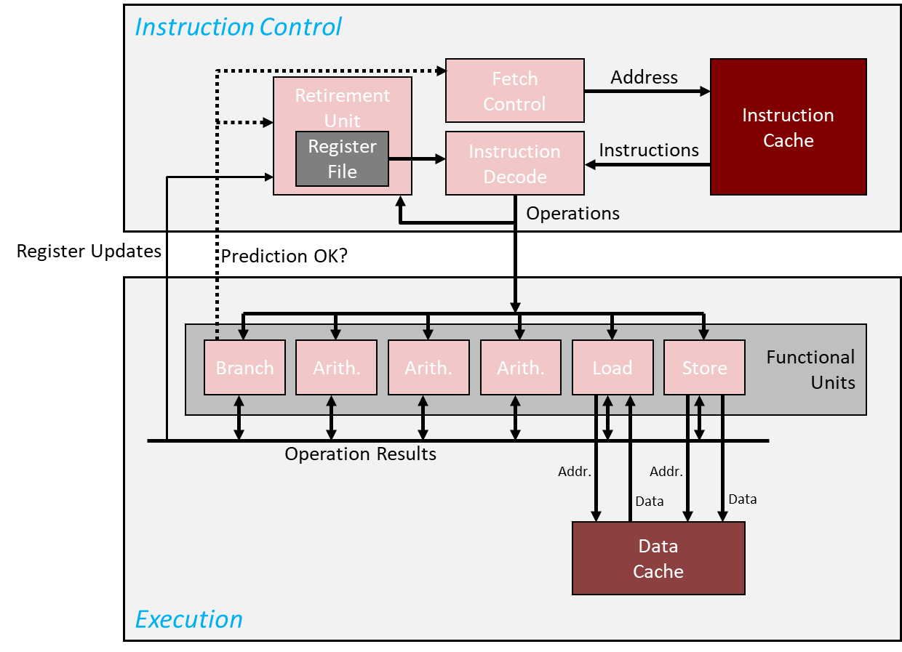
Pipelining vs. Multiple Issue
(a) Three-stage pipeline
(b) Multiple issue processor
[Modern Operating System, Tanenbaum-Bos]→

Slide 31
Attributes of Dynamic Multiple-Issue
The data dependencies between instruction being processed takes place at run time
Checking for dependencies is complex, requires high cost in time and energy
Checks in place to make sure result is ok
“ok”: no difference if the instructions are executed “multiple-issue” or “single issue”
NOTE: a chip that can do multiple-issue is also called a superscalar architecture
Notes:
CU acts as supervisor to see what instructions can be issued and dispatched simultaneously

Slide 32
Instruction-Level Parallelism (ILP) [belongs to a single specific thread of a process] & Thread Level Parallelism (TLP) [happens on a single core]
ILP:
Including Pipelining, OOOE, and multiple-issue
ILP is a property of a program
ILP is an IPC (Instruction Per Cycle) that:
Processor does the entire instruction in one cycle
Processor can do any number of instructions in the same cycle
Important: these instructions belong to the same program or process; i.e., belong to one thread
“process” – how the operating systems calls your program
TLP:
chip executes simultaneously instructions from different processes or different threads
Important to keep in mind: we are talking about parallelism on one hardware core, not multicore
Difference:
Recall concept of “Program Counter” (PC): a register that holds address of next instruction
ILP == all instructions executed by the chip in parallel are associated with one PC
TLP == the stream of instructions simultaneously processed by the chip associated with more than one PC
Notes:
Dynamic multiple-issue makes use of a buffer for instructions to be able to look ahead.
We already alluded to other ILP techniques:
out of order execution
speculative execution and branch prediction
also, register renaming, etc.

Slide 33
Process vs. thread – getting a bit into the weeds
There is a subtle difference between processes & threads:
TLP is what happens when two processes such as Matlab and Microsoft Word run on the chip
Because two different processes, there are two different PCs
TLP: two (or even more) OpenMP or POSIX threads simultaneously run on the chip
Because two different threads, there are two different PCs
How similar: Both processes and threads are independent sequences of execution
How different:
Threads (of the same process) run in a shared memory space
This is how shared-memory parallel computing takes place. Like OpenMP
Processes run in separate memory spaces
This is how distributed-memory parallel computing takes place. Like MPI*

Slide 34
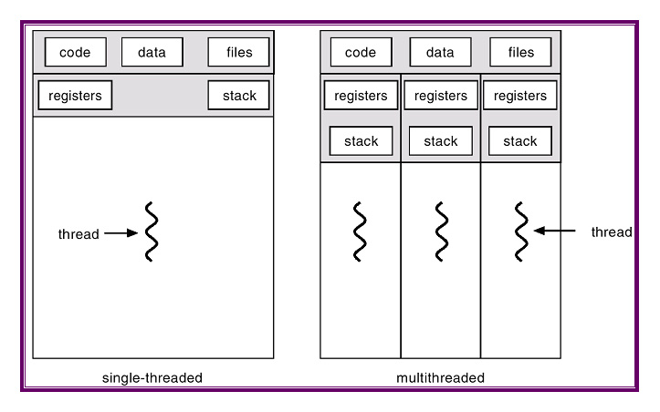
Each thread has its own register file, stack; but not memory space
Physically, it runs on one core
(one CU, one ALU, one register file)
Physically, it runs on one core
(one CU, one ALU, one register file)
[Mirela Damian]$→$

Slide 35
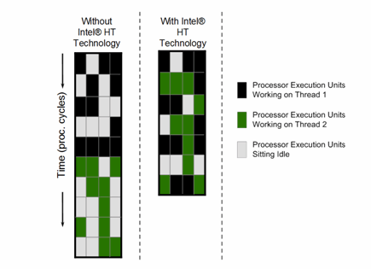
Multi-threading makes the full use of TLP
Multi-threading, a possible taxonomy (Hennessey & Paterson)
Coarse grain multi-threading
The Instruction Control issues instructions from one thread for many cycles
Instruction Control switches to issuing from another thread only when the first thread runs into a long-latency operation
Examples: cache miss, interrupt, etc.
“long-latency”: Hundreds of cycles or so
Fine grain multi-threading
Instruction Control can issue instructions from a different thread each cycle
“Barrel-gun style” processing: thread from where next instruction is picked for execution can change at every cycle
Examples: GPU computing similar to this
More nimble/sophisticated compared to coarse multi-threading
Simultaneous multi-threading
Instruction Control can issue instructions from different threads in the same cycle

Slide 36
Superscalar processor or TLP processor
Superscalar vs. TLP
Superscalar: instructions associated with one PC
TLP: instructions associated with two PCs
Superscalar: one PC on the chip
HW has the means to execute more than one instruction per cycle
Superscalar: it’s more than a “scalar”; i.e., one thread
TLP: Processor handles instructions from different threads/processes
NOTE: we are not talking about multiple-cores; we are still talking about one CPU core here

Slide 37
Measuring Speed of Execution

Slide 38
Nomenclature
Wall Clock Time
Amount of time from the beginning of a program to the end of the program
CPU Execution Time
Counts only the amount of time that is effectively dedicated to *your* program
Many other programs running on your machine at the same time (time slicing)
Requires a profiling tool to assess (like gprof, for instance)
On a dedicated machine; i.e., a quiet machine, Wall Clock Time and CPU Execution Time should be identical
User time – the time spent processing instructions compiled out of code generated by the user or in libraries that are directly called by user code
System time – time spent in support of the user’s program but in instructions that were not generated out of code written by the user
OS support: open file for writing/reading, throw an exception, etc.
Clock cycle: sets the pace at which the execution proceeds
A constant value dictated by the frequency at which processor operates
[Patterson, 4th edition]→
Notes:
In general: Program Execution Time is what you care about (end-to-end time to solution)

Slide 39

The CPU Performance Equation
Three ingredients control the amount of time for execution of a program:
Number of instructions that your program has (Instruction Count)
Average number of “clock-cycles per instructions” (CPI)
Clock Cycle Time
The CPU Performance Equation reads:
Alternatively, using the clock rate:
As repeatedly demonstrated in practice, reducing the Instruction Count (IC) often times leads to an increase in CPI. And the other way around.
$CPU Execution Time=Instruction Count ×CPI ×Clock Cycle Time$
$$CPU Execution Time= \frac{Instruction Count ×CPI}{Clock Rate}$$
[Patterson, 4th edition]→

Slide 40
Big New Topic: Memory Aspects

Slide 41
SRAM vs. DRAM: wrap-up
Order of the SRAM access time: 4 to 5 cycles (nanoseconds)
Expensive but fast
Transistor hog
Needs no refresh
Order of the DRAM access time: 10s of cycles
The information stored as a charge in a capacitor
Less expensive but slow
Requires one capacitor and one transistor, might have capacitor leak
Higher capacity per unit area
Needs refresh every 10-100 ms (a small overhead in memory access – around 0.1%)
Sensitive to disturbances
Limit case: a 10X - 100X speedup
if you can work off the SRAM
 | Transistors per bit | Access Time | Persistent? | Sensitive? | Price | Applications
SRAM | 6 | 1X | Yes | No | 100X | Cache memories
DRAM | 1 | 10s X | No | Yes | 1X | Main Memory
 | SRAM | DRAM | Flash
Speed | Very fast | Fast | Very slow
Density | Low | High | Very high
Power | Low | High | Very low
Refresh | No | Yes | No
Retention | Volatile | Volatile | Non-volatile
Mechanism | Bi-stable Latch | Capacitor | Fowler-Nordheim tunneling
[Rauber&Runger]→
Notes:
[Rauber&Runger]→ Typical access times are 0.5–2.5 ns (ns = nanoseconds = 10−9 seconds) compared to 50–70 ns for DRAM (values from 2008 [84])
From Rochester (http://www.cs.rochester.edu/~sandhya/csc252/lectures/lecture-storage.pdf):
Key features
– RAM is packaged as a chip.
– Basic storage unit is a cell (one bit per cell).
– Multiple RAM chips form a memory.
• Static RAM (SRAM)
– Each cell stores bit with a six-transistor circuit.
– Retains value indefinitely, as long as it is kept powered.
– Relatively insensitive to disturbances such as electrical noise.
– Faster and more expensive than DRAM.
• Dynamic RAM (DRAM)
– Each cell stores bit with a capacitor and transistor.
– Value must be refreshed every 10-100 ms.
– Sensitive to disturbances.
– Slower and cheaper than SRAM.

Slide 42
New Topic: The Memory Hierarchy
Observation 1: over time, speed of data processing increased faster than speed at which we could bring over data to be processed
Observation 2: the bigger the memory used to store data, the longer it takes to find/access an entry therein
Compromise between size and speed of access
Consequences of Observations 1 & 2: a hierarchy of memories has emerged
Managing memory hierarchy not trivial → a dedicated hardware asset called MMU (memory management unit) handling this task
MMU’s purview: virtual memory management, cache control, memory protection, bus arbitration, etc.
Compromise:
Have some SRAM on-chip, making up what is called the “cache”
Have a lot of inexpensive DRAM off-chip, making up the “main memory”
This is what people have in mind when they ask you “How much memory does your system have”?
In our code, we hope to have low “average memory access time” by hitting the cache repeatedly instead of taking costly trips to main memory
All caches are typically on the chip and are SRAM

Slide 43
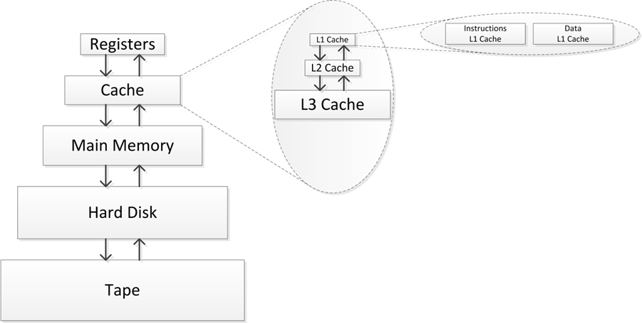
Memory Hierarchy
The collection of all registers is called “the register file”
Moving on to talk about caches

Slide 44
Cache Memories
Cache memories are small, fast, on-chip SRAM-based memories
Purpose: to store close to the CU/ALU frequently accessed blocks of main (aka “system”) memory
Schematic of chip’s datapath (chip=datapath + CU), and where cache fits in the big pic:
The DATAPATH
Register file
ALU
Cache
memory
System bus
Memory bus
Main
memory
Bus interface
I/O
bridge
[Bryant and O‘Hallaron: CMU] →

Slide 45
How Cache Comes into Play
All* read/write operations go through cache
Caches used to hold both data and instructions
Data and instructions caches are in general different
Intel: L1 DC (data cache) and L1 IC (instruction cache) have been distinct since about 1993
CPU Core
Cache
Bus
Main Memory

Slide 46
Caches: Come In Two Flavors
Data caches feed processor with data manipulated during execution
If processor would rely on data provided by main memory the execution would be pitifully slow
“Processor Clock” much faster than the “Memory Clock”
Caches alleviate the memory pressure – processors are data hungry
Instruction caches: used to store instructions
Simpler to deal with compared to the data caches
By and large, instruction use is much more predictable than data use

Slide 47
Processor Clock vs. Memory Clock [important to understand]
From RAM
Processor Clock: (look for the box )
Dictates/defines the frequency at which Functional Units operate
Memory Clock:
Dictates/defines the frequency used to move data into/out from main memory into cache
To/From RAM

Slide 48
Multiple Levels of Cache
Typically, commodity chips today have 3 cache levels
(some chips have a fourth cache level, see previous slide)
CPU Core
L1 D$
CPU Core
Cache
Zoom in
L1 I$
L2 Cache
Bus
L3 Cache
Main Memory
Bus
Main Memory

Slide 49
Example: Intel Core i7 Cache Hierarchy
Processor package
Core 0
Core 7
Regs
Regs
L1 i-cache and d-cache:
32 KB, 8-way assoc.
Access: 4 cycles
L2 unified cache:
256 KB, 8-way assoc.
Access: 10 cycles
L3 unified cache:
8 MB, 16-way assoc.
Access: 40-75 cycles
Cache line size: 64 bytes for all caches.
L1
d-cache
L1
i-cache
L1
d-cache
L1
i-cache
…
L2 unified cache
L2 unified cache
L3 unified cache
(shared by all cores)
Main memory
[Bryant and O‘Hallaron: Computer Systems - A Programmer's Perspective 3rd edition] →

Slide 50
The reason caches can [sometimes] make a difference: “Principle of Locality”
Principle of Locality: Programs tend to use data and instructions with addresses near or equal to those they have used recently
Temporal locality:
“Recently referenced items are likely to be referenced again in the near future”
Example:
A for loop with some variables inside the loop
Variable sum referenced at each iteration
Spatial locality:
“Items with nearby addresses tend to come into use together”
A memory access pattern characterized by bursts of repeated requests for data that is physically located within the same memory region
Example:
Reference instructions in sequence
Array abc elements accessed in succession (stride-1 reference pattern)
[Bryant and O‘Hallaron: Computer Systems - A Programmer's Perspective 3rd edition] →

Slide 51
Matrix, stored in 2D format
Legend:
Boxes of this color used to show sequence of entries read for row-wise access of elements
Boxes of this color used to show sequence of entries read for column-wise access of elements
1st row
The Memory
2nd row
0
1
2
3
4
5
6
7
8
9
10
11
0
250000
1
2
250,000th row
12
13
14
15
249999
3
999996
999999
16
17
18
19
999997
999998
4
Matrix dimensions
250,000 × 4
1 million elements
Matrix storage scheme:
“proper 2D”

Slide 52
Three observations related to our 2D and 3D examples
Observation 1: Final value for sum - stays the same (at least as far as we can tell)
We’ll talk more about this when we do parallel computing w/ CUDA and then OpenMP
Observation 2: Difference between Debug vs Release builds
3X to 4X speedup normal to see when going from debug to release (see also results on next slide)
Observation 3: Amount of time to get the result quite different
Release mode build: the undesirable solution for 3D matrix is 30 times slower
This is the case you see in practice – you build in release

Slide 53
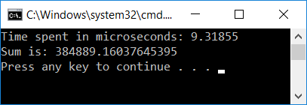
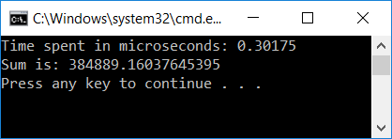
Observations on “Observation 1”
The fact that the results are the same is remarkable
Why remarkable?
Finite precision arithmetic: addition loses its commutative and associative attributes
$ python
Python 3.9.12 (main, Apr 5 2022, 06:56:58)
[GCC 7.5.0] :: Anaconda, Inc. on linux
Type "help", "copyright", "credits" or "license" for more information.
>>> 0.001 + 1E20 - 1E20
0.0
>>> -1E20 + 1E20 + 0.001
0.001
>>>

Slide 54
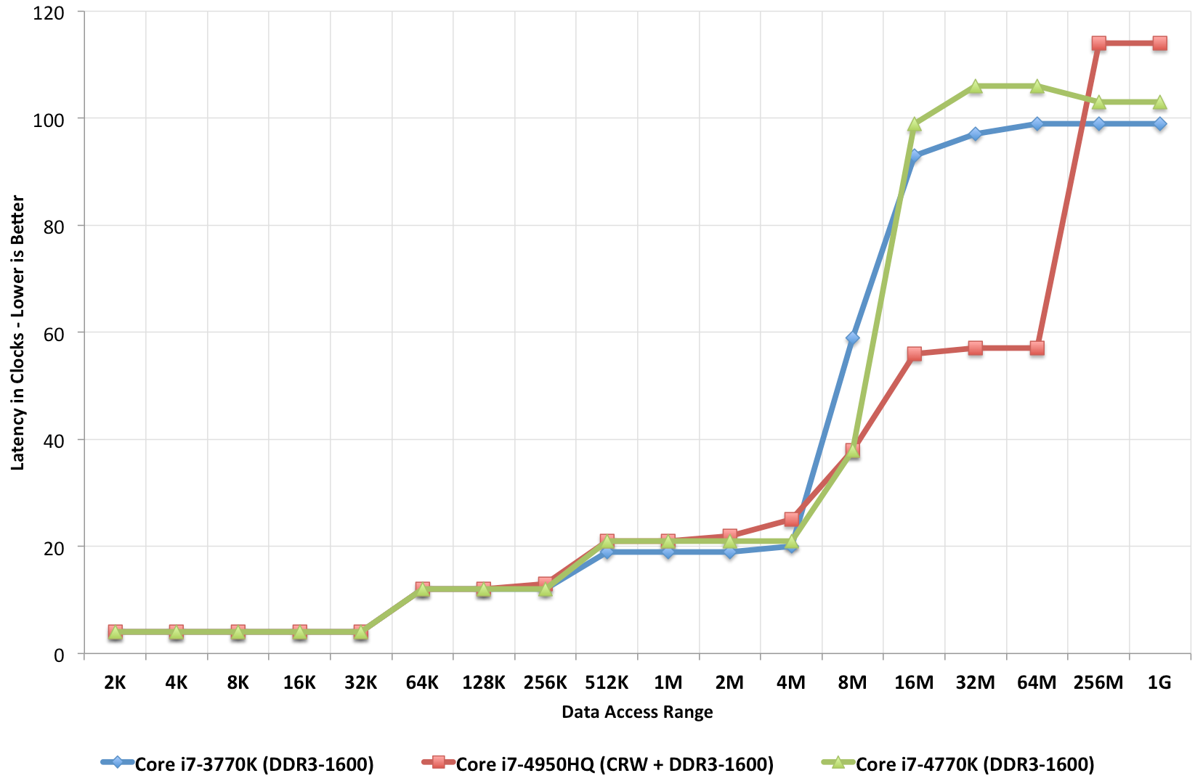
Observations on “Observation 3” (most important)
Q: What mechanism comes into play to yield a 30X speed gain?
A: The cache
L1 cache: 4 cycles
System memory access: 100-120 cycles

Slide 55
The Lesson Learned
Fact: Wide gap in the speed of “using data” vs. “moving data”
Using data: you do sin of that data, log, pow, add, subtract, etc. (processing the data)
Moving data: getting your data from the system memory (64 GB/128/etc. GB that you have on your system)
Fact: The cache used to close the big speed gap
Trait of well-written programs: the programs leverage data/instruction locality
Locality is what allows caches to come into play
Locality necessary, but not sufficient (more later, “false sharing”)

Slide 56
The Lesson Learned
Fact: Wide gap in the speed of “processing data” vs. “moving data”
Processing data: on that data, you do operations such as sin, log, pow, add, subtract, etc.
Moving data: getting your data from the system memory (64 GB/128/etc. GB of main memory)
Fact: The cache emerged as a way of managing the CPU vs. Memory speed gap
Trait of well-written programs: the programs leverage data/instruction locality
Locality is what allows caches to assist you

Slide 57
[Back to caches: The inner workings of caches] General Cache Concepts
Everything handled in hardware. Invisible to programmer
Smaller, faster, more expensive
memory can store a subset of
the main memory blocks
The Cache
8
4
9
14
10
3
Data copied in block-sized transfer units. Each block (such as block 10, for instance) typically holds 64 bytes of data (called cache line).
4
10
0
1
2
3
4
4
5
6
7
8
9
10
The Main Memory
10
11
Main Memory: Larger, slower, cheaper memory
(shown here as partitioned into “blocks” that are
mapped into cache lines)
12
13
14
15
[Bryant and O‘Hallaron: Computer Systems - A Programmer's Perspective 3rd edition] →
Notes:
10, or 9, or 3, etc. – these are cache line (or blocks). In main memory, called “a block”; in cache, called “a line”

Slide 58
Cache Line (aka Cache Block)
When data is brought in cache because a piece of data is needed, the MMU brings more than just the needed piece of data
Bring more data than what absolutely necessary -- because penalty is not high for bringing more: wide buses, little extra cost in bringing more data than exactly what needed
Corollary: you will reduce the number of trips to main memory if you use multiple times data from a cache line
“cache line”
Many systems have cache line of 64 Bytes (8 doubles OR 16 floats OR 16 ints OR 64 chars, etc.)
Cache line size is the same for L1, L2, and L3 caches

Slide 59
General Cache Concepts: Hit
Delivery to registers…
Request: 14
Data in block b is needed
Block b is in cache:
Hit!
Cache
8
9
14
3
14
Memory
0
1
2
3
4
5
6
7
8
9
10
11
Hit Rate: on average, how many out of 100 mem requests hit the cache? (we’ll talk about this again)
12
13
14
15
[Bryant and O‘Hallaron: Computer Systems - A Programmer's Perspective 3rd edition] →

Slide 60
General Cache Concepts: Miss
Delivery to registers…
Request: 12
Data in block b is needed
Block b is not in cache:
Miss!
Cache
8
9
14
3
12
Block b is fetched from
memory
12
Request: 12
Block b is stored in cache
Placement policy: determines where Block b goes
Replacement policy: determines which block gets evicted (victim), should there be any freedom of choice
Memory
0
1
2
3
4
5
6
7
8
9
10
11
12
12
13
14
15
[Bryant and O‘Hallaron: Computer Systems - A Programmer's Perspective 3rd edition] →

Slide 61
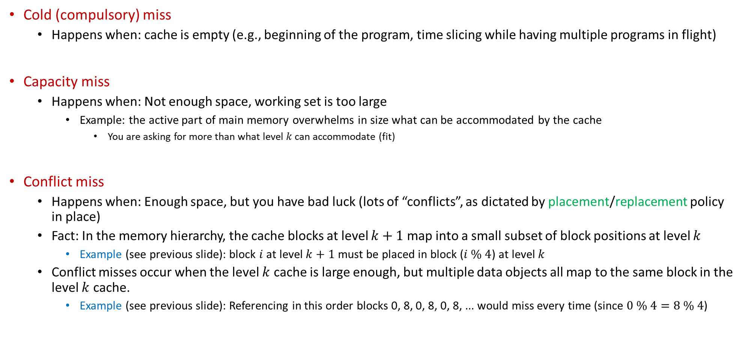
Most common reasons for Cache Misses
Cold (compulsory) miss
Happens when: cache is empty (e.g., beginning of the program, time slicing while having multiple programs in flight)
Capacity miss
Happens when: Not enough space, working set is too large
Example: the active part of main memory overwhelms in size what can be accommodated by the cache
You are asking for more than what level $k$ can accommodate (fit)
Conflict miss
Happens when: Enough space, but you have bad luck (lots of “conflicts”, as dictated by placement/replacement policy in place)
Fact: In the memory hierarchy, the cache blocks at level $k+1$ map into a small subset of block positions at level $k$
Example (see previous slide): block $i$ at level $k+1$ must be placed in block ($i \% 4$) at level $k$
Conflict misses occur when the level $k$ cache is large enough, but multiple data objects all map to the same block in the level $k$ cache.
Example (see previous slide): Referencing in this order blocks 0, 8, 0, 8, 0, 8, ... would miss every time (since $0 \% 4=8 \% 4$)

Slide 62
Cache Miss Classification, by Request Type
Cache read miss from an instruction cache: generally causes the most delay, because the processor, or at least the thread of execution, has to wait (stall) until the instruction is fetched from main memory
A cache read miss from a data cache: usually causes less delay (compared to instruction cache miss)
OOOE: Instructions not dependent on the cache read (if any) can be issued and executed until the data is fetched from main memory and the stalled instructions can resume execution
TLP: Another thread can be picked up for execution
A cache write miss to a data cache: generally causes the least delay, because the write can be queued and there are few limitations on the execution of subsequent instructions. The processor can continue unless the queue is full and then it has to stall for the write buffer to partially drain

Slide 63



Placement & Replacement Policies
Direct mapping: cache structured as skinny skyscraper, with one apartment per story (E = 1)
An “apartment” large enough to accommodate 64 folks (Bytes)
Associative, K-way: a certain number of floors (stories), each with K apartments
Fully associative cache: apartment complex with ground level only (ranch)

Slide 64
Placement & Replacement Policies: further discussion
Direct map (the tall skinny skyscraper)
Pros: very fast to find if in cache or not
Cons: sometimes, you’ll have to evict a cache line that sees a lot of use (no freedom at all in the placement policy)
K-way associative (Hilton Garden Inn)
Decent compromise:
You don’t have to search too many “apartments” at a floor level for a matching tag
It yields a reasonably decent replacement policy – you have K options to choose from
Fully associative (the ranch)
Pros: you have full control which old cache line you want to kick out (lots of freedom for replacement policy)
Cons:
Higher overhead to find what you’re looking for (data can be anywhere in cache)
Higher overhead to decide whom to evict (the “victim”) – in case you don’t have a hit

Slide 65
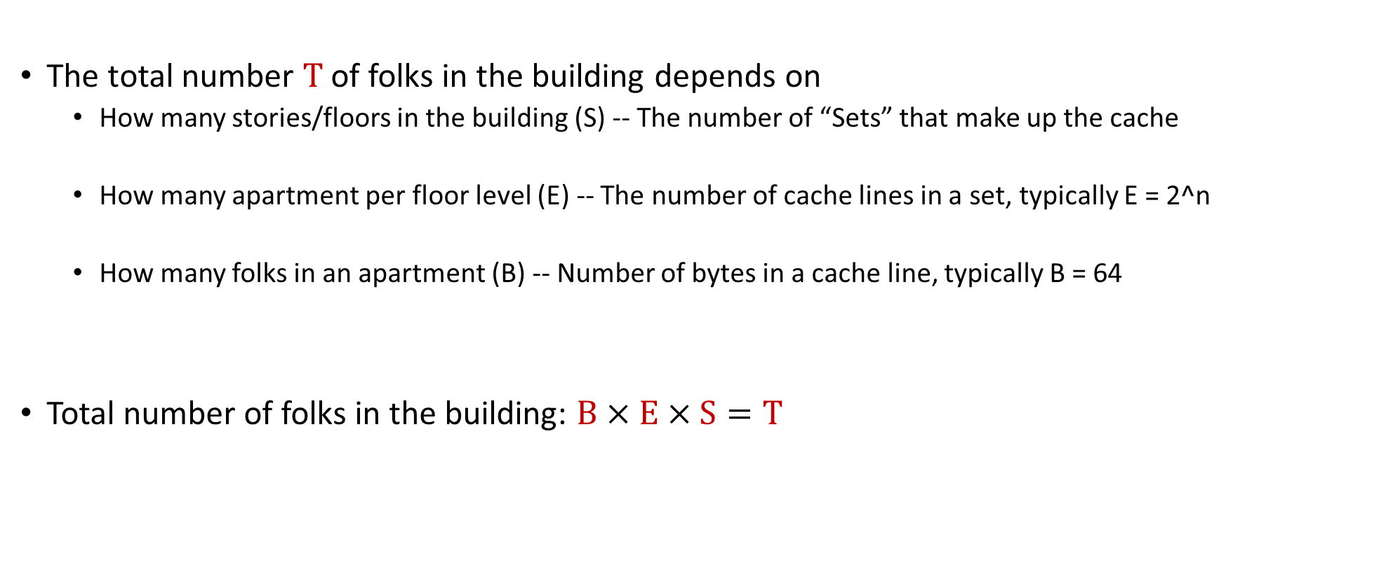
The BEST rule: The “folks in an apartment building” metaphor
The total number T of folks in the building depends on
How many stories/floors in the building (S) -- The number of “Sets” that make up the cache
How many apartment per floor level (E) -- The number of cache lines in a set, typically E = 2^n
How many folks in an apartment (B) -- Number of bytes in a cache line, typically B = 64
Total number of folks in the building: $B×E×S=T$
Memory address (either 32 or 64 bits)
t bits
s bits
b bits
tag
set
index
block
offset
NOTE: Think of the “set index” as which floor in the building

Slide 66
General Cache Organization (B, E, S)
E = 2e lines per set
a “cache Set”
a “cache Element” (it wraps inside a cache line; an element belongs to a set)
S = 2^{s} sets
Cache size:
B x E x S=T data bytes
How a “cache Element” is organized
v
tag
0
1
2
B-1
valid bit
B = 2^{b} bytes of data per cache block (cache line)
[Bryant and O‘Hallaron: CMU] →

Slide 67
We’ve done memory reads. What about writes?
Multiple copies of data exist stored in different places and at the same time:
L1, L2, L3, Main Memory, Secondary Memory (Disk)
How should a write-hit be handled?
Write-through (write immediately to main memory as well)
Write-back (defer write to memory until replacement of line)
Need a dirty bit (indicate whether line different from memory or not)
How should a write-miss be handled?
Write-allocate (write to next level down memory, but also update this cache level)
Good if more writes to the location follow; i.e., if locality is good
No-write-allocate (writes straight to next level down memory, do not load into this cache level)
Typical combos met in practice:
Write-back + Write-allocate ← more common
Write-through + No-write-allocate

Slide 68
Cache performance metrics [a nomenclature matter]
Miss Rate
Defined as Miss Rate = 1 – Hit Rate (note that we defined the “Hit Rate” concept before)
Miss rate represents the fraction of memory references that are not found in cache
3 - 10% for L1
Can be quite small (e.g., < 1%) for L2, depending on size, nature of problem you run, etc.
Hit Time
Time to deliver a line in the cache into a register of the processor
Includes time to determine whether the line is in the cache
Typical numbers:
4 clock cycles for L1
10 clock cycles for L2
Miss Penalty
Additional time required because of a miss
Typically 50-200 cycles for main memory (Trend: slightly increasing)
[Bryant and O‘Hallaron: CMU] →

Slide 69
People Talk about Miss Rate, Not Hit Rate
People talk about miss rate, and not hit rate
Weird math: Although 97 and 99 are close, is 99% hit rate twice as costly as 97% hit rate???
Assumptions, for back of the envelope calculation: a) cache hit time of 1 cycle b) miss penalty of 100 cycles
97% vs 99% hit rate: Access cost for 100 mem operations
97% hit rate: $1+1+…+1+100+100+100=397 cycles$
99% hit rate: $1+1+…+1+ 1 + 1 +100=199 cycles$
$$\frac{397}{199}≈2$$
You’d think that 97% is as good as 99%. It’s not…
This is why “miss rate” is used instead of “hit rate”: 1% miss rate vs. 3% miss rate
[Bryant and O‘Hallaron: CMU] →

Slide 70
Writing Cache Friendly Code: Rules of Thumb
Basic facts:
You have no direct control over what data gets cached
You can perhaps ensure your code is “local” (spatially and/or temporally)
Make the common case go fast
Focus on the inner loops of the “heavy” functions
Try to have cache-friendly code in the inner loops
Repeated references to same variables are good (temporal locality)
“stride of one” reference patterns are good (spatial locality)
[Bryant and O‘Hallaron: CMU] →

Slide 71
The “Memory Mountain” Experiment
Memory mountain: Measures read-throughput as a function of spatial and temporal locality
Compact way to characterize memory system performance
Read throughput (or “read bandwidth”)
Number of bytes read from main memory per second (MB/s)
“effective bandwidth”: computed by dividing amount of data moved to solve the problem (in Bytes) to the amount of time required to finish the execution (in seconds)
NOTE: “effective bandwidth” is smaller than or equal to the bandwidth
A lot of data might be moved, but only a small subset might be used towards solving the problem
Happens when you violate the principle of locality
The “effective bandwidth” computed based on the amount of Bytes in the “small subset”

Slide 72
New Topic: Virtual Memory

Slide 73
Virtual vs. Physical Memory
Virtual memory: a dally and quaint fictitious space of 2³² addresses (on 32 bit architectures) in which a process sees its data being placed, the instructions stored, etc. This is what the compiler deals with
Physical memory: a busy place that hosts at the same time data and instructions associated with tens of applications running on the system
The Virtual Memory paradigm allows:
Running programs that manipulate more data than storage physically available in the main memory
Running multiple programs seemingly “simultaneously” (multi-tasking)
Transparent and unitary handling of main memory and secondary storage (hard disk / solid state disk)
Handling of memory fragmentation/segmentation insofar as the main memory is concerned
The Memory Management Unit (MMU) manages the Virtual Memory and can perform:
Memory protection
Cache control
Bus arbitration

Slide 74
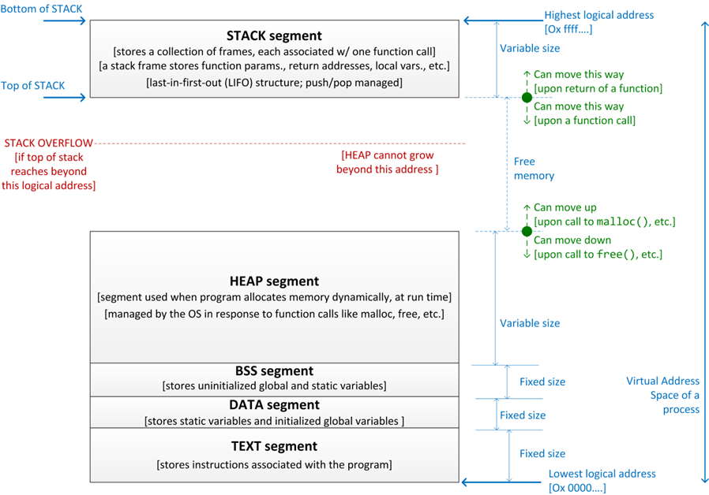

The Virtual Memory: its anatomy
$2^{32}$ addresses (32 bit OS)
Notes:
Ignore for the moment the messiness of the physical memory and concentrate on how the “pristine” layout of the virtual memory is seen by a process.
Each process partitions its virtual memory layout in several segments as shown here.
Nice discussion why BSS & DATA segments are needed is here: https://stackoverflow.com/questions/16557677/difference-between-data-section-and-the-bss-section-in-c

Slide 75
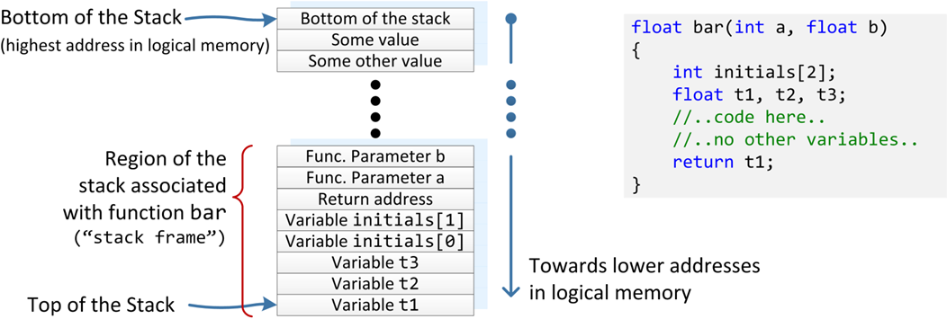
Anatomy of the Stack
Function bar and associated stack frame
Notes:
Reasons for the stack: you don’t know how many times a function is called. The function needs to place its data somewhere. It’s like a hidden malloc followed by a copying of the arguments (a and b, above) in this memory, which will also be hit by t1, t2, etc.
The stack is a segment of fixed size that is managed in a LIFO manner (push and pop).
Order of variables in stack is decided by compiler. Typically arrays are stored contiguously.
Note: stack also stores value of return address (from subroutine). This is a back-door that can be used by malicious programs to hijack execution: bar() above could try to write to initials[1000] in the hope to overwrite a return address for a function higher up in the call stack.

Slide 76
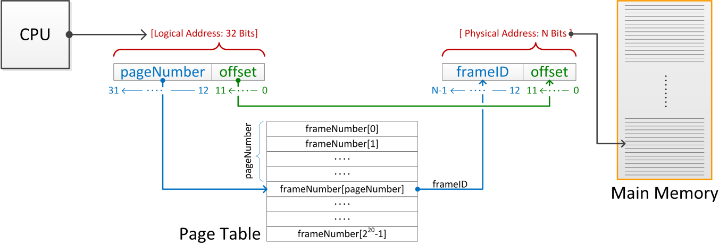
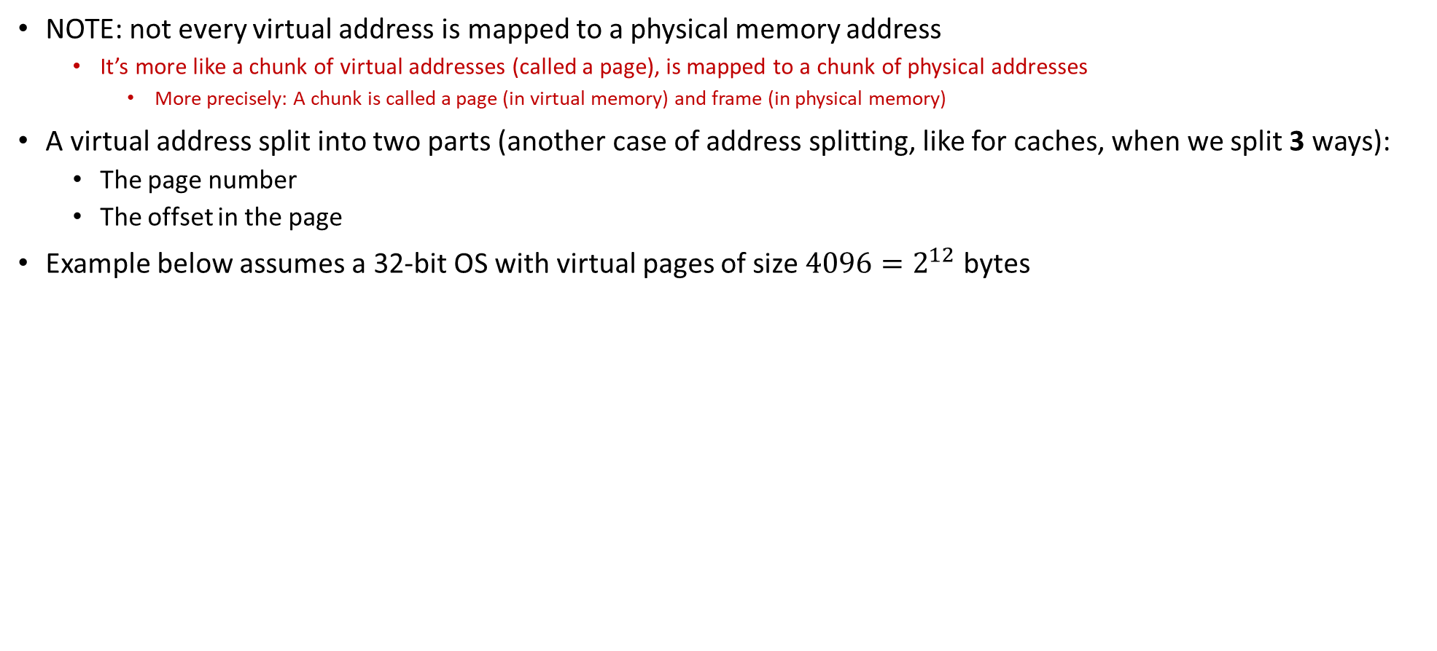
Page Table [stored in main memory]: the mechanics of address translation
NOTE: not every virtual address is mapped to a physical memory address
It’s more like a chunk of virtual addresses (called a page), is mapped to a chunk of physical addresses
More precisely: A chunk is called a page (in virtual memory) and frame (in physical memory)
A virtual address split into two parts (another case of address splitting, like for caches, when we split 3 ways):
The page number
The offset in the page
Example below assumes a 32-bit OS with virtual pages of size $4096=2^{12}$ bytes
[physical memory]
Notes:
The virtual memory is split into pages.
The physical memory is split into frames.
This is for a 32-bit OS with virtual pages of 4096 bytes.
4096 = 2^12 → need 12 bits to indicate the offset in the page.
(Note: unit of address resolution is 8 bits → a virtual page holds 4 KB)
The remaining 32-12 = 20 bits used to index into the Page Table to get the corresponding frame number (which is held in N bits)

Slide 77
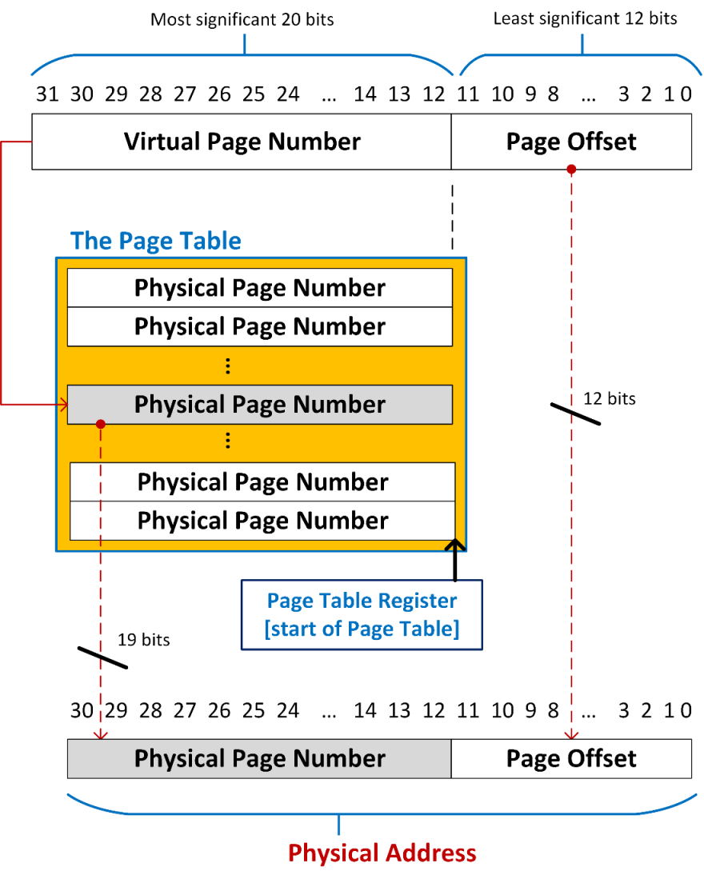
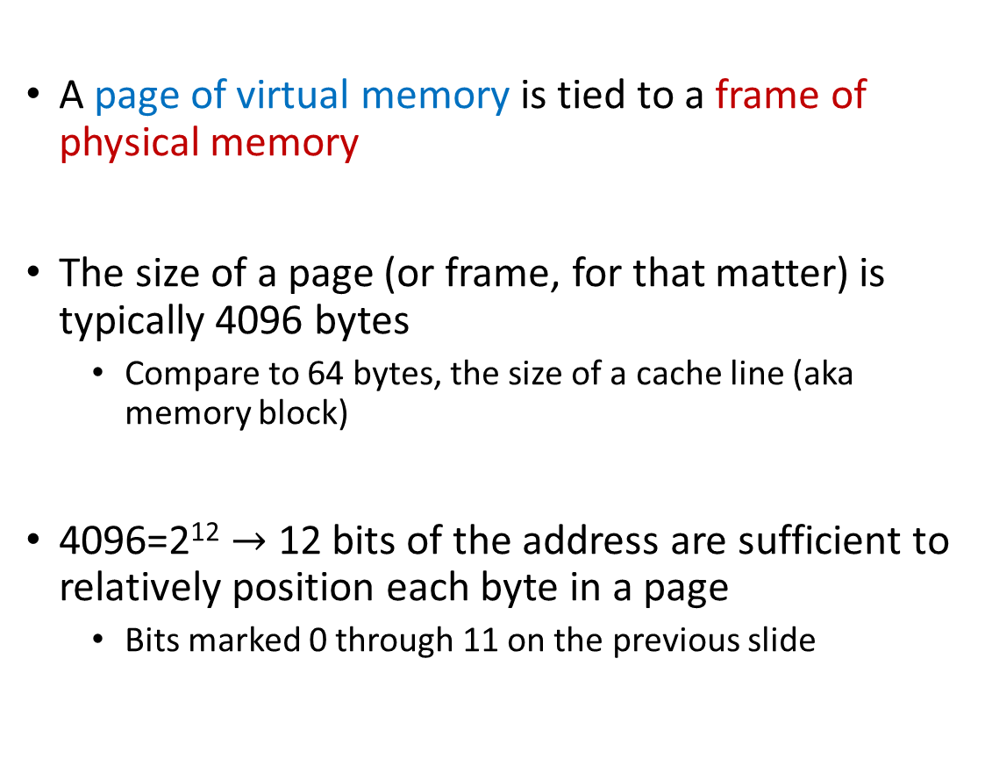
Anatomy of a Virtual Memory Address
A page of virtual memory is tied to a frame of physical memory
The size of a page (or frame, for that matter) is typically 4096 bytes
Compare to 64 bytes, the size of a cache line (aka memory block)
4096=2¹² $→$ 12 bits of the address are sufficient to relatively position each byte in a page
Bits marked 0 through 11 on the previous slide
Physical Frame ID
Physical Frame ID
Physical Frame ID
Physical Frame ID
Physical Frame ID
Physical Frame ID

Slide 78
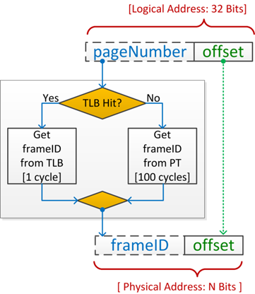
The TLB [Translation Lookaside Buffer]
If you go to Page Table in main memory for each address translation this would be very costly
One trip to translate address, one trip to actually fetch the data
There is a “cache” for the address translation process: TLB
Translation Lookaside Buffer: holds the translation of a small collection of virtual page numbers into frame IDs
The Good: TLB hit == quicker address translation
The Bad: TLB miss -> go to main memory -- required to read the PT entry
The Ugly: TLB miss again at main memory
-> go to secondary memory -- page fault
== significant latency & memory thrashing
== repeatedly hitting page faults that time wasted in
handling page faults dominates all the rest
Notes:
On page fault, the OS does the following:
data requested is located in secondary storage
request made for an entire (“surrounding”) frame to be brought over in main memory
room is made for the new frame as a virtual page (this may require evicting an existing one; e.g. using a LRU strategy)
the new frame is loaded in the virtual page
the PT is updated to reflect the change
control returns to process which is instructed to retry the instruction that led to a page fault

Slide 79
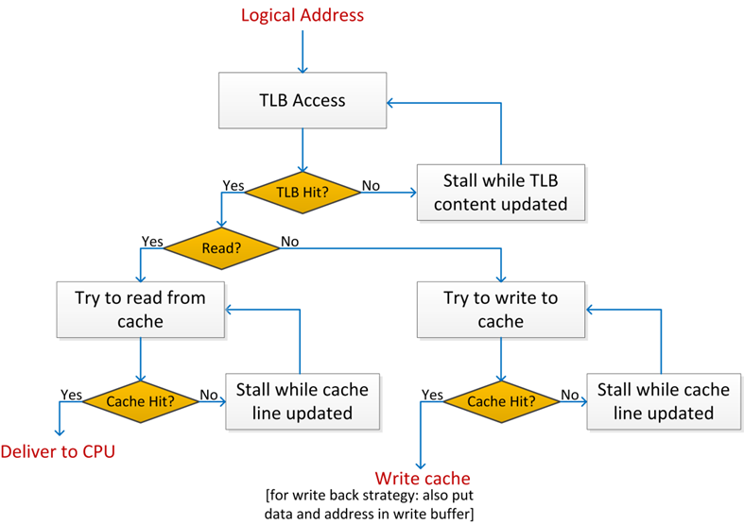
Memory Access: The Big Picture, Includes Cache
A simplified version of how a memory request is serviced:
Notes:
Note that the virtual memory mechanism allows looking at main memory as a “cache” for secondary storage.
Memory block → memory frame
Cache line (64 bytes) → virtual memory page (4096 bytes)
Cache miss → page fault
Note: page fault much more costly (secondary storage is even “farther” from RAM than RAM is to CPU)

Slide 80
malloc vs. calloc: some ways in which they’re different
malloc:
Allocates space in virtual memory
Sets aside no space in physical memory
Physical memory set aside only when needed
(Delayed physical allocation, done upon “touch”)
The Page Table not populated yet with values that are valid yet
calloc:
Allocates space in virtual memory
Sets aside also physical memory
Physical memory initialized to a bunch of zeros
calloc takes longer than similar malloc call: physical mem actually provisioned and also set to zero
int * alloc_ints(size_t requested_count)
{
int * big_array;
big_array = (int *)calloc(requested_count, sizeof(int));
if (big_array == NULL) {
printf(“can’t allocate %d ints : %m\n”, requested_count);
return NULL;
}
/* big_array[0] through big_array[requested_count-1] are
* valid and zeroed. */
return big_array;
}

Slide 81
The Clean/Dirty Bit & the concept of Page Fault
Bit is “clean”: two conditions need to happen for the bit to be clean
The frame that the page gets translated into has been loaded in main memory
Since last translation, that very frame has not been associated with other virtual page
Bit is “dirty”:
We called this “page fault”, costly scenario to handle
The OS will look for the needed frame on disk (secondary memory)
The way you can think about it: the RAM (main mem) is the cache of the hard-disk (secondary mem)
If bit in Page Table is dirty, the translation refers to address in secondary memory, not in main memory
NOTE: A lot of such bits will be dirty when you start the execution of a program
Your data & instructions are not in memory

Slide 82
[New Short Topic] The size of the frame/page
Refresher: a memory page, or virtual page, is a fixed-length contiguous block of virtual memory, described by a single entry in the Page Table
The frame is the fysical (or physical) counterpart of a virtual page
Typically, size of page is 4 KB but can be of 1024 KB for certain applications
Example: working with very large data sets (big data)
Large page size,
Pros: less TLB pressure -- fewer pages to blanket the virtual memory means fewer entries in the Page Table, which means
Fewer values that compete for storage in the TLB cache. More TLB hits: faster program
[not that big of a deal] The size of the Page Table is smaller – less memory needed to store it
Cons: might lead to wasteful use of physical memory
Bad for the other processes running next to yours in time-sharing (multi-tasking)
The OS might start recording lots of page faults

Slide 83
Parallel computing: why, and why now?

Slide 84
Main causes for sequential computing speed stalling
Memory Wall
The growing disparity of speed between CPU and memory outside the chip
Due to latency and limited communication bandwidth beyond chip boundaries
The trend: ever growing caches to improve average memory reference time to fetch or write instructions or data
Memory-wise, you may or may not be at top speed for your memory
Effective bandwidth==Nominal bandwidth: you move lots of data - ok, fact of life, some applications are just like that
Effective bandwidth < Nominal bandwidth: you bring a block of data, use little of it, and ask for data from a different block
Instruction Level Parallelism (ILP) Wall
ILP elicits very complex microarchitecture
Power Wall
Power dissipation related to the clock frequency and feature length
Consequence (the wall): clock rates are limited to some threshold value
Significant increase in clock speed without heroic/expensive cooling not possible -- Chips would simply melt
Power, and not manufacturing, limits traditional general purpose microarchitecture improvements
Not necessarily walls, but increasingly steep hills to climb
Notes:
Predicted in 2000:

Slide 85
Memory Latencies [typical server and mobile computers]
Server
CPU
Registers
Mobile
Courtesy of Elsevier, Computer Architecture, Hennessey and Patterson, fifth edition
Notes:
Hammad: in the fifth edition of the book embedded/mobile have their own diagram

Slide 86
Memory Latency vs. Memory Bandwidth [1/2]
Latency [in our context]: how much time it takes a packet of data to get from one designated point to another
Measured in seconds, also called “lag”
The utility “ping” in Linux measures the latency of a network
For memory transactions: send 32 bits to destination and back, measure how much time it takes gives you latency
Bandwidth: how much data can be transferred per second
You can talk about bandwidth for memory but also for a network (Ethernet, Infiniband, modem, DSL, etc.)
Improving Latency and Bandwidth
Mostly the job of folks in Electrical Engineering
Once in a while, Materials Science colleagues deliver a breakthrough
Promising technology: optic networks; layered memory on top of chip; etc.

Slide 87
Memory Latency vs. Memory Bandwidth [2/2]
Memory Access Latency more challenging to improve as opposed to improving Memory Bandwidth
Improving Bandwidth: doable, add more “pipes”
Requires more pins that come out of the chip for DRAM, for instance
Adding more pins is not simple – very crowded real estate plus the technology is tricky
Improving Latency: no quick way to improve things here
Analogy:
If you carry commuters with a train, add more cars to a train to increase bandwidth
Improving latency requires the construction of high speed trains (expensive/complex)
IMPORTANT NOTE: Improving bandwidth is challenging, but doable; improving latency is very tough

Slide 88
The ILP Wall
Dedicated hardware speculatively executes future instructions before the results of current instructions are known, while providing hardware safeguards to prevent the errors that might be caused by out of order execution
Branches must be “guessed” to decide what instructions to execute simultaneously
If you guessed wrong, you throw away that part of the result
Data dependencies may prevent successive instructions from executing in parallel, even if there are no branches
Predicting the future comes at the cost of microarchitecture complexity and power cost

Slide 89
Parallel computing: The Ox vs. Chickens Analogy
“If you were plowing a field, which would you rather use: Two strong oxen or 1024 chickens?” [Seymour Cray$→$]
Ox: one powerful CPU core, running at high frequency, large cache to hide memory latency
Chicken: many meagre processors, running at lower frequency, not much cache or CU brain
Requires other ways to hide memory latency
Few were eating chicken two decades ago. Very popular now

Slide 90
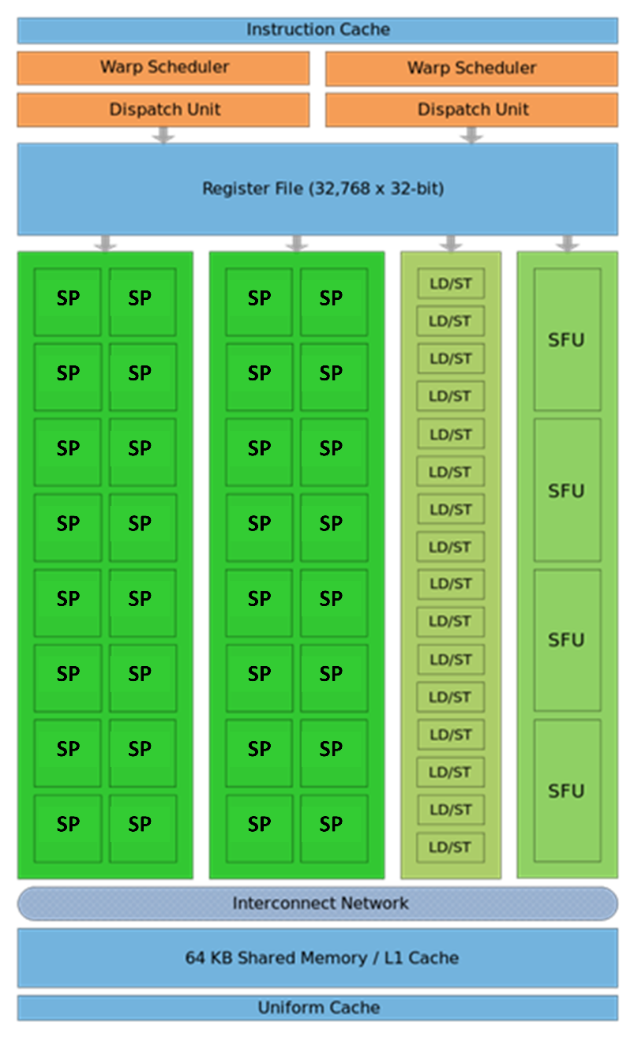
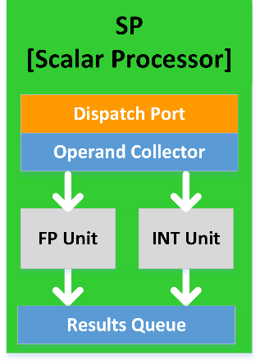
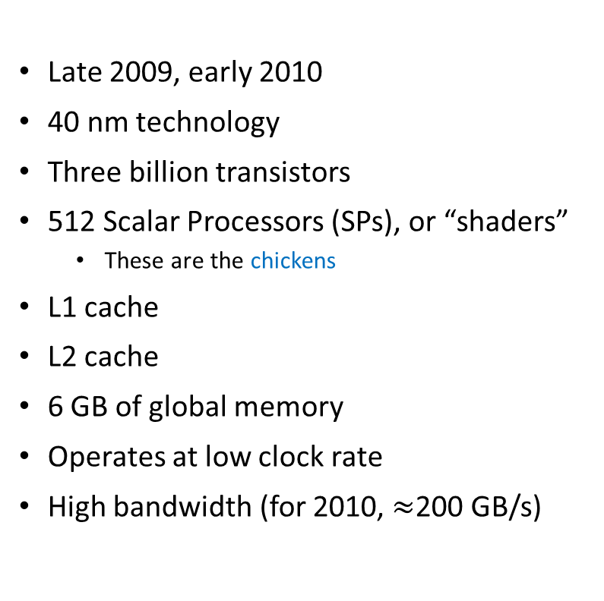
The Fermi Architecture [ Schematic of a NVIDIA Stream Multiprocessor (SM)]
Late 2009, early 2010
40 nm technology
Three billion transistors
512 Scalar Processors (SPs), or “shaders”
These are the chickens
L1 cache
L2 cache
6 GB of global memory
Operates at low clock rate
High bandwidth (for 2010, $≈$200 GB/s)

Slide 91
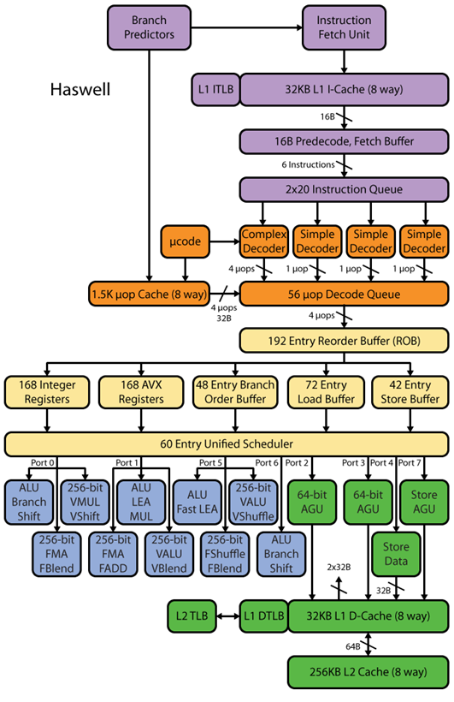
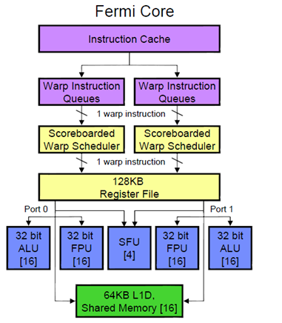
A Fermi SM (Streaming Multiprocessor (SM); one of 16)
Fermi Stream Multiprocessor
Not a whole lot of brain here, compared to CPU.
Specifically, no orange boxes, which have to do with ILP.
[NOTE: color code is the same for SM & CPU]

Slide 92
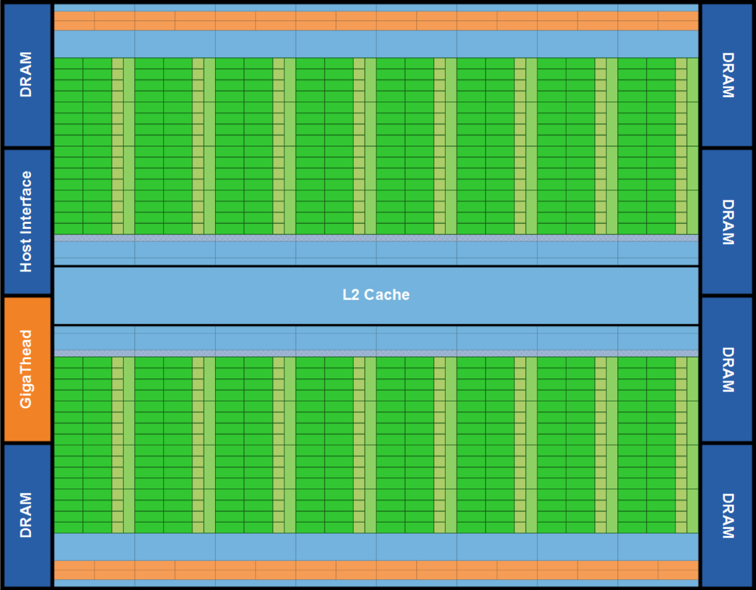
Fermi: 30,000 feet perspective, the entire chip
Lots of ALU (green), not much of CU (orange)
Explains why GPUs are fast for high arithmetic intensity applications
Arithmetic intensity: high when many operations performed per byte of data

Slide 93
The CPU and GPU: showing their true colors
The GPU is specialized for compute-intensive, highly data parallel computation (owing to its graphics rendering origin)
More transistors devoted to data processing rather than data caching and control flow
Where are GPUs good: high arithmetic intensity (the ratio between arithmetic operations and memory operations)
The video game industry exerts strong economic pressure that pushes things forward in GPU computing
Control
ALU
ALU
ALU
ALU
CPU
GPU
Cache
DRAM
DRAM

Slide 94
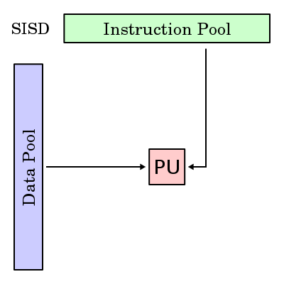
[New Topic] Flynn’s Taxonomy of Architectures [Moving away from hardware; moving into software aspects]
Classification based on how instructions are executed in relation to data
PU = Processing Unit
SISD - Single Instruction/Single Data
SIMD - Single Instruction/Multiple Data
GPUs
MISD - Multiple Instruction/Single Data
MIMD - Multiple Instruction/Multiple Data
Almost all our desktop/laptop chips
Each PU is free to do as it pleases
Either shared memory or distributed memory

Slide 95
Algorithmic vs. Intrinsic Scaling
Algorithmic Scaling of a solution algorithm
Strictly about a mathematical solution algorithm
Expresses how the algorithm scales with the problem size
Examples:
Naïve implementation of the N-body problem scales like O(N²), where N is the number of bodies
Sophisticated algorithms scale like O(N logN)
Gauss elimination for matrix factorization scales like the cube of the number of unknowns in your linear system
Implementation Scaling of a solution on a certain architecture
Intrinsic Scaling: how the execution time changes with an increase in the size of the problem
Strong Scaling: how the execution time changes when you increase the processing resources
Weak Scaling: how the execution time changes when you increase the problem size but also the processing resources in a way that basically keeps the ratio of “problem size/processor” constant

Slide 96
Scaling, Closing Remarks
Important: Is the Intrinsic Scaling similar to the Algorithmic Scaling?
If Intrinsic Scaling significantly worse than Algorithmic Scaling then probably memory transactions are dominating the implementation
If the problem doesn’t scale, it can be an interplay of several factors
The intrinsic nature of the problem at hand
The attributes (organization) of the underlying hardware
The algorithm used to solve the problem; i.e., the parallelism it exposes

Slide 97
GPU Computing with CUDA

Slide 98
Bandwidth in a CPU-GPU System [high speed requires high bandwidth]
Latency:
Very Low
GPU SMs
CPU Core
Cache L1: 32 KB
L2: 256 KB
L3: 45 MB (shared)
NOTE: The width of the black lines is proportional to the bandwidth.
120
GB/s
1555
GB/s
Latency:
Medium Low
Latency:
Rel.Low
System Memory
(256 GB)
GPU Memory
(40 GB)
Infiniband to Next Node
16-32 GB/s
6GB/s
Latency:
High
[4-6 us]
Latency:
Medium
98
Notes:
98
Hammad – GPU numbers are for a Pascal P100, PCI numbers are for PCIe3
Infiniband is assuming mellanox results from here: http://www.mellanox.com/page/performance_infiniband
CPU memory numbers are for a E7 8890v3 http://ark.intel.com/products/84685/Intel-Xeon-Processor-E7-8890-v3-45M-Cache-2_50-GHz
CPU cache numbers are an average between expected L1 and L3 cache performance (not exact but approximate)

Slide 99
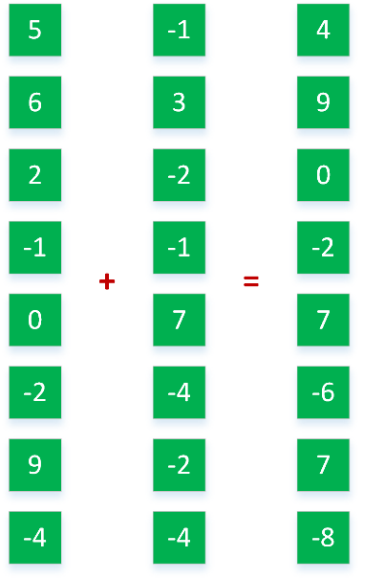
Coarse Grain vs. Fine Grain Parallelism
#pragma omp parallel sections
{
#pragma omp section
a = alice();
#pragma omp section
b = bob();
#pragma omp section
k = kate();
}
double s = boss(a, b);
double result = bigboss(s,k);
Fine Grain
Coarse Grain
alice
bob
[IOMPP]→
Control
ALU
ALU
boss
kate
GPU
ALU
ALU
CPU
Cache
bigboss
DRAM
DRAM

Slide 100
Coarse Grain vs. Fine Grain Parallelism
Coarse grain parallelism (good for CPUs)
Few tasks
Tasks are heterogeneous
Tasks are in general complex, lots of control flow
Example: baking a cake, making coffee, broiling fish – all at the same time
Fine grain parallelism (very good for GPU, ok for CPU)
Many, many tasks
Tasks are basically identical
Tasks are in general pretty straightforward, lots of math, not much control flow
Example application: computer graphics – lots of pixels to deal with
“shaders” – deal with one pixel at a time

Slide 101
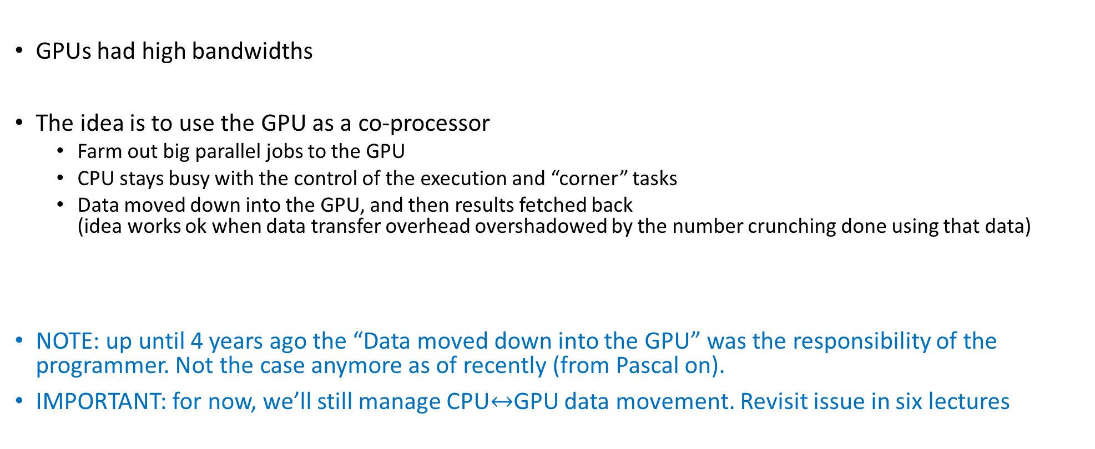
GPGPU Computing [General Purpose GPU Computing]: how carried out
GPUs had high bandwidths
The idea is to use the GPU as a co-processor
Farm out big parallel jobs to the GPU
CPU stays busy with the control of the execution and “corner” tasks
Data moved down into the GPU, and then results fetched back (idea works ok when data transfer overhead overshadowed by the number crunching done using that data)
NOTE: up until 4 years ago the “Data moved down into the GPU” was the responsibility of the programmer. Not the case anymore as of recently (from Pascal on).
IMPORTANT: for now, we’ll still manage CPU$↔$GPU data movement. Revisit issue in six lectures
Notes:
People realized quickly that GPUs can be used for more, beyond graphics.
GPGPU – first utilization of GPUs for General Purpose.
The idea was to “hijack” shader programs to make them do other useful computations
very awkward and difficult
limited (e.g. communication limited between pixels: only gather, but no scatter – could only write to 1 pixel, no support for integer arithmetic)

Slide 102
CUDA Programming Model: GPU as a Highly Multithreaded Coprocessor
CUDA: “Compute Unified Device Architecture”
The GPU is viewed as a compute device that:
Is a co-processor to the CPU or host
Has its own memory (device memory, in CUDA parlance)
Runs many threads in parallel
Data-parallel portions of an app. run on the device as kernels executed in parallel by many threads
Differences between GPU and CPU threads
GPU threads are extremely lightweight
Very little creation overhead
GPU needs 1000s of threads for full efficiency
Multi-core CPU needs only a few heavy ones
The basic rule: the CUDA Driver API is backward, but not forward compatible
The functionality in later versions increased, was not there in previous versions
Notes:
The model is:
host copies data to device
host launches a computation (kernel) on the device
host copies back data from device

Slide 103
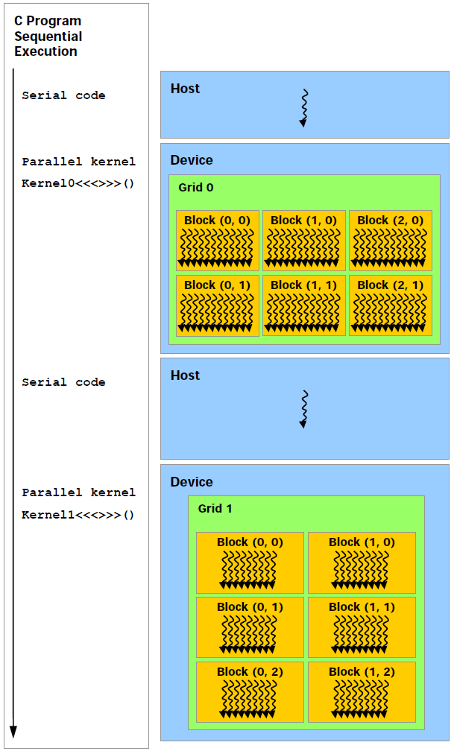
The CUDA Execution Model
Execution of Kernel0
Execution of Kernel1
This is how your C code looks like
This is how the code gets executed on the hardware in heterogeneous computing. GPU calls are asynchronous…
Notes:
NOTE: Execution on the GPU is ORDERED!
You can COUNT on this + global memory PERSISTENT → split work in multiple kernels.
Asynchronous: Important because you can do useful work on the CPU while the GPU works
Beware of this when timing kernel execution – see later
If you really need to make the CPU wait for the GPU, use cudaDeviceSynchronize(), which enforces the CPU to wait until all preceding commands in all streams of all host threads have completed.
Copying data from device back to host is a synchronization point in that stream: cudaMemcpy is synchronous.
There are asynchronous versions of cudaMemcpy

Slide 104
The CUDA Execution Model
Data needs to be copied into GPU device memory and the results need to be fetched back
This happens over a PCI-Express 3.0/4.0 connection
Can also happen over NVLink (5-12 times faster than PCI-E)
NVLink: Available on one Euler node only
IMPORTANT:
For GPU computing to pay off, the data transfer overhead should be overshadowed by the GPU number crunching that draws on that data
The CUDA kernel calls and copying to/from GPU are managed by the CUDA runtime in a separate stream associated w/ the GPU execution
Notes:
The GPU has actually 3 engines which can be used simultaneously.
We will not get into this more advanced topic (streams)
GPU cards support multiple streams so that you can execute in a stream and copy data in another stream. The streams are independent, so you must explicitly synchronize. Working with a single stream (0), synchronization at copying time is automatic.

Slide 105
The concept of “CUDA host stream”
“CUDA host stream”: it has nothing to do with the SM (Stream Multiprocessor), which is a hardware thing
The CUDA runtime places all calls that invoke the GPU in a stream (i.e., ordered collection) of calls
This stream is a FIFO (first-in-first-out) stream
In example of two slides ago, Kernel1 will only be called once Kernel0 finished execution
Important: there is an a-synchronicity between host and device
Host: minds its business, continuing execution right away after launching a kernel
Device: minds its business, taking on the next task in the sequence of tasks in the stream
Notes:
The GPU has actually 3 engines which can be used simultaneously.
We will not get into this more advanced topic (streams)
GPU cards support multiple streams so that you can execute in a stream and copy data in another stream. The streams are independent, so you must explicitly synchronize. Working with a single stream (0), synchronization at copying time is automatic.

Slide 106
Further comments, on the “asynchronous” aspect of GPU computing
Caveat to a-synchronicity
There are implicit synchronization points: A H2D or D2H memory data copy cannot take place (stalls the host) until all other CUDA operations in the stream have completed
You can even force everything to be synchronous during the execution of the code
Simply set CUDA_LAUNCH_BLOCKING environment variable to 1.
If you force kernel calls to be synchronous, you lose the opportunity to do something on the host while the device is busy running your kernel
Notes:
The GPU has actually 3 engines which can be used simultaneously.
We will not get into this more advanced topic (streams)
GPU cards support multiple streams so that you can execute in a stream and copy data in another stream. The streams are independent, so you must explicitly synchronize. Working with a single stream (0), synchronization at copying time is automatic.

Slide 107
More specifics: GPU operations that are asynchronous
The following calls made on the host return the control to host right away
CUDA kernel launches
CUDA memory copies within a single device's memory
On the host, you ask the GPU to copy bytes from the GPU’s device memory to some other GPU mem location
CUDA memory copies from host to device of a memory block of 64 KB or less
CUDA memory copies performed by functions that are suffixed with Async
CUDA “memory set” function calls

Slide 108
The CUDA Execution Model: Three Opportunities for Asynchronous Execution
Three opportunities, listed in increasing order of use/engagement complexity
Opportunity 1: The GPU and CPU work in asynchronous mode
The CPU moves on right away after a kernel launch
The GPU works at the same time the CPU works
Opportunity 2: the GPU has three engines that can work at the same time
copy-in engine + copy-out engine + execution engine
More later (when we talk about streams)
Opportunity 3: Multiple GPUs can work at the same time on one host
Notes:
The GPU has actually 3 engines which can be used simultaneously.
We will not get into this more advanced topic (streams)
GPU cards support multiple streams so that you can execute in a stream and copy data in another stream. The streams are independent, so you must explicitly synchronize. Working with a single stream (0), synchronization at copying time is automatic.

Slide 109
CUDA Function Declarations: (the “C with extensions” part)
 | Executed on the: | Only callable from the:
__device__ float myDeviceFunc() | device | device
__global__ void myKernelFunc() | device | host
__host__ float myHostFunc() | host | host
__global__ defines a kernel function, launched by host, executed on the device
Must return void
NOTE: can combine __device__ with __host__
See CUDA Reference Manual http://docs.nvidia.com/cuda/cuda-c-programming-guide/index.html
Notes:
Can combine: __device__ __host__

Slide 110
GPU Execution Configuration

Slide 111
[New Topic] The concept of Execution Configuration
A kernel function must be called with an execution configuration:
Threads in each block:
The threads can be organized as a 3D structure (x,y,z)
Maximum x- or y-dimension of a block is 1024
Maximum z-dimension of a block is 64
The maximum number of threads in each block is 1024
There is a limitation on the number of blocks in a grid:
The grid of blocks can be organized as a 3D structure: max of 2³¹-1 by 65,535 by 65,535 grid of blocks
__global__ void kernelFoo(...); // declaration
dim3 DimGrid(100, 50); // 2D grid structure, w/ total of 5000 thread blocks
dim3 DimBlock(4, 8, 8); // 3D block structure, with 256 threads per block
kernelFoo<<< DimGrid, DimBlock>>>(...your arg list comes here…);
Notes:
How many threads do you want to use?
Difference with an OpenMP parallel for loop (forward reference)
on CPU you typically use as many threads as (virtual) cores you have
on a GPU you launch many more threads than SPs!
if you have a loop with 1 million iterations, those will be divided into 8 chunks on CPU
on a GPU you launch 1 million threads
You must divide the threads into blocks → these are executed by one SM (quantum of GPU scalability)
Max. number threads / block = 1024

Slide 112
Important slide: a “block of threads” gets mapped to a SM
The concept of block is important since the “block of threads” represents the entity that gets executed by an SM
An SM can in some cases execute more than one block at the same time

Slide 113
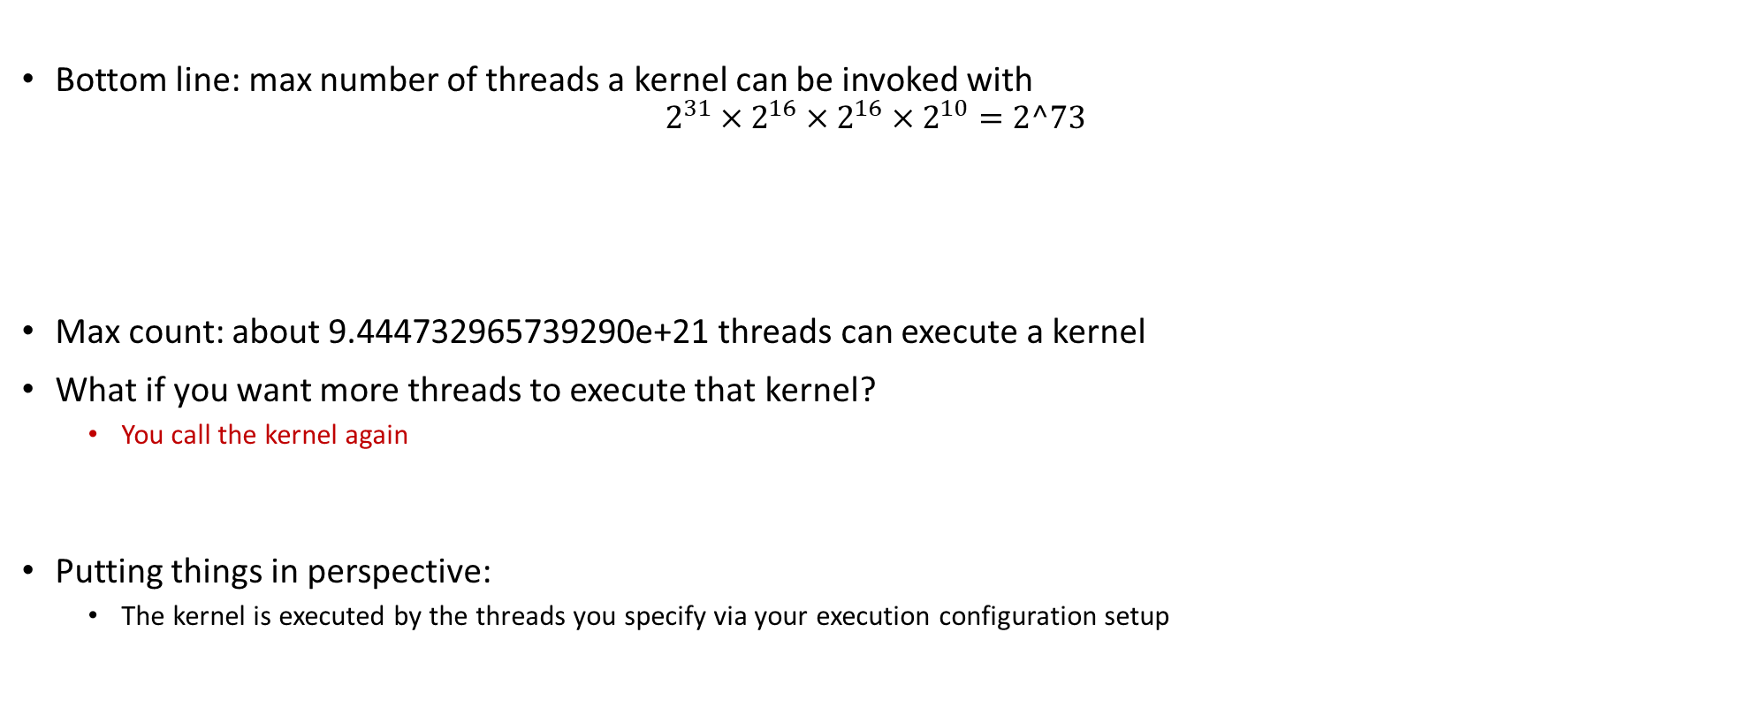
More on the Execution Configuration
Max number of threads in a block
Bottom line: max number of threads a kernel can be invoked with
$$2^{31}×2^{16}×2^{16}×2^{10}=2^73$$
Max count: about 9.444732965739290e+21 threads can execute a kernel
What if you want more threads to execute that kernel?
You call the kernel again
Putting things in perspective:
The kernel is executed by the threads you specify via your execution configuration setup
Max number of blocks in x-direction
Max number of blocks in z-direction
Max number of blocks in y-direction
Notes:
Discuss 1-D, 2-D, 3-D configurations.
As of compute capability 5.x:
Maximum number of resident blocks per multiprocessor: 32
Maximum number of resident warps per multiprocessor: 64
Maximum number of resident threads per multiprocessor: 2048
Question: what do you do when you have more threads than possible? Launch multiple kernels!

Slide 114
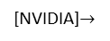
Block and Thread Index (Idx)
Threads and blocks have indices
Used by each thread the decide what data to work on (more later)
Block Index: a triplet of uint
Thread Index: a triplet of uint
Why this 3D layout?
Simplifies memory addressing when processing multidimensional data
Handling matrices
Solving PDEs on 3D subdomains
…
Device
Grid 1
Block
(0, 0)
Block
(1, 0)
Block
(2, 0)
Block
(0, 1)
Block
(1, 1)
Block
(2, 1)
Block (1, 1)
Thread
(0, 0)
Thread
(1, 0)
Thread
(2, 0)
Thread
(3, 0)
Thread
(4, 0)
Thread
(0, 1)
Thread
(1, 1)
Thread
(2, 1)
Thread
(3, 1)
Thread
(4, 1)
[NVIDIA]$→$
Thread
(0, 2)
Thread
(1, 2)
Thread
(2, 2)
Thread
(3, 2)
Thread
(4, 2)
Notes:
A block is a collection of threads that can cooperate with each other by:
Synchronizing their execution
Efficiently sharing data through a low-latency shared memory
Each thread must know what piece of data it’s working on → must be able to “differentiate” itself from other threads in the same block or in a different block
Exercise:
How was the grid defined here (how many dimensions, how many blocks in each direction)?
How was a block defined?

Slide 115
A couple (not all) of the built-in CUDA variables [Critical in supporting the SIMD parallel computing paradigm]
Each thread can find out the grid and block dimensions and its block index and thread index
This info used to figure out what work the thread needs to do
Each thread when executing a kernel has access to the following read-only built-in variables
threadIdx (uint3) – contains the thread index within a block
blockDim (dim3) – contains the dimension of the block
blockIdx (uint3) – contains the block index within the grid
gridDim (dim3) – contains the dimension of the grid
[ warpSize (uint) – provides warp size, we’ll talk about this later… ]
Notes:
dim3 → unspecified dimensions are initialized to 1 (not zero!)
warpSize → not used directly by CUDA code

Slide 116
Matrix Multiplication Example - Device-side Kernel Function
// Matrix multiplication kernel – thread specification
__global__ void MatrixMulKernel(Matrix M, Matrix N, Matrix P) {
// 2D Thread Index; computing P[ty][tx]…
int tx = threadIdx.x;
int ty = threadIdx.y;
// Pvalue will end up storing the value of P[ty][tx].
// That is, P.elements[ty * P. width + tx] = Pvalue
float Pvalue = 0;
for (int k = 0; k < M.width; ++k) {
float Melement = M.elements[ty * M.width + k];
float Nelement = N.elements[k * N. width + tx];
Pvalue += Melement * Nelement;
}
// Write matrix to device memory; each thread one element
P.elements[ty * P. width + tx] = Pvalue;
}
N
WIDTH
M
P
tx
WIDTH
Note: Pvalue is a local value; stored in a register. Access global memory once at the very end
ty
WIDTH
WIDTH
Notes:
Discuss why we have the local variable Pvalue
if we updated directly into the desired entry of P, we would make trips to global memory at each iteration
Pvalue declared here is local (and stored in a register)
we make a single trip to global memory to deposit the aggregate Pvalue
Note: a similar “trick” used in CPU code. There it has to do with not trashing the cache.

Slide 117
Putting things in perspective
if (whichEntry < size) is needed to prevent out of bounds indexing
GPU computing: in general, one uses as many threads as data items/tasks present
This replaces the purpose in life of the “for” loop
Number of threads & blocks is established at run-time
Thus, in many cases, the rule is Number of threads = Number of data items (or tasks)
You’ll have to come up with a rule to match a thread to data item that this thread needs to process
Understanding what thread does what job: very common source of errors in GPU computing
This issue never fails to deliver (frustration)
:-(
Notes:
RECALL: make sure you do not access outside of bounds.
Always, check the thread ID against the data size.
Mapping threads <-> work is a recurring theme in CUDA programming. Important to do it right! Frustrating arithmetic and logic.

Slide 118
Pad a Matrix for Overshooting
1493 entries in 1D array
You are overshooting here, some threads do no work
Block 0: 512 threads
Block 1: 512 threads
Block 2: 512 threads
1D problem
You are overshooting here
Block 16 by 16
Block 16 by 16
Block 16 by 16
Block 16 by 16
Block 16 by 16
Block 16 by 16
Here’s what can happen in a 2D problem:
Block 16 by 16
Block 16 by 16
Block 16 by 16
Block 16 by 16
Block 16 by 16
Block 16 by 16
You are overshooting here as well

Slide 119
Array Indexing Demo: The multi-block case
[Important to grasp: shows thread-to-task mapping]
When working w/ multiple blocks – you will likely be using more than just threadIdx.x
Consider indexing into an 1D array, one thread accessing one element
Assume you have M=8 threads per block and the array is 32 entries long
threadIdx.x
threadIdx.x
threadIdx.x
threadIdx.x
0
1
2
3
4
5
6
7
0
1
2
3
4
5
6
7
0
1
2
3
4
5
6
7
0
1
2
3
4
5
6
7
blockIdx.x = 0
blockIdx.x = 1
blockIdx.x = 2
blockIdx.x = 3
With M threads per 1D CUDA block, the array index that a thread works on is:
int index = threadIdx.x + blockIdx.x * M;
[NVIDIA]→
Notes:
Made up example, where a block can only have 8 threads, but we want to process an array with 32 entries.
0 <= threadIdx.x <= 7
What thread works on entry 21?
Identical to finding offset in 1-dimensional storage of a 2-dimensional matrix:
int index = x + width * y;

Slide 120
Recurring Theme in CUDA Programming [summarizing previous discussion, started after CUDA Example]
Imagine you are one of many threads; you have your thread index & block index
Two things need to be addressed
You need to figure out the work, or the job, you need to take care of
Just like we did on previous slide, where thread 5 in block 2 realized it needed to work on entry 21
You have to make sure you actually need to do that work
In many problems there are threads that need not do any work
Example: you launch 2 blocks with 512 threads; your array is only 1000 elements long; 24 threads at the end might do nothing
“24 threads at the end might do nothing” – depending on the implementation

Slide 121
Execution Scheduling Issues
Notes:
Understanding execution scheduling is important for performance (effectively using the hardware).
Knowing the underlying hardware is also important on the CPU (e.g. being aware of caching – as we will see in the OpenMP section). However, the compiler and tool development on the GPU is much more recent and more is left to the developer.

Slide 122
High-level Perspective
There are two schedulers at work in GPU computing
A device-level scheduler: assigns one [more] block to an SM that signal that it has “excess capacity”
Once a block is picked up for execution by one SM, the block does not leave that SM before all threads in that block finish executing the kernel
Once a block is finished & retired, only then can another block land for execution on that SM
The Device-Level Scheduler dispatches a block of threads to an SM that indicates that it has excess capacity
This explains why it’s good to have many SMs in your GPU
The more expensive the GPU, the more SMs it has (just like a CPU having more cores)
An SM-level scheduler: schedules the execution of the threads in a block onto the SM functional units
This is the more interesting scheduler
Notes:
We’ll talk more about the SM-level scheduler as it is more interesting and important

Slide 123
Device-Level Scheduler
This is the first levels of scheduling:
For running [desirably] a large number of blocks (thousands) on a relatively small number of SMs
There are perhaps tens of thousands of blocks that will eventually get executed in 108 SMs (on an A100)
Thread Blocks are distributed to the SMs
Potentially more than one block per SM
As a Thread Block completes kernel execution on an SM, resources on that SM are freed
Device level scheduler can launch next block in line
Limits, for resident blocks/SM:
32 blocks on the Pascal SM, Volta SM, and Ampere SM
Another hard limit: no more than 2048 threads can be hosted on an SM (no matter how many blocks the threads are associated with/coming from)
Host
Device
Grid 1
Kernel 1
Block
(0, 0)
Block
(1, 0)
Block
(2, 0)
Block
(0, 1)
Block
(1, 1)
Block
(2, 1)
Grid 2
Kernel 2
Block (1, 1)
Thread
(0, 0)
Thread
(1, 0)
Thread
(2, 0)
Thread
(3, 0)
Thread
(4, 0)
Thread
(0, 1)
Thread
(1, 1)
Thread
(2, 1)
Thread
(3, 1)
Thread
(4, 1)
Thread
(0, 2)
Thread
(1, 2)
Thread
(2, 2)
Thread
(3, 2)
Thread
(4, 2)
Notes:
Device-level schedules blocks for execution.
You cannot rely on order of block execution or assignment of blocks over SMs.
You can have 8 (Fermi) or 16 (Kepler) or 32 (recent) blocks resident on an SM

Slide 124
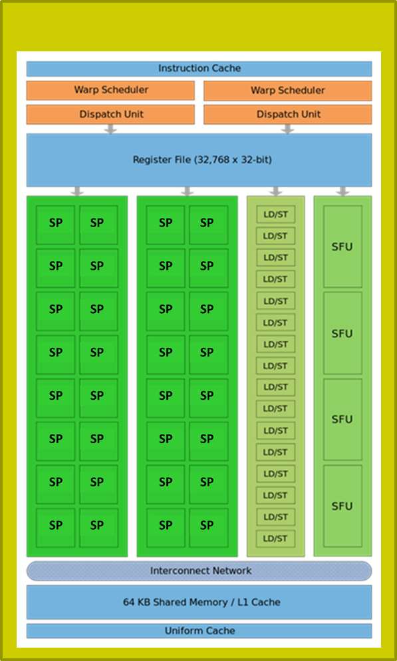
SM-Level Schedulers
…
…
Warps of Block 1
Warps of Block 2
…
…
t0 t1 t2 … t31
t0 t1 t2 … t31
Each block of threads divided in 32-thread warps
“32”: selected by NVIDIA, programmer has no say
Warp: A group of 32 threads of consecutive IDs
Warps are the basic scheduling unit on the SM
Limit, number of resident warps on an SM: 64
64: on Kepler, Maxwell, Pascal, Volta, Ampere (i.e., 2048 resident threads)
48: on Fermi (i.e., 1536 resident threads)
32: on Tesla (i.e., 1024 resident threads)
SP
SP
SP
124
Notes:
Assume 2 blocks with 256 threads each.
So you have 512 threads that must be executed on a small number of SPs (32 on Fermi, 64 on Pascal).
How do they get a chance to execution?
The SM has 2 warp schedulers. What gets scheduled for execution on an SM are warps. So we must deal with 16 warps from 2 blocks.
Scheduling is done based on scoreboarding: each warp gets a score based on whether or not they have everything needed to execute (e.g. all operands, required SFU). The schedulers work at ½ the frequency of the SPs.

Slide 125
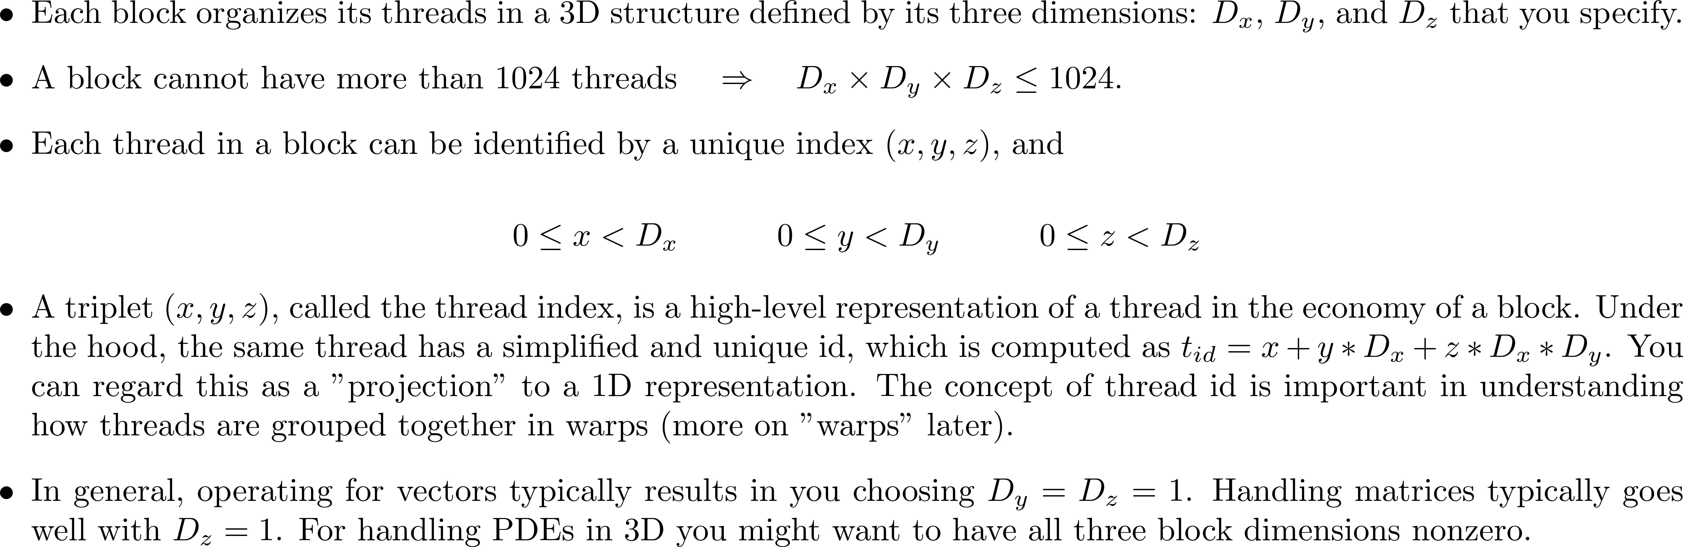
[short/important topic]: Thread Index vs. Thread ID [critical in ($i$) understanding how SIMD is supported in CUDA, and ($ii$) understanding the concept of “warp”]
Notes:
Thread indices are a convenience to the programmer.
The actual threads are organized in a single, linear array of IDs.
This concept also very important in how threads are organized into warps.
Warps are important because the threads in a warp proceed in lock-step fashion (implications to thread divergence, etc.). Warps are the quantum unit of scheduling on an SM.
The index that runs faster is x, next y, slowest z.
For thread with thread index (4,2,3), the next one (for scheduling purposes) is thread with index (5,2,3)! Not (4,2,4)

Slide 126
Organizing Threads into Warps
Thread IDs within a warp are consecutive and increasing
Related to the 1D projection from thread index to thread ID
Recall: in multidimensional blocks, the x thread index runs fastest, then y, then z
Threads with IDs (0...31) combine into warp 0, threads (32…63) into warp 1, etc.
Partitioning of threads into warps is always the same
You can use this in control flow
Warp size has always been 32 and is unlikely to change soon
While you can rely on ordering among threads (each thread has a fixed ID, & the IDs are in sequence), DO NOT rely on any ordering among warps (there is no such thing)
Warp scheduling is not under user control in CUDA
Notes:
In other words, thread with ID 67 will always be in warp 2. You can use that!
(What you probably will use is that thread IDs 66 and 67 are in the same warp)
But you cannot count on, say, warp 1 to be always scheduled before warp 2!

Slide 127
Threads are Organized & Executed as Warps
Each thread block split into one or more warps
If thread block size is not multiple of warp size, unused lanes go wasted
Example: block w/ 50 threads – 64 lanes, of which last 14 lanes go wasted
The hardware schedules each warp independently
Warps within a thread block execute independently
Warp of 32 threads
Block of 128 threads
Warp of 32 threads
Warp of 32 threads
Warp of 32 threads
NVIDIA [J. Balfour]→
Notes:
A block of 128 threads, color-coded in 4 colors (4 warps).
The warps are scheduled as a unit.
It is not required to have the block size a multiple of 32, but it’s a good idea!

Slide 128
The nitty-gritty: hardware resources dictate what a capability can do
[NVIDIA]$→$

Slide 129
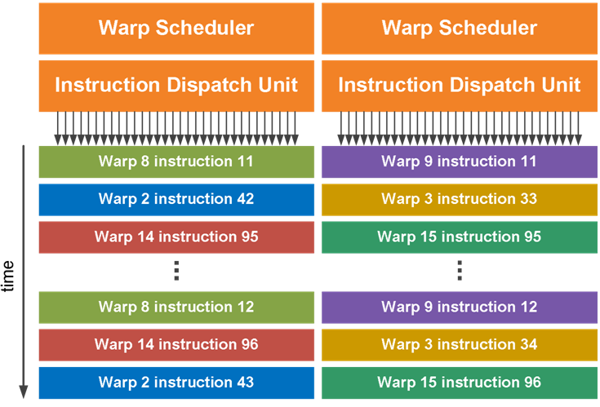
SM Warp Scheduling, more details
SM hardware implements almost zero-overhead warp scheduling
A warp whose next instruction has its operands ready for use is eligible for execution
Eligible warps are selected for execution on a prioritized scheduling policy
All threads in a warp execute same* instruction
The odd warp index are handled by a scheduler,
the even ones are handled by the other scheduler
No trading warps at run time between schedulers
even odd
Notes:
Low overhead for changing context (unlike CPU)
This is because the context for each thread (e.g. registers) is already available (no need to pack/unpack this with the threads as done on the CPU).
Important to have many warps on an SM: better chance to find one that’s ready to be executed.
Note: on old cards (Tesla) there were only 8 SPs and one scheduler: 4 cycles needed for one instruction (for one warp). Fermi has 2 schedulers and 2x16 SPs that work at twice the frequency of the schedulers → 1 instruction / cycle
This information is important because it can tell you how many warps are needed (for a particular code) to hide memory access latencies with useful computations. In this example: 34 warps minimum.
High arithmetic intensity → fewer warps needed to hide latencies.

Slide 130
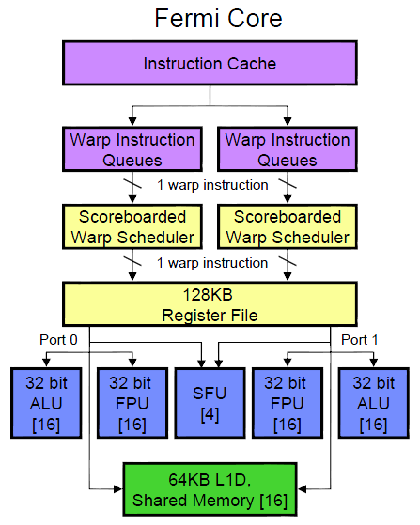
Fermi Specifics
There are two schedulers that can each issue one warp of “ready-to-go” threads
One warp issued at each clock cycle by each scheduler
During no cycle can more than 2 warps be dispatched for execution on the SM’s functional units
Scoreboard is used to figure out which warp is ready
Fermi SM
Notes:
4 function units:
16 ALU/FPU (integer/single precision)
16 ALU/FPU (integer/single precision)
4 SFU (for special mathematical functions)
16 LDST (load/store)
For double precision: both 1 and 2 are used
Scoreboarding looks at:
instructions being fetched/decoded
necessary resources (operands ready? SFU required?)
what instruction modifies what register
Two warps with same score are selected oldest-first

Slide 131
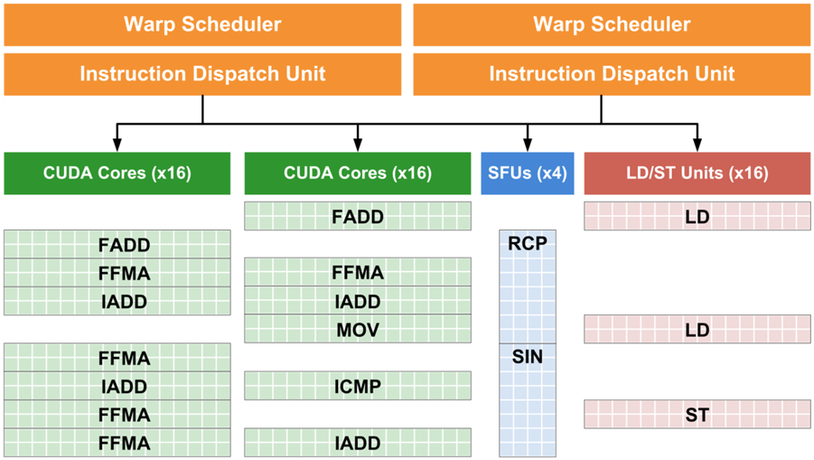
Fermi Specifics
As shown in picture, at no time can we see more than 2 warps being dispatched for execution during a cycle
Note that at any given time we might have more than two functional units working though (which is actually very good, device kept busy)
Threads / Warp = 32 -> each Warp Scheduler can control at most 32 threads – there could be multiple Warp Schedulers
Functional units
Present
T i m e
Past
Notes:
Because there are 2 schedulers: at most 2 instructions are dispatched for execution in a cycle.
But you can have more of them being executed at any given time! Indeed, an SFU for example needs 4 cycles to complete. Other warps that do not require them can be executing on other FUs (ALU, FPU, LDST)

Slide 132
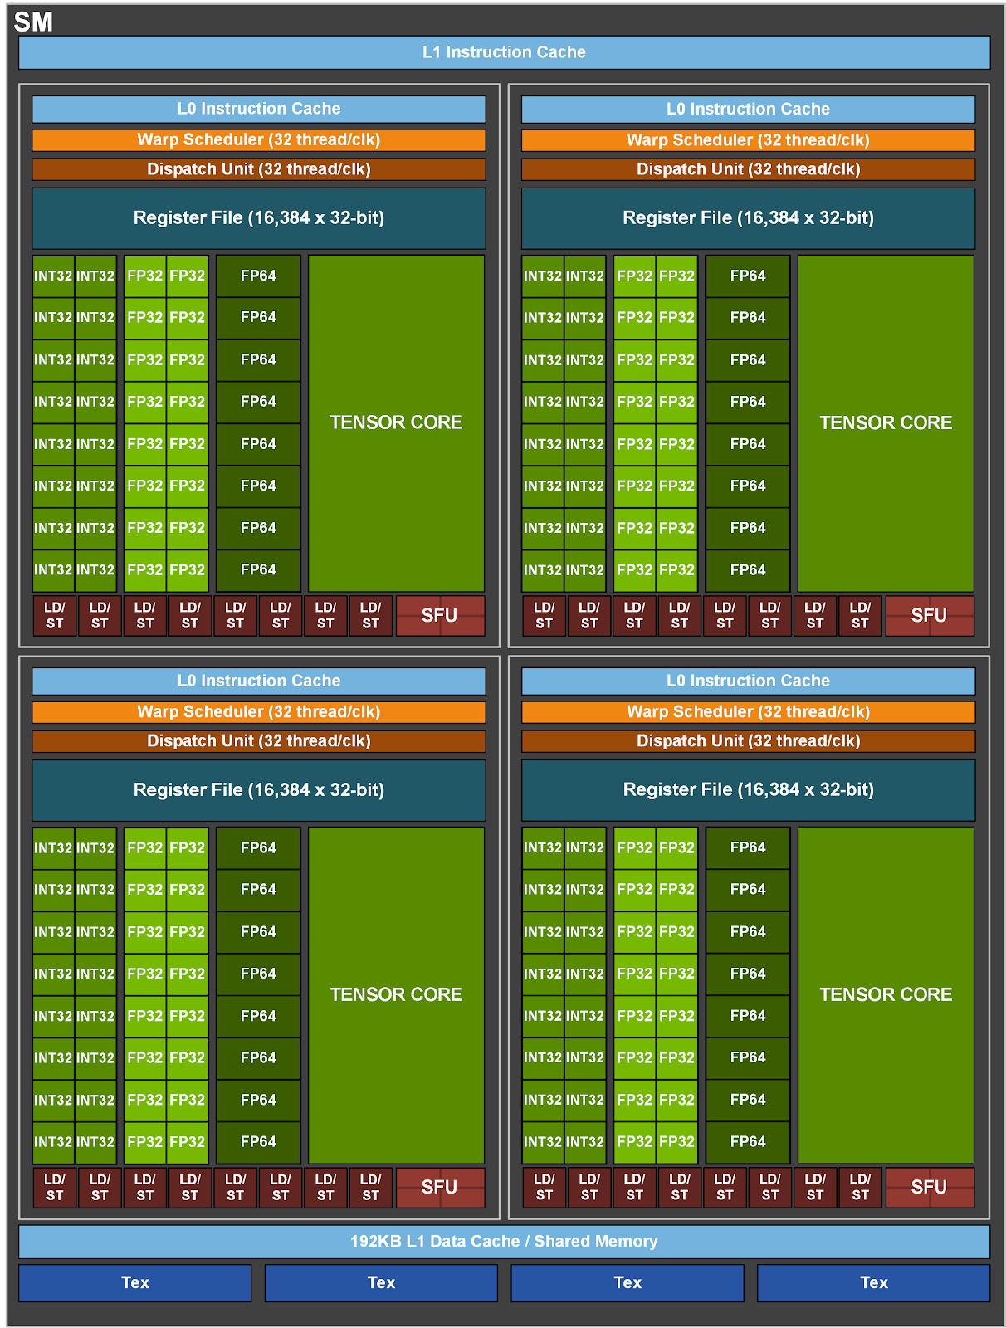
Good to know… When SM has multiple partitions (like Ampere)
A warp always runs on one of the four sub-partitions
It does not change sub-partitions during execution
Each sub-partition holds up to 16 warps
Per SM:
4 partitions $×$ 16 warps
64 warps $⇒$ max 2048 threads
[NVIDIA]$→$

Slide 133
Possible state of a warp (the interplay between warps & warp-scheduler)
First possible state: Active Warps (deployed on an SM)
A possible sub-state: Ineligible Warp (a subset of the Active Warps, waiting on data or functional units)
Another possible sub-state: Eligible Warps (a subset of the Active Warps)
Another possible sub-state: Issued Warps (formerly Eligible, now executing)
Second possible state: Retired Warps (no more instructions left in the kernel for these Warps)
Causes for a warp to be ineligible
An instruction fetch
Next instruction not available (super sad!!!)
A memory dependency
Result of memory instruction, e.g., load
An execution dependency
Result of previous instruction (recall data hazard in pipelining)
A synchronization barrier (more on this later)
E.g., __syncthreads()

Slide 134
Execution Configuration, revisiting the concept
Prefer thread block sizes that result in mostly full warps
Bad: kernel<<<N, 1>>> ( ... )
Okay: kernel<<<(N+31) / 32, 32>>>( ... )
Better: kernel<<<(N+127) / 128, 128>>>( ... )
Max Threads / SM = 2048, Max Threads / Block = 32, so 2048 / 32 = 64 blocks -> 64 > 32 = Max Blocks / SM
Max Threads / Block = 128, so 2048 / 128 = 16 blocks -> 16 < 32 -> all used
Many threads per block provide SM with many warps to switch between
This is how the GPU hides memory access latency
Resource like amount of ShMem & size of RegFile may constrain number of threads per block
NVIDIA [J. Balfour]→
Notes:
Do not launch N blocks each with 1 thread!
OK, but not great, to have 32 threads in 1 block (that’s only 1 warp)
Best: Use 128, 256 threads/block
But maximum number of threads in a block is limited by shared memory (for example – see later). That would limit the number of blocks resident on an SM. This may reduce occupancy.
The moral of the story: algorithms may need to be changed for parallel computing, maybe to something that would be ridiculous to do on a sequential architecture!
We will see this on matrix multiplication with shared memory

Slide 135
Scheduling: Summing It Up…
When host invokes a kernel grid, the blocks of the grid are enumerated and distributed to SMs with available execution capacity
Number of resident blocks on one SM
Up to 8 blocks (on Fermi)
Up to 16 on Kepler & Turing
Up to 32 on Maxwell, Pascal, Volta , Ampere
When a block of threads is executed on an SM, its threads are grouped in warps. The SM manages several warps at the same time
Up to 48 warps can be managed by an SM on Fermi
Up to 32 warps can be managed on Turing
Up to 64 warps can be managed on Kepler, Maxwell, Pascal, Volta, Ampere
When a thread block finishes, a new block is launched on the vacated SM

Slide 136
Thread Divergence
[pre-Volta]
Notes:
New topic related to execution scheduling

Slide 137
Thread Divergence in “if-then-else”
Handling of an if-then-else construct in CUDA
First, a subset of threads of the warp execute one branch
Execution moves forward for these threads in lockstep fashion
Next, the rest of the threads in the warp execute the other branch
Execution moves forward for these threads in lockstep fashion
After the if-then-else statement all threads of the warp move on in lockstep fashion
The system automatically handles control flow divergence, conditions in which threads within a warp execute different paths through a kernel
Often, this requires that the hardware execute multiple paths through a kernel for a warp
For example, both the if clause and the corresponding else clause

Slide 138
Thread divergence issues
__global__ void kv(int* x, int* y)
{
int i = threadIdx.x + blockDim.x * blockIdx.x;
int t;
bool b = f(x[i]);
if( b )
{ // g(x)
t = g(x[i]);
}
else
{ // h(x)
t = h(x[i]));
}
y[i] = t;
}
NVIDIA [J. Balfour]→
Notes:
Some threads in the warp follow the if branch. The rest are idle.
Some threads in the warp follow the else branch. The rest are idle.

Slide 139
Thread divergence issues
Nested branches are handled similarly
Deeper nesting results in more threads being temporarily disabled
In general, one does not need to consider divergence when reasoning about the correctness of a program*
Certain code constructs, such as those involving schemes in which threads within a warp spin-wait on a lock, can cause deadlock
In general, one does need to consider divergence when reasoning about the performance of a program
NVIDIA calls execution model SIMT (Single Instruction Multiple Threads) to differentiate from actual SIMD where threads really are in lockstep
NVIDIA [J. Balfour]→
Notes:
You do not need to understand this to write code that runs correctly. The system handles this.
You need to worry about this for code that is performant.
Thread divergence is why NVIDIA calls their execution model SIMT. Subtle difference from SIMD: SIMT is SIMD for as long as the threads in a warp execute in lockstep mode; slightly different when threads diverge.

Slide 140
Performance of Divergent Code
Performance decreases with degree of divergence in warps
Compiler and hardware can detect when all threads in a warp branch in the same direction
Example: all take the if clause, or all take the else clause
The hardware is optimized to handle these cases without loss of performance
if (threadIdx.x / WARP_SIZE >= 2) { }
Creates two different control paths for threads in a block
Branch granularity is a whole multiple of warp size; all threads in any warp follow the same path. No warp divergence…
The compiler can also compile short conditional clauses to use predicates (bits that conditionally convert instructions into null ops)
Avoids some branch divergence overheads and is more efficient
Often acceptable performance with short conditional clauses
NVIDIA [J. Balfour]→
Notes:
Note:
the presence of an if/else statement in a kernel function is not a problem by itself.
thread divergence concerns only divergence of threads within a warp!
Even for threads diverging inside a warp, in special situations (short sequences), the compiler can modify the code to remove thread divergence: all threads in a warp execute the same instructions, but some of those are replaced by the compiler with no-ops which do not write memory or registers. → acceptable penalty hit

Slide 141
The “schedule optimizer” hardware asset
To maximize parallel efficiency, Volta includes a “schedule optimizer” which determines how to group together into SIMT units the active threads from the same warp
Threads can now diverge and re-converge at sub-warp granularity
While the scheduler supports independent execution of threads, it optimizes non-synchronizing code to maintain as much convergence as possible
“convergence optimizer” still groups together threads that execute the same code to run them in parallel

Slide 142
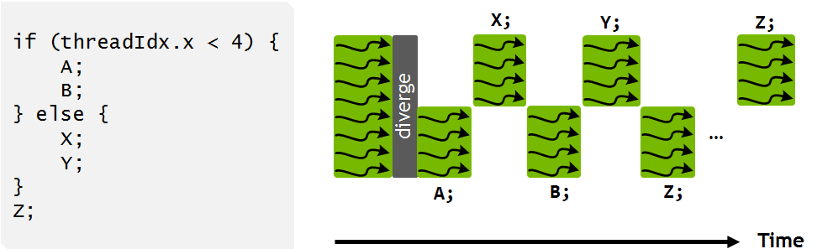
Handling thread divergence, Volta/Turing/Ampere
Instructions from the if and else branches can now be interleaved in time, as shown in the pic.
NOTE: what’s shown in the pic is one possibility. How the scheduling takes place depends on the code being executed and be different than what shown in the pic
IMPORTANT: execution is still SIMT – at any given clock cycle, the same instruction is executed for all active threads in a warp just as before Volta
NOTE: this is why the “schedule optimizer” tries to converge all threads
If all converged, the 32 threads get to execute an instruction. Otherwise, only a subset of threads get to execute an instruction
Why bother with understanding this?
Ability to independently schedule threads within a warp makes it possible to implement complex, fine-grained algorithms and data structures in a more natural way
[NVIDIA]$→$

Slide 143
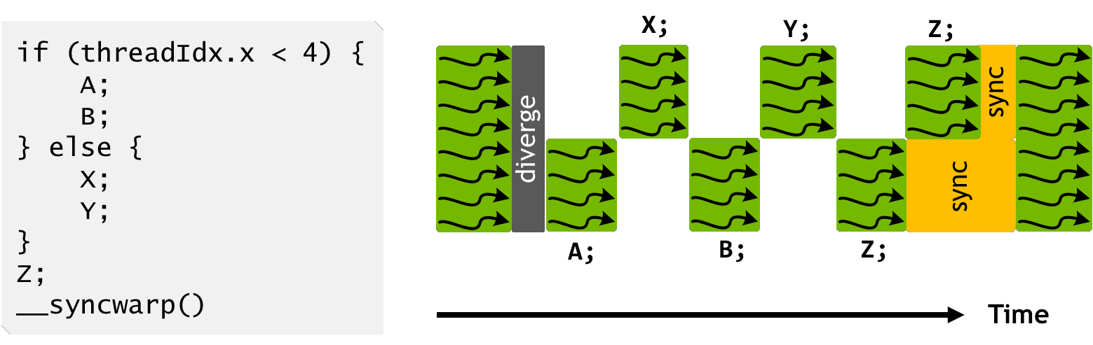
Handling thread divergence, Volta/Turing/Ampere
Note that instruction Z is fairly likely not to be executed by all warp threads at the same time
Call CUDA warp synchronization function syncwarp() to force reconvergence (lower pic)
The divergent portions of the warp might not execute Z together, but all execution pathways from threads within a warp will complete before any thread reaches the statement after the syncwarp()
Placing the call to syncwarp() before the execution of Z would force reconvergence before executing Z, potentially enabling greater SIMT efficiency if the developer knows that this is safe for their application
[NVIDIA]$→$

Slide 144
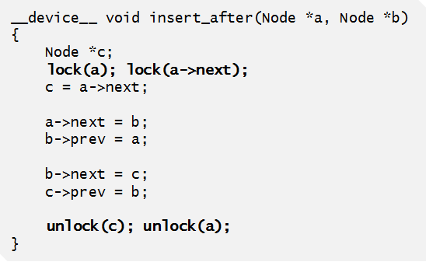
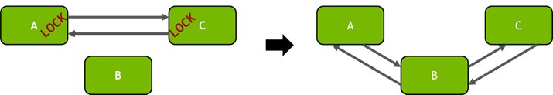
Example: Volta thread scheduling helps algorithm implementation
“Starvation-free algorithm” – a parallel algorithm that works on the presumption that a thread that participates in the implementation of the algorithm cannot be starved
NVIDIA GPUs prior to Volta: didn’t support starvation avoidance
Indeed, one or more threads may repeatedly acquire and release a mutex while starving another thread from ever successfully acquiring the mutex
Example at right shows how Volta independent thread scheduling implements a starvation-free algorithm
Inserting nodes into a doubly linked list in a multithreaded application
Per-node locks are acquired (left) before inserting node B into the list (right).
[NVIDIA]$→$
Notes:
Independent thread scheduling in Volta ensures that even if a thread T0 currently holds the lock for node A, another thread T1 in the same warp can successfully wait for the lock to become available without impeding the progress of thread T0. Note, however, that because active threads in a warp execute together, threads spinning on a lock may degrade the performance of the thread holding the lock.
It is also important to note that the use of a per-node lock in the above example is critical for performance on the GPU. Traditional doubly-linked list implementations may use a coarse- grained lock that provides exclusive access to the entire structure, rather than separately protecting individual nodes. This approach typically leads to poor performance in applications with many threads—Volta may have up to 163,840 concurrent threads—caused by extremely high contention for the lock. By using a fine-grained lock on each node, the average per-node contention in large lists will usually be low except under certain pathological node insertion patterns.

Slide 145
The NVIDIA GPU Memory Ecosystem

Slide 146
CUDA Memory Ecosystem, high vantage point [Note: picture assumes two blocks, each with two threads]
One SM
Another SM
Image shows the memory hierarchy that a block sees while running on an SM
Each thread can:
R/W per-thread registers
R/W per-thread local memory
R/W per-block shared memory
R/W per-grid global memory
Read only per-grid constant memory
Read only per-grid texture memory
Read only per-grid surface memory
(Device) Grid
Block (0, 0)
Block (1, 0)
Shared Memory
Shared Memory
Registers
Registers
Registers
Registers
Thread (0, 0)
Thread (1, 0)
Thread (0, 0)
Thread (1, 0)
Local
Memory
Local
Memory
Local
Memory
Local
Memory
Host
Global
Memory
Host can R/W global, constant, and texture* memory
*: texture can be written only as “surface” mem
Constant
Memory
Texture
Memory
[UIUC]$→$
Notes:
Global, constant, and texture memory spaces are persistent across kernels called by the same application.
“surface” memory is like “texture”, except that the former can be written (“texture” can only be read)

Slide 147
IMPORTANT NOTE:
Global, constant, and texture memory spaces are persistent between kernels called by the same
host application
Note: if you use gdb to debug, don’t expect to be able to read memory off a device pointer
Debugging for GPU computing relies on cuda-gdb

Slide 148
What “register” means in CUDA
Any variable that you are using in a kernel at some point eats up a register
The variable that you use – it needs to “live” somewhere
Then every single variable you use in a kernel will burn (at some point in the execution flow) a register
NOTE: even a variable stored in ShMem, for it to be operated on, it’ll eat up a register* at some point in the execution
*: except on Ampere, where one can actually control this…
As execution advances through a kernel, the number of registers occupied keeps changing
What’s relevant: max number of registers required during the execution of the kernel
The complier controls/decides the register allocation when executing a kernel

Slide 149
Programmer View of Register File
4 blocks
3 blocks
Number of 32 bit registers in one SM is as follows:
8K registers in each SM in G80
16K on Tesla
32K on Fermi
64K on Kepler and Maxwell, Pascal, Volta, and Ampere
Registers are dynamically partitioned across all Blocks assigned to the SM
Registers are always evenly split between blocks
Once assigned to a Block, these registers are NOT accessible by threads in other Blocks
A thread in a Block can only access registers assigned to itself
IMPORTANT: A thread can have assigned by the compiler up to 255 registers
There is no parsimony in usage of a register
Any data type that requires less then or equal to 4 bytes eats up a register
One char thus eats up an entire register
Possible per-block partitioning scenarios of the RF available on the SM

Slide 150
The Concept of Local Memory [“local”: misnomer]
(Device) Grid
Physically, local memory does not exist
In reality, data stored in “local memory” is placed in cache or the global memory at run time or by the compiler
What gets stored in local memory?
Register spill, if too many registers are needed for computation (“high register pressure”)
The stack of the thread
Quick observations:
“Local” means that it’s got local scope; i.e., it’s specific to one thread and not visible to any other thread
Local memory has the same latency as global memory, unless cached
Block (0, 0)
Block (1, 0)
Shared Memory
Shared Memory
Registers
Registers
Registers
Registers
Thread (0, 0)
Thread (1, 0)
Thread (0, 0)
Thread (1, 0)
Local
Memory
Local
Memory
Local
Memory
Local
Memory
Host
Global
Memory
Constant
Memory
Texture
Memory
Notes:
Global, constant, and texture memory spaces are persistent across kernels called by the same application.

Slide 151
Caches & the Shared Memory
Logically, there is a distinction between cache and shared memory
That is, they are handled differently by the runtime
Physically, there is no difference between the two of them
You can turn a “dial” and have more or less cache, that is, have less or more shared memory
Caches: controlled by the runtime
Shared memory: controlled by you (think of it as “fast scratchpad memory”)

Slide 152
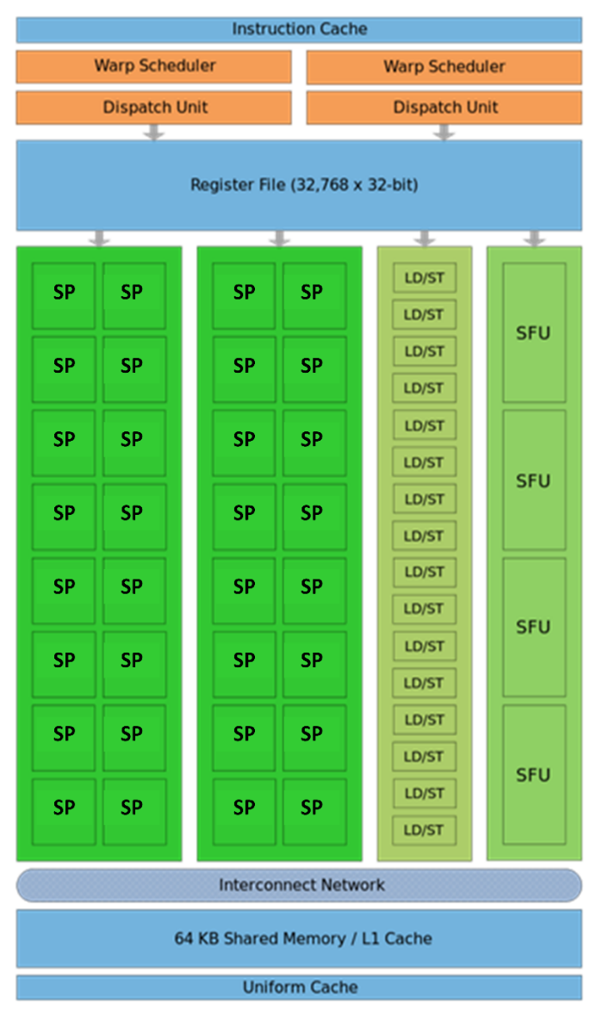
Caches & the Shared Memory
Fermi
Each SM: 64 KB L1 cache & shared memory
All SMs tap into a common 768 KB L2 cache memory
Pascal:
Each SM: Unified 24 KB L1 cache
Each SM: 64 KB shared memory
All SMs tap into 4096 KB of L2 cache memory
Volta:
L1 cache + Shared Mem = 128 KB per SM
One can carve out of 128KB shared memory as follows:
0 KB, 8 KB, 16 KB, 32 KB, 64 KB, or 96 KB
What is not taken by the ShMem becomes L1 cache:
128 KB, 120 KB, 112 KB, 96 KB, 64 KB, 32 KB
All SMs tap into 6144 KB of L2 cache memory, visible to all SMs
IMPORTANT: Numbers reported are per SM
Fermi SM
Notes:
The previous plot is bandwidth for moving data from/to global memory.
Each SM has local L1 cache (shared with shared memory, ratio under user control).
Fermi default: 48 KB shared / 16 KB L1 cache (can also do16/48)
Kepler: 48/16, 32/32, 16/48
Difference: shared memory is controlled by the user. L1 cache use is automatic. If you do not use shared memory, increase the chunk for L1 cache to allow the hardware to leverage it.

Slide 153
Global, Constant, and Texture Memories
Global memory
Main means of communicating R/W Data between host and device
Contents visible to all threads
Texture and Constant Memories
Constants initialized by host
Contents visible to all threads
Global, texture and constant memories are accessible by host
Done at high latency, low bandwidth
(Device) Grid
Block (0, 0)
Block (1, 0)
Shared Memory
Shared Memory
Registers
Registers
Registers
Registers
Thread (0, 0)
Thread (1, 0)
Thread (0, 0)
Thread (1, 0)
Local
Memory
Local
Memory
Local
Memory
Local
Memory
Host
Global
Memory
Constant
Memory
NOTE: We will not emphasize texture in ME759.
Texture
Memory
[NVIDIA]$→$

Slide 154
CUDA Device Memory Allocation/Deallocation
(Device) Grid
Block (0, 0)
Block (1, 0)
cudaMalloc()
Allocates mem in the device Global Memory
Requires two parameters
Address of a pointer to the allocated object
Size of allocated object
cudaFree()
Frees mem from device Global Memory
Requires a pointer to freed object
Shared Memory
Shared Memory
Registers
Registers
Registers
Registers
Thread (0, 0)
Thread (1, 0)
Thread (0, 0)
Thread (1, 0)
Local
Memory
Local
Memory
Local
Memory
Local
Memory
Host
Global
Memory
Constant
Memory
Texture
Memory

Slide 155
CUDA Host-Device Data Transfer
(Device) Grid
cudaMemcpy()
Memory data transfer
Requires four parameters
Pointer to source
Pointer to destination
Number of bytes copied
Type of transfer
Host to Host
Host to Device
Device to Host
Device to Device
Things happen over a PCIe connection
Up to 16 GB/s (PCIe 3.0 x16, in each direction)
Up to 32 GB/s (PCIe 4.0 x16, in each direction)
Block (0, 0)
Block (1, 0)
Shared Memory
Shared Memory
Registers
Registers
Registers
Registers
Thread (0, 0)
Thread (1, 0)
Thread (0, 0)
Thread (1, 0)
Local
Memory
Local
Memory
Local
Memory
Local
Memory
Host
Global
Memory
Constant
Memory
Texture
Memory
Notes:
PCIe 4.0 16X (expected 2017) → almost 32 GB/s
NVLink (available on Pascal) → 5-12 times faster than PCIe 3.0

Slide 156
Memory Access Times
Register – dedicated HW on chip - single cycle NOTE: you don’t have control over this
Cache/Shared Memory – dedicated HW on chip – a few cycles NOTE: physically, like L1 cache
Local Memory – DRAM, (if not in cache - *slow*; if cached – relatively fast)
Global Memory – DRAM, no cache - *slow*; cached, is fast…
Constant Memory – DRAM, cached, 10s…100s of cycles, depending on cache locality
Texture Memory – DRAM, cached, 10s…100s of cycles, depending on cache locality
Instruction Memory (invisible) – DRAM, cached
Memory | Location | Cached | Access | Who
Register | On-chip | N/A | Read/write | One thread only
Shared | On-chip | N/A | Read/write | All threads in a block
Global | Off-chip | Yes | Read/write | All threads + host
Constant | Off-chip | Yes | Read | All threads + host
Texture | Off-chip | Yes | Read | All threads + host
Off-chip means on the GPU but not on the SM, which translates into high latency.
Notes:
Take away message: organize your code to use as much as possible the faster memory:
keep in mind the relative access times (some of these change with new hardware)
be careful how you organize data and what data you bring over (do not duplicate information)
Recall:
GPUs have much larger register files than a CPU
64K registers (each one word, i.e. 32 bits) per SM on Pascal
But you can also have up to 2048 threads resident per SM
So you end up with just 32 registers per thread!
In fact, NVIDIA sets an upper limit of 255 registers/thread

Slide 157
Putting things in perspective: The 3 most important GPU memory spaces
Thread
Register: per-thread basis
Private per thread
Can spill into local memory (potential performance hit unless cached)
Shared Memory: per-block basis
Shared by threads of the same block
Used for: intra-block inter-thread communication
Global Memory: per-application basis
Available for use by all threads
Used for: global access, all threads
Also used for inter-grid communication
Register
Block
Shared
Memory
Grid 0
Global
Memory
. . .
Sequential
Grids
in Time
Grid 1
. . .

Slide 158
A Common CUDA Programming Pattern: Tiling w/ Shared Memory
Global memory access - much slower when compared to shared memory access
No brainer: Use shared memory, if possible
Partition data into data subsets (tiles) that each fits into shared memory
Handle each data subset (tile) with one thread block by:
Loading the tile from global memory into shared memory, using multiple threads to exploit memory-level parallelism
Performing the computation on the tile from shared memory; each thread can efficiently multi-pass over any data element of the tile
Notes:
Recall: global memory: DRAM Shared memory: SRAM (split with L1 - Fermi or dedicated - Pascal)
Focus on data reuse
Introduce the concept of tiling (common programming pattern)

Slide 159
Tiling used for Matrix-Matrix multiplication
One block computes one square sub-matrix C_{sub} of size Block_Size
One thread computes one entry of C_{sub}
Assumption: A and B are square matrices and their dimensions of are multiples of Block_Size
Doesn’t have to be like this, but keeps example simpler and focused on the concepts of interest
In this example work with Block_Size=16x16
NOTE: A similar technique is used on CPUs to improve cache hits. See slide “Blocking Example” at
http://cseweb.ucsd.edu/classes/fa10/cse240a/pdf/08/CSE240A-MBT-L15-Cache.ppt.pdf
Notes:
We will have a first loop over tiles (moving left in A, moving down in B)
Then, inside a tile (i.e. a block), each thread will loop over a row in the A tile and a column in the B tile to calculate a piece of its final value (the red square in C)

Slide 160
// Shared memory for the sub-matrices (tiles) of A and B
__shared__ float As[BLOCK_SIZE][BLOCK_SIZE];
__shared__ float Bs[BLOCK_SIZE][BLOCK_SIZE];
// Loop over all the sub-matrices (tiles) of A and B required to
// compute the block sub-matrix; moving in A left to right in
// a row, and in B from top to bottom in a column
for (int a = aBegin, b = bBegin;
a <= aEnd;
a += aStep, b += bStep) {
// Load tiles from global memory into shared memory; each
// thread loads one element of the two tiles from A & B
As[ty][tx] = A[a + wA * ty + tx];
Bs[ty][tx] = B[b + wB * ty + tx];
// Synchronize to make sure the matrices are loaded
__syncthreads();
// Each thread in this block computes one element
// of the block sub-matrix (tile). Thread with indexes
// ty and tx computes in this tile the entry [ty][tx].
for (int k = 0; k < BLOCK_SIZE; ++k)
Csub += As[ty][k] * Bs[k][tx];
// Synchronize to make sure that the preceding
// computation is done before loading two new
// sub-matrices of A and B in the next iteration
__syncthreads();
}
// Write the block sub-matrix to global memory;
// each thread writes one element
int c = wB * BLOCK_SIZE * by + BLOCK_SIZE * bx;
C[c + wB * ty + tx] = Csub;
}
// Device multiplication function called by Mul()
// Compute C = A * B
// wA is the width of A
// wB is the width of B
__global__ void Muld(float* A, float* B, int wA, int wB, float* C)
{
// Block index
int bx = blockIdx.x; //the B (and C) matrix sub-block column index
int by = blockIdx.y; //the A (and C) matrix sub-block row index
// Thread index
int tx = threadIdx.x; //the column index in the sub-block
int ty = threadIdx.y; //the row index in the sub-block
// Index of the first sub-matrix of A processed by the block
int aBegin = wA * BLOCK_SIZE * by;
// Index of the last sub-matrix of A processed by the block
int aEnd = aBegin + wA - 1;
// Step size used to iterate through the sub-matrices of A
int aStep = BLOCK_SIZE;
// Index of the first sub-matrix of B processed by the block
int bBegin = BLOCK_SIZE * bx;
// Step size used to iterate through the sub-matrices of B
int bStep = BLOCK_SIZE * wB;
// The element of the block sub-matrix that is computed
// by the thread
float Csub = 0;
Notes:
if __shared__ does not appear: each thread sets aside 16x16 memory locations for As and 16x16 for Bs
that’s already double what could ever be in registers → spills to local memory
with __shared__ this memory is specific to the block and shared between all threads in the block!
attention: all threads bring over disjoint pieces of data
Why do we need the __syncthreads here? Only threads in the same warp proceed in lock-step fashion. But threads in different warps do not.
Who gets synchronized? Threads in the same block
Would it make sense to have a Cs in shared memory? No – recall the “test for using shared memory”; no other thread needs this information

Slide 161
Synchronization Function [Rule of Thumb: Try hard to use shared memory]
Synchronization accomplished through a device lightweight function
void __syncthreads();
Synchronizes all threads in a block (acts as barrier for all block threads)
Does not synchronize threads from two blocks
One more condition for execution to commence once all threads in a block reached the sync point:
All global & shared mem. transactions made by these threads prior to __syncthreads() are visible to all block threads
Used to avoid RAW/WAR/WAW hazards when accessing shared or global memory (more later)
Be very cautious when using a __syncthreads() in a conditional
The actual behavior is not clear
Some difference between the Programming Guide and what happens in reality
If you, as a thread, use data that can also be used by another
thread in your block, then you should consider using shared memory
__global__ void badIdeaSynchronization(int* data) {
int i = threadIdx.x + blockDim.x * blockIdx.x;
if ((i & 0x01) == 0) {
data[i] = data[i] + i; // if not odd, come here
}
else {
data[i] = data[i] + 2 * i; // come here if you're odd
__syncthreads();
}
}
Notes:
Attention: do not put a __syncthreads in an if statement unless you can guarantee all threads in the block go through there!

Slide 162
3 Ways to Set Aside Shared Memory
First way: Statically, declared inside a kernel
See matrix multiplication example w/ shared memory use
Second way: Through the execution configuration
Ns below indicates size (in bytes) to be allocated in shared memory (shMemArray)
__global__ void MyFunc(float*) // __device__ or __global__ function
{
extern __shared__ float shMemArray[];
// Size of shMemArray determined through the execution configuration
// You can use shMemArray as you wish here…
}
// invoke like this
MyFunc<<< Dg, Db, Ns >>>(parameter);
Third way: Dynamically, via CUDA Driver API
Advanced feature, uses API function cuFuncSetSharedSize(), not discussed here

Slide 163
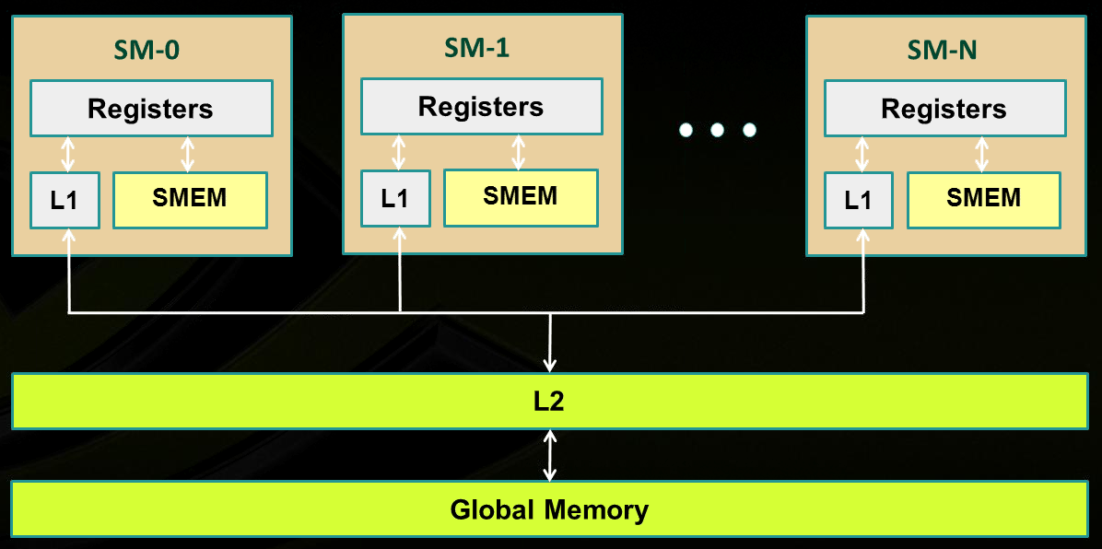
Memory Layout: All GPU units communicate to global memory through L2 cache
L2 cache: one big mem pool available to all SMs (sometimes called “uniform cache”; uniformly available)
Keep in mind: L2 is not on the SM, it is on the GPU
On the CPU core: L1:L2 ratio is 1:8; On the GPU SM: L1:L2 ratio is 1:1.7
SM₀
SM₁
SM_{N-1}
NVIDIA→
Note: shared memory is not cached (visible in pic as well)
Notes:
Illustration of caches intermediating global memory access.
Recall: shared memory is not cached

Slide 164
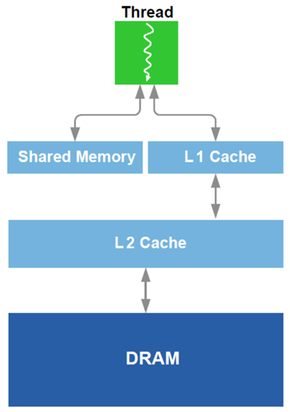
L1 Cache vs. Shared Memory
Starting w/ Fermi architecture, you can adjust how much shared memory and how much cache
A zero-sum game; they share the physical banks
Example, Fermi: you can go 48/16 or 16/48 KB for Shared Mem/Cache
OPTION 1: you choose to go w/ “Lots of Cache & Little Shared Mem”
Cache handled for you by the scheduler
No control over it
Can’t have too many blocks of threads running if blocks use Shared Mem
OPTION 2: you choose to go w/ “Lots of Shared Mem & Little Cache”
Good in tiling, you have full control
Shared Mem pretty cumbersome to manage
Notes:
On Maxwell and Pascal, dedicated shared memory (64) and unified L1 cache (24), per SM
Pre-Pascal, the L1 cache / ShMem split can be done at runtime, or through compiler option
One last note about specifying use of shared memory for a block:
statically, declared in the kernel function using the keyword __shared__ like we did before
specify requirements through the execution configuration: __global__ void my_kernel(…) { extern __shared__ float As[]; // size is Ns bytes … } my_kernel<<< grid_dim , block_dim , Ns >>> (…);
dynamically, through the CUDA driver API (low-level) cuFuncSetSharedSize();
Note: as of Fermi, no direct access to shared memory. May need to use volatile to prevent the compiler from optimizing by using registers! Not needed here because __syncthreads already has memory-fencing built-in (i.e. the registers are evicted back to shared memory at that point)

Slide 165
On the microarchitecture of the GPU’s Shared Memory [1/2]
GPU computing: many threads access the ShMem at the same time
To service more than one thread, ShMem is divided into independent banks
This layout essential to achieve high bandwidth
Each SM has ShMem organized in 32 Memory banks
Successive 32-bit words map to successive banks
Each bank has a bandwidth of 32 bits per clock cycle
Bank 0
Bank 1
Bank 2
Bank 3
Bank 4
Bank 5
Bank 6
Bank 7
Bank 31

Slide 166
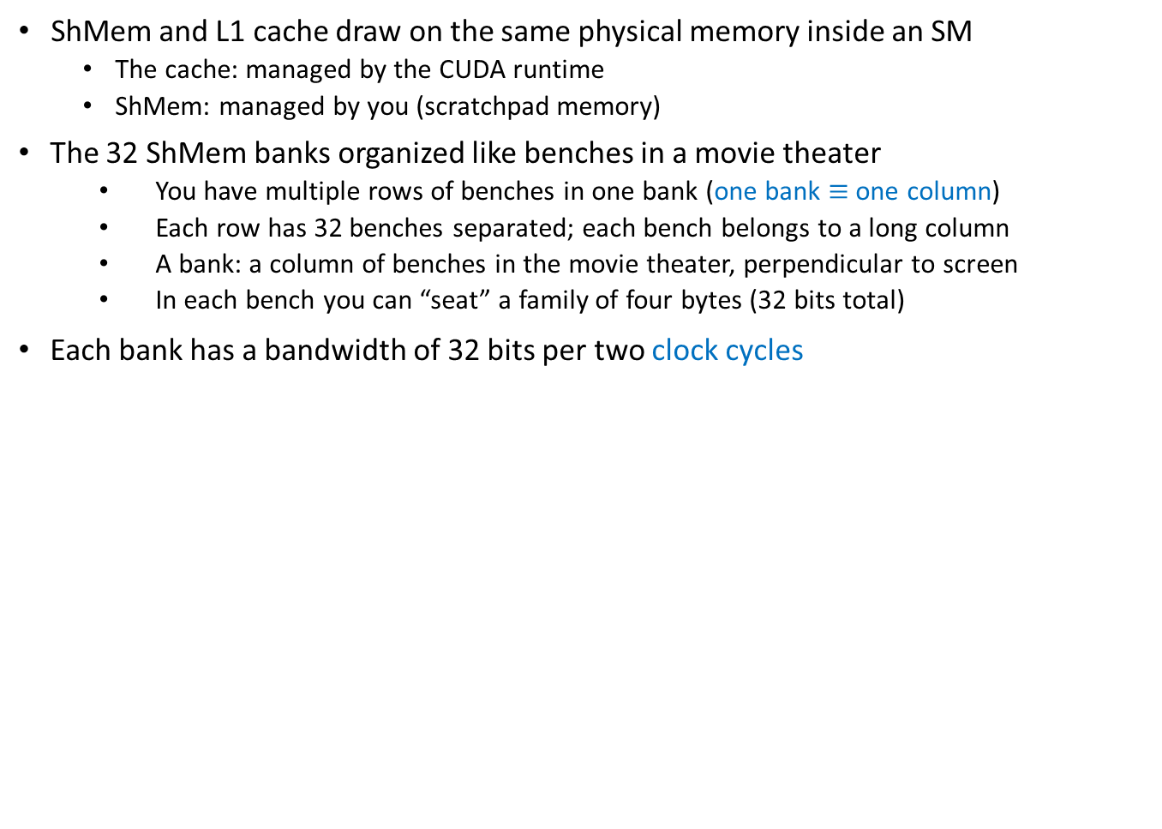
On the architecture of the GPU’s Shared Memory
ShMem and L1 cache draw on the same physical memory inside an SM
The cache: managed by the CUDA runtime
ShMem: managed by you (scratchpad memory)
The 32 ShMem banks organized like benches in a movie theater
You have multiple rows of benches in one bank (one bank $≡$ one column)
Each row has 32 benches separated; each bench belongs to a long column
A bank: a column of benches in the movie theater, perpendicular to screen
In each bench you can “seat” a family of four bytes (32 bits total)
Each bank has a bandwidth of 32 bits per two clock cycles
I
$
There are 32 columns of benches (banks);
each column is very deep (many benches)
L
1
Bank 0
Multithreaded
Bank 1
Instruction Buffer
Bank 2
Bank 3
R
D
$
Shared
This is the back of the screen of the movie theater
Bank 4
F
L
1
Mem
Bank 5
Bank 6
Operand Select
Bank 7
Bank 31
MAD
SFU

Slide 167
Shared Memory: Transaction Rules & Bank Conflicts
When reading in four-byte words, 32 threads in a warp attempt to access shared memory simultaneously
Bank conflict: two different threads access *different* words in different rows of the same bank
Note that there is no conflict if different threads access any bytes within the same word (same row)
Bank conflicts enforce the hardware to serialize a ShMem access, which adversely impacts bandwidth
If multiple threads make the same ShMem read access, one thread receives the data & then broadcasts it to the other threads.
When multiple threads write to the same ShMem location, only one thread succeeds in the write; which thread that succeeds is undefined
Notes:
DN (12/18/2020): “A shared memory request for a warp does not generate a bank conflict between two threads that access any address within the same 32-bit word (even though the two
addresses fall in the same bank). When multiple threads make the same read access, one thread receives the data and then broadcasts it to the other threads. When multiple threads write to the same location, only one thread succeeds in the write; which thread that succeeds is undefined”

Slide 168
Shared Memory Bank Conflicts
No bank conflicts:
Shared memory access is fast, but not quite as fast as register access
On the bright side, latency is roughly 100x lower than global memory latency
ShMem operation, the fast case:
If all threads of a warp access different banks, there is no bank conflict
If all threads of a warp access an identical address for a fetch operation, there is no bank conflict (broadcast)
ShMem memory operation, the slow case:
Worst case: 32 threads access 32 different words in the same bank
Must serialize all the accesses
In general, cost = max # of simultaneous accesses to a single bank
An allotted chunk of shared memory starts at an address that is at least a multiple of 128 (if not 256)
Bank you work with = (address of offset) % 32
IMPORTANT: There is no such thing as “bank conflicts” between threads belonging to different warps

Slide 169
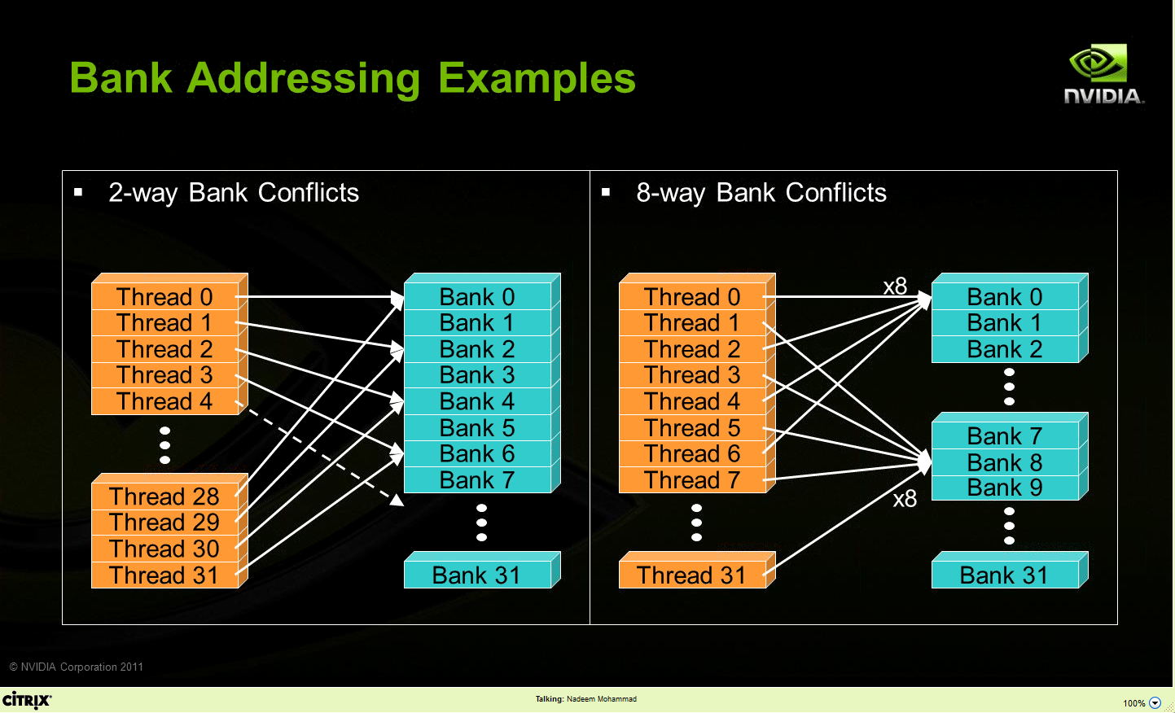
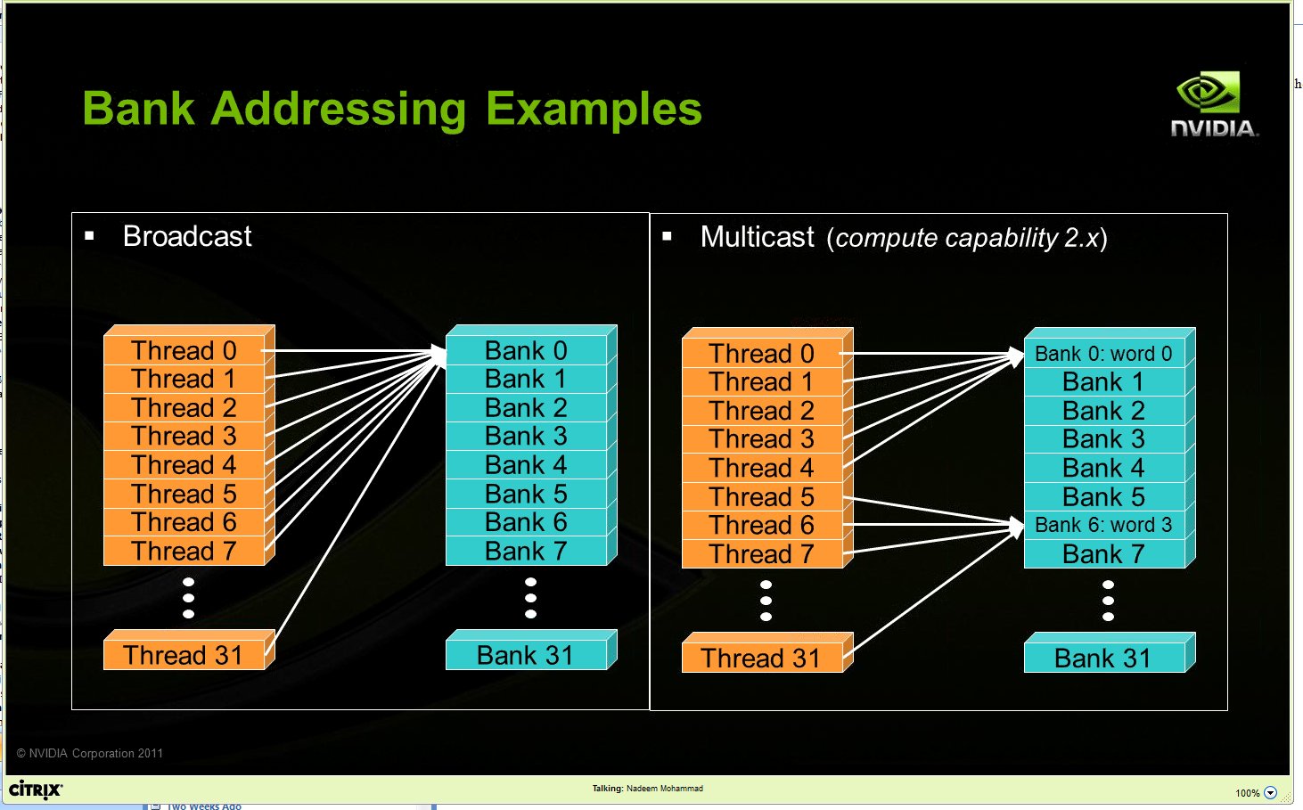
Bank Addressing Examples Transactions Involving 4 Byte Words
No Bank Conflicts
Random 1:1 Permutation
Bank Conflicts:
A case in which only the even banks end up being accessed, and the warps access different words in each bank
Thread 0
Bank 0
Thread 1
Bank 1
Thread 2
Bank 2
Thread 3
Bank 3
No conflict scenarios, reading operations:
Broadcast: all threads in a warp access the same word in a bank
Multicast: several threads in a warp access the same word in the same bank
Thread 4
Bank 4
Thread 5
Bank 5
Thread 6
Bank 6
Thread 7
Bank 7
Thread 31
Bank 31
Avoid Conflicts: arranging the access in sequential way not parallel way -- however, sequential way is slow as the next access needs to wait for its predecessor to finish before it starts
[NVIDIA]$→$

Slide 170
Linear Addressing, Data types and bank conflicts
No conflicts if s shares no common factors with the number of banks
__shared__ float sharedM[256];
float foo = sharedM[baseIndex + s * threadIdx.x];
No conflicts if shrd is a 32-bit data type:
foo = shrd[baseIndex + threadIdx.x]
Also, if accessing one byte-per-thread, no conflict since different bytes of the same word are accessed
No conflicts:
extern __shared__ char shrd[];
foo = shrd[baseIndex + threadIdx.x];
No conflicts:
extern __shared__ short shrd[];
foo = shrd[baseIndex + threadIdx.x];
Thread 0
Bank 0
Thread 1
Bank 1
Thread 2
Bank 2
Thread 3
Bank 3
Thread 4
Bank 4
Thread 5
Bank 5
Thread 6
Bank 6
Thread 7
Bank 7
Thread 31
Bank 31
Thread 0
Bank 0
Thread 1
Bank 1
Thread 2
Bank 2
Thread 3
Bank 3
Thread 4
Bank 4
Thread 5
Bank 5
Thread 6
Bank 6
Thread 7
Bank 7
Thread 31
Bank 31

Slide 171
Data Hazards in Parallel Computing (not only GPU)
Backdrop:
Threads $i$ and $j$ execute two streams of instructions in parallel and operate at some point on the same memory entry
For program’s correctness, the programmer’s expectation is that $i$ executes before $j$
Three types of data hazards
Read-After-Write (RAW) – think of it as a violation of “$j$ ought to Read only After the Write by $i$ occurred”
How things go wrong: $j$ reads a source before $i$ writes it, so $j$ incorrectly gets the old value
Perhaps most common of them three hazards
Write-After-Read (WAR) – think of it as a violation of “$j$ ought to Write only After the Read by $i$ occurred”
How things go wrong: $j$ writes a destination before it is read by $i$ , so $i$ gets the new (and wrong) value
Write-After-Write (WAW) – think of it as a violation “$j$ ought to Write only After the Write by $i$ occurred”
How things go wrong: $j$ writes an operand before it is written by $i$.
The writes end up being performed in the wrong order, leaving the value written by $i$ rather than the value written by $j$ in the destination
Moral of the story: The ordering of memory operations is important in getting the result right

Slide 172
Parallel computing, bottom line
Parallel computing: previous slide, two threads led to race conditions – in absence of special measures, there is no way to know who executes what and when
A matter of “thread racing”, or “race conditions”
“special measures”, example: use of __syncthreads()
Can we at least say something about the order in which memory operations are carried out?
A matter of “sequence of memory ops”, pertains one thread (with side effects when a 2nd thread present)

Slide 173
The CUDA __threadfence function, backdrop
What we have just learned:
If a memory transaction was posted, it does not imply that it has been completed before another memory transaction that follows it
Need a guarantee that memory transaction has completed before another one is started
Comes through functionality associated w/ threadfence calls

Slide 174
The CUDA __threadfence family of functions
Goal: Need a guarantee that memory transaction has completed before another one is started
__threadfence_block();
Execution of the kernel by the calling thread pauses until all its global and shared memory outstanding writes are visible to all threads in block
__threadfence();
Execution of kernel by a calling thread ensures its global and shared memory outstanding writes are visible to all threads in block AND all other threads in flight for global data
__threadfance_system();
A thread stops in its execution of the kernel until global and shared memory accesses prior to the __threadfance_system() are visible to
all threads in the block for ShMem accesses
all threads in the device for global memory accesses,
host threads for page-locked host memory accesses
NOTE: memory fences are NOT a synchronization mechanism
Not all threads should reach the fence function for the thread calling the fence to be allowed to move past the fence
It’s just a way to enforce that memory transactions for ONE thread can be seen by other threads

Slide 175

The nitty-gritty, has to do with enforcing ordering…
The fine print, for __threadfence_block(), two statements:
All writes to all memory made by the calling thread before the call to __threadfence_block() are observed by all threads in the block of the calling thread as occurring before all writes to all memory made by the calling thread after the call to __threadfence_block()
All reads from all memory made by the calling thread before the call to __threadfence_block() are ordered before all reads from all memory made by the calling thread after the call to __threadfence_block()
Similar semantics for __threadfence() & __threadfence_system()
[NVIDIA CUDA]$→$

Slide 176
The concept of “memory consistency”
__device__ volatile int X = 1, Y = 2;
__device__ void writeXY()
{
X = 10;
Y = 20;
}
__device__ void readXY()
{
int A = Y;
int B = X;
}
Backdrop
Thread_1 executes writeXY()
Thread_2 executes readXY()
Sequential: all in-order
Relaxed: some reordering are allowed
Weak: all arbitrarily reordered
For sequential consistency (“strongly-ordered mem. model”), the only possible scenarios are
A=2 and B=1
A=20 and B=10
A=2 and B=10
For weak consistency (“weakly-ordered memory model”), it is possible to have this
A=20 and B=1
Part 1: Insert a fence here to prevent A=20 and B=1
Part 2: Also, insert a fence here to prevent A=20 and B=1

Slide 177
The volatile qualifier
From CUDA Programming Guide
Compiler is “free to optimize reads and writes to global or shared memory” provided
It respects the memory ordering semantics of memory fence functions
It respects memory visibility semantics of synchronization functions
What is the compiler allowed to do?
Example: store global reads into registers or L1 cache to speed up the computation
These “behind your back” optimizations disabled using the volatile keyword
CUDA: “If a variable located in global or shared memory is declared as volatile, the compiler assumes that its value can be changed or used at any time by another thread and therefore any reference to this variable compiles to an actual memory read or write instruction.”
[CUDA Programming Guide]→

Slide 178
The volatile qualifier: how things go south, ShMem example
To speed execution, compiler places a variable that should make it into ShMem into a register
A register is specific to a thread; another thread cannot see what’s stored in that register
Perhaps your code relies on thread B reading something that was deposited in ShMem by thread A
Thread A’s variable didn’t make it all the way to the ShMem since the compiler wrote that variable in a register, to speed up the computation
volatile prevents the compiler from playing these games and forces any variable to be written to the location in the memory where it ought to be stored – no funny business
Note: if in your kernel you do not expect any thread B to read from ShMem values deposited by thread A, then there is no need to use volatile
Notes:
See also this: https://stackoverflow.com/questions/15331009/when-to-use-volatile-with-shared-cuda-memory

Slide 179
volatile vs. __threadfence(): how different?
volatile applies equally well to sequential computing
Not an appendage of CUDA, exists in the standard C
Like a wall, each thread runs its own, touches that wall and stops until all threads have touched the wall
When waiting at the wall, all finished results are visible to all threads
__threadfence() specific to parallel computing
Although this particular syntax is specific to CUDA, the idea of a memory fence is not
Work towards each thread
The process after the fence can access all data in this thread before the fence

Slide 180
GPU Cache Line
All global memory accesses are cached
A cache line is 128 bytes
It maps to a 128-byte aligned segment in global memory
Note: it so happens that 128 bytes = 32 (warp size) * 4 bytes
In other words, 32 floats or 32 ints fit in one cache line (and can be brought in L2 or L1 in one trip)
If the size of the type accessed by each thread is more than 4 bytes, a memory request by a warp is first split into separate 128-byte memory requests that are issued independently
Notes:
What is important about a cache line of 128 bytes?
it maps well in a data transaction for an entire warp: 32 floats or 32 ints
in one operation services all threads in a warp
You can determine at *compile* time (through flags: -dlcm=ca/cg) if you double cache [L1 & L2] or only cache [L2 only]
If [L1 & L2], a memory access is serviced with a 128-byte memory transaction
If [L2 only], a memory access is serviced with a 32-byte memory transaction
This can reduce over-fetch in the case of scattered memory accesses
Good for irregular pattern access (sparse linear algebra)

Slide 181
Memory Access Issues
Issue 1: Not all global memory accesses are equally efficient
How can you optimize memory access?
Question is highly relevant (for fast execution)
Issue 2: Not all shared memory accesses are equally efficient
How can we optimize shared memory accesses?
Moderately relevant question
Discussed already (bottom line: avoid bank conflicts)
NOTE: Getting global memory access right has higher priority
Notes:
We discuss the 1st one:
scheduling is important here
We do not discuss the 2nd one:
physical layout of the memory banks used for L1 cache / ShMem
bank conflicts

Slide 182
Data Access “Divergence”
Concept is similar to thread divergence and often conflated
Hardware is optimized for accessing contiguous blocks of global memory when performing loads and stores
“block of global memory”: a 128-byte aligned chunk of 128 byte of memory
Becomes a GPU cache line, once it gets read in L2 (and possibly L1) memory

Slide 183
Global Memory Access
Two attributes of a global memory access are relevant when fetching data into shared memory and/or registers
Attribute 1: The layout of the access to global memory (the pattern of the access)
Attribute 2: The alignment of the data you try to fetch from global memory
IMPORTANT:
The two attributes in red should be interpreted in the context of a global memory transaction carried out by one warp of threads
That is, not by one thread, not all threads in a block, not all threads in a grid, etc. But one warp of threads
Notes:
Recall: most programs are memory-bound, flops are cheap
Memory transactions are playing key role in the performance of your code. Getting maximum memory throughput requires you to follow certain access pattern rules.
Data “divergence”: concept similar to thread divergence
hardware is optimized for so-called coalesced memory transactions (accessing contiguous blocks of global memory)
divergence: neighboring threads access memory locations physically far from each other

Slide 184
Comment, on the “layout of the access” attribute
The basic idea:
Suppose each thread in a warp accesses a global memory address for a load operation at some point in the execution of the kernel
These threads can access global memory data that is either (a) neatly grouped, or (b) scattered all over the place
Case (a) is called a “coalesced memory access”
If you end up with (b) this will adversely impact the effective bandwidth of your program
Analogy
It’s one thing to get the timber I need from one forest
Alternatively, in case I need timber from different forests several trips will be in order to get what I need

Slide 185
Comment, on the “alignment” attribute
Fact: Any address of memory allocated in device memory with cudaMalloc is a multiple of 256
The “alignment” component of this story:
It’s great when all threads in a warp access data inside only one memory block

Slide 186
Hitting the jackpot/winning the lottery
Best memory accesses are simultaneously: (1) coalesced and (2) properly aligned

Slide 187

Why is this important?
← A
B →
In Scenario B you have half the effective bandwidth you get in Scenario A
Just because of the alignment of your data access
If your code is memory bound and dominated by this type of access, you might see a sizeable slow down…
However, the slowdown is not by a factor of 2, since the memory transactions are pipelined too
The moral of the story:
When you reach out to fetch data from global memory, visualize how a warp of threads reaches out for access.
Is the access coalesced and well aligned?

Slide 188

A note on the effective bandwidth
If you need data from multiple 128 byte-memory blocks, effective bandwidth goes down
However, latency is not
Reduction in effective bandwidth (assuming caching doesn’t come into play)
Reduction equal to the number of 128-byte memory blocks you are hitting on
Side effect: if you work with type double, effective bandwidth halves (vs. float or int)
float & int: 4 bytes (4 $×$32 threads/warp = 128 bytes)
double: 8 bytes (8 $×$32 threads/warp = 256 bytes $→$ likely hitting at least 2 mem. blocks)

Slide 189

Test Your Understanding
Given that the x field of a thread index changes the fastest, is the array indexing scheme on the previous slide good or bad?
HINT: think how threads are mapped into a set of 1D sequence of consecutive IDs
The “good or bad” refers to how data is accessed in the device’s global memory
In other words should we have
or…
C[i][j] = A[i][j] + B[i][j]
C[j][i] = A[j][i] + B[j][i]
Notes:
Mapping threads to data is not unique. Some choices are better than others… (from a memory access point of view)
Must keep in mind how 2-dimensional arrays are stored in C/C++
Answer: C[j][i] = A[j][i] + B[j][i]

Slide 190
Reflecting on Accessing Global Memory in CUDA
Assume dA is a device array, holding ints
Assume z[] is an array of unsigned ints
Which of these global memory accesses are good/bad? Why?
dA[threadIdx.x] -> come coalesced (1,2,3,…) -> good
dA[threadIdx.x+2] -> almost coalesced (1,3,5,…) -> good, but not as good as 1
dA[7*threadIdx.x+2] -> diverged (2,9,16,…) -> bad
dA[z[threadIdx.x]] -> cannot determine as we don’t know z[]
NOTE: When answering 1-4 above, imagine you’re a thread and try to understand what the other 31 threads in the warp do when the warp executes the memory instruction
Notes:
Some of these scenarios can lead to out-of-bounds access as well. Particularly the last one

Slide 191
How Do You Avoid Bad Memory Accesses?
Design your data structures in a way that leads to advantageous memory accesses
Choosing a design: done before you write any line of code
Reflect on your algorithm
What data it needs, how much of it, where you read from/write to, how often
A good data structure choice for parallel computing could be quite different than a good data structure choice for sequential computing
In the beginning, as we get going, we learn programming thinking about correctness
Then, we get wiser. Other aspects to consider when writing code:
speed of execution & convenience/productivity & code legacy & large team development & portability

Slide 192
Related to Data Organization
Say you use in your program complex data constructs that could be organized using C-structures
For GPU computing, how is it more advantageous to store data in global memory?
Alternative A: as an array of structures (AoS)
Alternative B: as a structure of arrays (SoA)
If you use all the data in a struct once you bring over, question not that relevant (although there are aspects that come into play)
However, if you only use one field from a struct, stick w/ SoA
Notes:
Example: 3D points
AoS: Swiss cheese (many holes → wasted trips to memory)
SoA: Parmesan (very dense)

Slide 193

SoA or AoS?
Collection of $N=10,000$ points in 3D
Need to compute difference between the $x$ coordinates of a bunch of points $A_{i}(x_{i},y_{i},z_{i})$:
${|x}_{i}−x_{j}|$ for $0≤i,j<N$
However, you don’t use the $y$ and $z$ coordinates of your points
SoA is better when we frequently access a part of struct $x_{1},x_{2},,…$
which will be coalesced in SoA but diverged in AoS
AoS is better when we frequently access full struct $\left(x_{1},y_{1},z_{1}\right),\left(x_{2},y_{2},z_{2}\right),…$
which can be coalesced simply with AoS

Slide 194
Latency vs. Bandwidth, or how the CPU and GPU go about hiding memory access overhead
CPU uses the low latency of the cache to hide memory access overhead
Caches have small latency (but also small capacity, unfortunately: 256 KB L2)
CPU uses TLP (recall Intel’s HTT) to hide data overhead
GPU hides memory latency via SM oversubscription
Caveat: data needs to find its way into the GPU global memory. Slow communication channel
PCIe – a good I/O bus, but not a good memory bus
NVLINK: a good memory bus

Slide 195
Atomic Operations

Slide 196
Coordinating Memory Operations to Avoid Data Hazards
In parallel computing, accesses to shared locations (global memory & shared memory) need to be correctly choreographed (orchestrated) to avoid race conditions
Race conditions: the system's substantive behavior is dependent on the sequence of other uncontrollable events
In many common shared memory multithreaded programming models, one uses coordination mechanisms such as locks to choreograph accesses to shared data
CUDA has a scalable coordination mechanism called “atomic memory operation”

Slide 197
Atomics, Introduction
Atomic memory operations (atomic functions) are used to solve access coordination problems in parallel computing
General concept: provide a mechanism for a thread to update a memory location such that the update appears to happen without interruption (atomically) with respect to all other threads
This ensures that all atomic updates issued are performed (in some unspecified order) to completion and that all threads can observe all updates

Slide 198
Atomic Functions, Example [1/3]
Atomic functions perform read-modify-write operations on data residing in global or shared memory
//example of int atomicAdd(int* addr, int val)
__global__ void update(unsigned int* x)
{
int i = threadIdx.x;
int j = atomicAdd(x, i); // j is now old value of x;
}
//-----------------------------------
// snippet of code in main.cu; mem. was already allocated on device
int x = 0;
cudaMemcpy(&d_x, &x, cudaMemcpyHostToDevice);
update<<<1,128>>>(&d_x);
cudaMemcpy(&x, &d_x, cudaMemcpyDeviceToHost);
NVIDIA [J. Balfour]→
Side-note question: in example below, are we working w/ global or shared memory?
Notes:
[DN]
This is what used to be: int j = atomicAdd(x, 1); // j = *x; *x = j + i;
This is now: int j = atomicAdd(x, 1); // j = *x;

Slide 199
Atomic Functions [2/3]
Atomic functions perform read-modify-write operations on data that can reside in global or shared memory
Synopsis of atomic function atomicOP(a,b) is typically (a and b below are pointers)
t1 = *a; // read
t2 = (*a) OP (*b); // modify
*a = t2; // write
return t1;
All statements are executed atomically without interruption by any other function/process
The atomic function returns the initial value, *not* the final value, stored at the memory location
NVIDIA [J. Balfour]→

Slide 200
Atomic Functions [3/3]
The order in which concurrent atomic updates are performed is not defined
While order is not clear, none of the atomically performed updates will be lost
Several different kinds of atomic operations:
Add (add), Sub (subtract), Inc (increment), Dec (decrement)
And (bit-wise and), Or (bit-wise or) , Xor (bit-wise exclusive or)
Exch (Exchange)
Min (Minimum), Max (Maximum)
Compare-and-Swap
Etc.
NVIDIA [J. Balfour]→

Slide 201
Histogram Example
// Compute histogram of colors in an image
//
// picturePixels – pointer to picture pixels, each w/ its own color
// picturePixels[i] – takes a value between 0 and 6 (7 colors total)
// bucket–pointer to histogram bucket of size equal to # of colors
//
__global__ void histogram(int n, int* picturePixels, int* bucket)
{
int i = threadIdx.x + blockDim.x * blockIdx.x;
if (i < n)
{
int c = picturePixels[i];
atomicAdd(&bucket[c], 1);
}
}
NVIDIA [J. Balfour]→
Notes:
picturePixels[i] returns one of say seven integers that correspond to the possible seven colors in the picture.
“bucket” is an array of int of dimension seve.

Slide 202
Performance Notes
While very convenient to use, atomics do impact the speed of the code
Performance poor when many threads attempt to perform atomic operations on a small number of locations
Bad case: all threads trying to update the same variable
NVIDIA [J. Balfour]→
Notes:
Hammad: The kepler and Maxwell architectures improved atomic performance. Maxwell improved performance for shared memory atomics.

Slide 203
No mix-and-match, please…
Atomic updates are not guaranteed to appear atomic to concurrent accesses that also use loads and stores
No mix and match, please
__global__ void broken(int n, int* x)
{
int i = threadIdx.x + blockDim.x * blockIdx.x;
if (i == 0)
{
*x = *x + 1;
}
else
{
int j = atomicAdd(x, 1); // j = *x; *x += i;
}
}
// main.cpp
broken<<<1,128>>>(128, d_x); // d_x = d_x + {1, 127, 128}
NVIDIA [J. Balfour]→

Slide 204
Rules of thumb, atomic ops
When to use: Cannot fall back on normal memory operations because of possible race conditions
Use for infrequent, sparse, and/or unpredictable global communication
Use shared memory and/or customized data structures & algorithms to avoid synchronization whenever reasonable
Compute capabilities post Maxwell improved the speed of atomic operations
NVIDIA [J. Balfour]→

Slide 205
Synchronization vs. Coordination
There is a qualitative difference between a __syncthreads() function and an atomic operation
__syncthreads() has the connotation of barrier; i.e., of synchronization
__syncthreads() establishes a point in the execution of the kernel that every thread in the **block** needs to reach before any block thread can move beyond that point. Also, all memory ops are seen through
The “atomic operation” concept instead tied to the idea of coordination in relation to operations that involve memory transactions
Threads need not synchronize their execution, it’s only that a certain memory operation in a kernel is conducted in an atomic fashion

Slide 206
Resource Management Considerations

Slide 207
Some Hard Constraints (1/2)
How do you get to use the card at capacity?
“used at capacity”: SM executes the max. number of warps it can possibly host
The three factors that come into play are: threads/block = ?, registers/thread = ?, shMem/block = ?
Max number of warps that one SM can service simultaneously:
32 on Tesla C1060 and Turing (Turing is weird)
48 on Fermi
64 on Kepler, Maxwell, Pascal, Volta, and Ampere
Max number of blocks that one SM can process simultaneously:
8 on Fermi
16 on Kepler and Turing (wow)
32 on Maxwell, Pascal, Volta, and Ampere
Notes:
Fermi: must have at least 2 blocks to even have a chance to reach 100% occupancy
Indeed, 1024 max. threads/ block → 32 max. warps / block

Slide 208
Some Hard Constraints (2/2)
The number of 32-bit registers available on each SM is limited:
16,384 registers (on Tesla C1060)
Roughly 48,000 on Fermi
Roughly 64,000 on Kepler, Maxwell, Pascal, Volta, and Ampere
The amount of shared memory available to each SM is limited
16 KB on Tesla 1060
64 KB on Fermi (16/48 or 48/16 configurable between L1 and shared memory)
64 KB on Kepler (16/48 or 48/16 or 32/32 configurable)
64 KB on Maxwell and Pascal, but not split w/ L1
96 KB on Volta (this is split-able again, w/ L1 and texture)
Up to 164 KB on Ampere (out of 196KB, which is to be shared w/ L1)
Note: there is also a max amount of ShMem that a block can get assigned
At 48 KB , sometimes 64KB, sometimes 96 KB
Notes:
Also, each thread can use a maximum of 256 registers

Slide 209
The Concept of Occupancy
registers | ↔ | per thread
shared mem | ↔ | per block
What prevents you from getting high occupancy?
Amount of shared mem demanded by each block
Total amount of shared memory in one SM is limited: e.g., up to 64 Kb on Pascal
Number of registers used by each thread
Size of the register file in one SM: 64K four-byte registers on Kepler, Maxwell, Pascal, etc.
How do you find out how many registers and shared memory get used?
Solution 1: using the CUDA profiler
Solution 2: use the flag –ptax-options=-v when you compile your kernel w/ nvcc

Slide 210
NVIDIA CUDA Occupancy Calculator
There is an “occupancy calculator” that can tell you what percentage of the HW gets utilized by your kernel
Comes as an Excel spreadsheet
Requires the following input
Compute capability
Threads per block
Registers per thread
Shared memory per block
Selected Shared Memory Size Config (bytes)
Selected Global Load Caching Mode
Search online “CUDA occupancy calculator” to get the excel file
Notes:
Can also use compiler flags to report resource utilization.
For example, passing –ptax-options=-v to nvcc will report the number of registers/thread
Profiler will also give you all this information.

Slide 211
Occupancy != Performance [yet a pretty good proxy]
Increasing occupancy does not necessarily increase performance
If you want to read more about this, there is a Volkov paper, assigned reading
What controls the damage is the Instruction Level Parallelism (ILP) that the compiler can capitalize on (better efficiency in pipelining, instruction reordering, etc.)
HOWEVER,
Low-occupancy multiprocessors are likely to have a hard time when it comes to hiding latency on memory-bound kernels
This latency hiding draws on Thread Level Parallelism (TLP); i.e., having enough threads (warps, that is) that are ready for execution

Slide 212
Parameterize Your Application
Parameterization helps adaptation to different GPUs
GPUs vary in many ways
# of SMs
Memory bandwidth
Shared memory size
Register file size
Max. threads per block
Max. number of warps per SM
You can even make apps self-tuning (like FFTW and ATLAS)
“Experiment” mode discovers and saves optimal configuration

Slide 213
CUDA Optimization Rules of Thumb

Slide 214
Writing CUDA Software: High-Priority Recommendations
To get the maximum benefit from CUDA, focus first on finding ways to parallelize sequential code. Expose fine grain parallelism
Minimize data transfer between the host and the device, even if it means running some kernels on the device that do not show performance gains when compared with running them on the host CPU
Strive to have aligned and coalesced global memory accesses. Design your implementation such that global memory accesses are coalesced for that part of the red-hot parts of the code
Minimize the use of global memory. Prefer shared memory access where possible (consider tiling as a design solution)
Very good resource: http://docs.nvidia.com/cuda/cuda-c-best-practices-guide/index.html#abstract

Slide 215
Writing CUDA Software: Medium-Priority Recommendations
Accesses to shared memory should be designed to avoid serializing requests due to bank conflicts
Strive for sufficient occupancy
Keep the number of threads per block a multiple of 32 to avoid wasted lanes
Use the fast math library whenever speed is very important, and you can live with a tiny loss of accuracy
Avoid thread divergence
http://docs.nvidia.com/cuda/cuda-c-best-practices-guide/index.html#abstract

Slide 216
Some nuts and bolts, compiler related and such [supplemental material]

Slide 217
Compiling CUDA Code [with nvcc driver]
C/C++ CUDA
Application
NVCC
CPU Code
PTX Code
PTX to Target
Compile
P100
…
A100
Target binary cubin code
Notes:
nvcc separates what should run on CPU from GPU code
First stage is to translate into PTX code (assembly)
PTX is machine independent
FORTRAN generates PTX too
Second stage: compile PTX for target GPU

Slide 218
PTX: Parallel Thread eXecution
PTX: an assembly language used in CUDA programming environment
nvcc translates code written in CUDA’s C into the language-agnostic Intermediate Representation, and then into PTX assembly
nvcc subsequently invokes an assembler which translates the PTX into a binary code which can be run on a certain GPU
PTX for fillKernel
.entry _Z10fillKernelPii (
.param .u64 __cudaparm__Z10fillKernelPii_a,
.param .s32 __cudaparm__Z10fillKernelPii_n)
{
.reg .u16 %rh<4>;
.reg .u32 %r<6>;
.reg .u64 %rd<6>;
.reg .pred %p<3>;
.loc 14 5 0
$LDWbegin__Z10fillKernelPii:
mov.u16 %rh1, %ctaid.x;
mov.u16 %rh2, %ntid.x;
mul.wide.u16 %r1, %rh1, %rh2;
cvt.u32.u16 %r2, %tid.x;
add.u32 %r3, %r2, %r1;
ld.param.s32 %r4, [__cudaparm__Z10fillKernelPii_n];
setp.le.s32 %p1, %r4, %r3;
@%p1 bra $Lt_0_1026;
.loc 14 9 0
ld.param.u64 %rd1, [__cudaparm__Z10fillKernelPii_a];
cvt.s64.s32 %rd2, %r3;
mul.wide.s32 %rd3, %r3, 4;
add.u64 %rd4, %rd1, %rd3;
st.global.s32 [%rd4+0], %r3;
$Lt_0_1026:
.loc 14 11 0
exit;
$LDWend__Z10fillKernelPii:
}
__global__ void fillKernel(int *a, int n)
{
int tid = blockIdx.x*blockDim.x + threadIdx.x;
if (tid < n) {
a[tid] = tid;
}
}
Notes:
PTX
similar to assembly code
does not contain information on what particular GPU card the code should run (device neutral representation)
important to distribute CUDA code to clients without knowing their GPU capability
[Colin] PTX is an assembly language. There is a separate assembler called ptxas which is used to build it.
nvcc is an LLVM-based compiler (like Clang); It generates a subset of LLVM IR called NVVM IR, which is then compiled to PTX assembly.
Other CUDA compilers (Fortran, for example) generate this IR, and then the rest of the process acts as normal.

Slide 219
More on the nvcc compiler
File suffix | How the nvcc compiler interprets the file
.cu | CUDA source file, containing host and device code
.cuh | CUDA header files, containing host and device code
.cup | Preprocessed CUDA source file, containing host code and device functions
.c | C source file
.cc, .cxx, .cpp | C++ source file
.gpu | GPU intermediate file (device code only)
.ptx | PTX intermediate assembly file (device code only)
.cubin | CUDA device only binary file
Notes:
nvcc can output
C code (which must then be compiled with the rest using another tool)
ptx code (device independent)
object code (cubin)

Slide 220
The JIT story
C code gets converted into an Intermediate Representation (IR) called NVVM IR
NVVM IR is then converted to PTX assembly
PTX assembly gets assembled into binary code for some number of GPU targets (“cubin”)
Why the intermediate steps?
Brings into the picture the concept of just-in-time (JIT) compiling
Compilers for other languages can generate this intermediate representation rather than implementing a dialect of PTX assembly for each frontend language (Clang and CUDA Fortran do this)
PTX material can be converted at run-time into cubin instructions
Why bother with JIT?
CON: JIT increases the load-time of an application (since an additional compile step needs to happen)
PRO: Allows the app to benefit from newer devices (better compilers, more advanced features supported by the hardware)
The only way an app can run on a device that didn’t exist at the time the PTX was generated
Notes:
[Colin] PTX is an assembly language. There is a separate assembler called ptxas which is used to build it.
nvcc is an LLVM-based compiler (like Clang); It generates a subset of LLVM IR called NVVM IR, which is then compiled to PTX assembly.
Other CUDA compilers (Fortran, for example) generate this IR, and then the rest of the process acts as normal.

Slide 221

Getting stuck with a CC, via the –code flag
Compiling to produce cubin binary code for CC 3.5 done like this
>> nvcc –code=sm_35 …otherstuff…
You are stuck with 3.5 CC, you can’t run this on a device of CC 4.0
Rule: A cubin object generated for CC $X.y$ will only run on hardware of CC $X.z$, where $z≥y$
Using the nvcc command above is ok as long as you know *for sure* that you only run on a certain card (like your personal laptop, office desktop, etc.)
Not good if you want to distribute the app to be run by other folks with unknown hardware

Slide 222
A word on PTX compatibility, and the role of the –arch flag
Some CUDA features supported only on devices of higher CC
Example: unified (managed) memory
You can control the C to PTX translation so that you do/don’t pick certain CUDA features
Example: Warp Shuffle Function available only in CC 3.0 and above
Code that contains Warp Shuffle functionality should be compiled with this in mind
Accomplished by the use of the –arch=compute_30 flag on nvcc
>> nvcc –arch=compute_30 …blahblah…
NOTE: the PTX generated by the above can then be compiled to cubin to run on higher CC
Recall the cubin generation control by the –code flag

Slide 223
Example, combining –arch and –code via -gencode
>> nvcc x.cu
-gencode arch=compute_35,code=sm_35
-gencode arch=compute_50,code=sm_50
-gencode arch=compute_60,code=\'compute_60,sm_60\'
The cubin fat binary generated by this command embeds the following (it’s got bigger footprint to accommodate all):
Binary code generated to work on Kepler (CC 3.5)
Binary code generated to work on Maxwell (CC 5.0)
PTX and binary code to work on Pascal (CC 6.0)
The arch part says that the binary code in each case should be produced based on PTX code generated as you’d expect: binary for 3.5 comes from PTX for 3.5, binary for 5.0 comes from PTX for 5.0, binary for 6.0 comes from PTX for 6.0
Shortcut: you can get -gencode arch=compute_60,code=\'compute_60,sm_60\‘ by simply saying :
>> nvcc x.cu -arch=sm_60
If you don’t say anything but “nvcc x.cu” the compile driver will use default arch & code settings

Slide 224
GPU Computing: Case studies
Three Case Studies:
a) 1D Stencil Operation
b) Vector Reduction in CUDA
c) Parallel Prefix Scan on the GPU

Slide 225
Problem at hand: Performing a 1D Stencil
Applying a 1D stencil to a 1D array of elements
Function of input elements within a certain radius
Operation is fundamental to many algorithms
Standard discretization methods, interpolation, convolution, filtering, etc.
radius
radius
NVIDIA [S. Satoor]→
Notes:
Now lets talk about a specific, realistic optimization example.

Slide 226
Serial Algorithm
= CPU Thread
(radius = 3)
in
…
…
f
out
…
…
NVIDIA [S. Satoor]→
Notes:
Describe how algorithm works from perspective of calculating each output element.

Slide 227
Serial Implementation [assume N=16 mil.]
int main() {
// allocate resources
float *weights = new float[2 * RADIUS + 1];
float *in = new float[N];
float *out= new float[N];
initializeWeights(weights, RADIUS);
initializeArray(in, N);
applyStencil1D(RADIUS, N-RADIUS, weights, in, out);
// free resources
delete[] weights; delete[] in; delete[] out;
}
void applyStencil1D(int sIdx, int eIdx, const float *weights, float *in, float *out) {
for (int i = sIdx; I < eIdx; i++) {
out[i] = 0;
// loop over all elements in the stencil
for (int j = -RADIUS; j <= RADIUS; j++) {
out[i] += weights[j + RADIUS] * in[i + j];
}
out[i] = out[i] / (2 * RADIUS + 1);
}
}
NVIDIA [S. Satoor]→
Notes:
Here’s a straight-forward implementation of the stencil algorithm in C.
RADIUS is relative small, 15 in this example.
N is large, 16 Melements

Slide 228
Serial Implementation
Allocate and initialize
int main() {
// allocate resources
float *weights = new float[2 * RADIUS + 1];
float *in = new float[N];
float *out= new float[N];
initializeWeights(weights, RADIUS);
initializeArray(in, N);
applyStencil1D(RADIUS, N-RADIUS, weights, in, out);
// free resources
delete[] weights; delete[] in; delete[] out;
}
void applyStencil1D(int sIdx, int eIdx, const float *weights, float *in, float *out) {
for (int i = sIdx; I < eIdx; i++) {
out[i] = 0;
// loop over all elements in the stencil
for (int j = -RADIUS; j <= RADIUS; j++) {
out[i] += weights[j + RADIUS] * in[i + j];
}
out[i] = out[i] / (2 * RADIUS + 1);
}
}
Apply stencil
Cleanup
NVIDIA [S. Satoor]→

Slide 229
Serial Implementation
For each element…
int main() {
// allocate resources
float *weights = new float[2 * RADIUS + 1];
float *in = new float[N];
float *out= new float[N];
initializeWeights(weights, RADIUS);
initializeArray(in, N);
applyStencil1D(RADIUS, N-RADIUS, weights, in, out);
// free resources
delete[] weights; delete[] in; delete[] out;
}
void applyStencil1D(int sIdx, int eIdx, const float *weights, float *in, float *out) {
for (int i = sIdx; I < eIdx; i++) {
out[i] = 0;
// loop over all elements in the stencil
for (int j = -RADIUS; j <= RADIUS; j++) {
out[i] += weights[j + RADIUS] * in[i + j];
}
out[i] = out[i] / (2 * RADIUS + 1);
}
}
Weighted mean over radius
NVIDIA [S. Satoor]→
Notes:
Because this is a serial implementation, note that we use a single thread to iterate over all output elements.

Slide 230
Serial Implementation
int main() {
// allocate resources
float *weights = new float[2 * RADIUS + 1];
float *in = new float[N];
float *out= new float[N];
initializeWeights(weights, RADIUS);
initializeArray(in, N);
applyStencil1D(RADIUS, N-RADIUS, weights, in, out);
// free resources
delete[] weights; delete[] in; delete[] out;
}
void applyStencil1D(int sIdx, int eIdx, const float *weights, float *in, float *out) {
for (int i = sIdx; I < eIdx; i++) {
out[i] = 0;
// loop over all elements in the stencil
for (int j = -RADIUS; j <= RADIUS; j++) {
out[i] += weights[j + RADIUS] * in[i + j];
}
out[i] = out[i] / (2 * RADIUS + 1);
}
}
CPU | MElements/s
i7-930 | 30
NVIDIA [S. Satoor]→
Notes:
Because this is a serial implementation, note that we use a single thread to iterate over all output elements.

Slide 231
Application Optimization Process
Identify Optimization Opportunities
1D stencil algorithm
Parallelize with CUDA and confirm functional correctness
cuda-gdb, cuda-memcheck
Note: cuda-memcheck useful for memory debugging
Out of bounds accesses
Accessing misaligned data
Race conditions
Memory leaks
Optimize
…dealing with this next, using nvvp (NVIDIA’s Visual Profiler)
NVIDIA [S. Satoor]→
Notes:
Application optimization process: we identified and parallelized
Used CUDA to expose parallelism
Used memory checking, debugging tools to get functional correctness
What about optimize?

Slide 232
Parallel Algorithm
= Thread
in
Serial: One element at a time
…
…
…
…
out
in
Parallel: Many elements at a time
…
…
…
…
out
…
…
NVIDIA [S. Satoor]→
Notes:
This algorithm can be parallelized. Calculation of each output element is independent of others, so we can have multiple threads working in parallel. Each thread calculates a different output element value.

Slide 233
The Parallel Implementation
int main() {
int wsize = 2 * RADIUS + 1;
//allocate resources
float *weights = new float[wsize];
float *in = new float[N];
float *out= new float[N];
initializeWeights(weights, RADIUS);
initializeArray(in, N);
float *d_weights; cudaMalloc(&d_weights, wsize * sizeof(float));
float *d_in; cudaMalloc(&d_in, N * sizeof(float));
float *d_out; cudaMalloc(&d_out, N * sizeof(float));
cudaMemcpy(d_weights, weights, wsize, cudaMemcpyHostToDevice);
cudaMemcpy(d_in, in, size, cudaMemcpyHostToDevice);
applyStencil1D<<<N / 512, 512>>>(RADIUS, N-RADIUS, d_weights, d_in, d_out);
cudaMemcpy(out, d_out, size, cudaMemcpyDeviceToHost);
//free resources
delete[] weights; delete[] in; delete[] out;
cudaFree(d_weights); cudaFree(d_in); cudaFree(d_out);
}
A bit of a
nuisance, extra leg work
The GPU kernel
__global__ void applyStencil1D(int sIdx, int eIdx, const float *weights, float *in, float *out) {
int i = sIdx + blockIdx.x * blockDim.x + threadIdx.x;
if ( i < eIdx ) {
out[i] = 0;
//loop over all elements in the stencil
for (int j = -RADIUS; j <= RADIUS; j++) {
out[i] += weights[j + RADIUS] * in[i + j];
}
out[i] = out[i] / (2 * RADIUS + 1);
}
}
Device | Algorithm | MElements/s | Speedup
i7-930* | Optimized & Parallel | 130 | 1x
Tesla C2075 | Simple | 285 | 2.2x
NVIDIA [S. Satoor]→

Slide 234

NVIDIA Visual Profiler [nvvp, part of CUDA installation]
CUDA API activity on CPU
The interesting part, done on the GPU
Memcpy and kernel activity on GPU
NVIDIA [S. Satoor]→
Notes:
General layout… timeline for visualization plus additional information…
Timeline shows GPU and CPU activity
Additional information available for kernels and memcpys

Slide 235

Detecting Low Memory Throughput
Spent majority of time in data transfer
Often can be overlapped with preceding or following computation
From timeline can see that throughput is low (happens over PCIe bus)
NVIDIA [S. Satoor]→
Notes:
From timeline we can easily see that majority of time for stencil algorithm is spent moving data to and from GPU
By looking at the memcpy details we see that BW is quite low…
Note that VP highlights the problem with ! indication

Slide 236
Visual Profiler Analysis
How do we know when there is an optimization opportunity?
Timeline visualization seems to indicate an opportunity
Documentation gives guidance and strategies for tuning
CUDA Best Practices Guide
CUDA Programming Guide
Visual Profiler analyzes your application
Uses timeline and other collected information
Highlights specific guidance from Best Practices
Like having a customized Best Practices Guide for your application
NVIDIA [S. Satoor]→
Notes:
What if not a PCIe expert… can see that memcpy is taking a lot of time but how do we know if that is an opportunity for optimization or not?

Slide 237

Visual Profiler Analysis
Analysis pointing out low memcpy throughput
Several types of analysis are provided
NVIDIA [S. Satoor]→
Notes:
Transition… accessing the analysis portion of visual profiler is easy. Simply click one button and vp will collect the necessary information to perform the analysis and then present the results.

Slide 238

Online Optimization Help
Each analysis has link to Best Practices documentation
NVIDIA [S. Satoor]→
Notes:
Best practices information is included, online in the visual profiler
Each result has link to get more details Best Practices information…

Slide 239
Pinned CPU Memory Implementation
int main() {
int size = N * sizeof(float);
int wsize = (2 * RADIUS + 1) * sizeof(float);
//allocate resources
float *weights; cudaMallocHost(&weights, wsize);
float *in; cudaMallocHost(&in, size);
float *out; cudaMallocHost(&out, size);
initializeWeights(weights, RADIUS);
initializeArray(in, N);
float *d_weights; cudaMalloc(&d_weights);
float *d_in; cudaMalloc(&d_in);
float *d_out; cudaMalloc(&d_out);
…
CPU allocations use pinned memory to enable fast memcpy
No other changes
NVIDIA [S. Satoor]→
Notes:
Spend some time reading best practices, understanding some additional CUDA features… and we learn that pinned memory can significantly increase memcpy BW
Also learn what code modification is needed… very simple in this case

Slide 240
Pinned Memory
DMA (direct memory access) uses physical addresses
The OS could accidentally page out the data that is being read or written by a DMA and page in another virtual page into the same location
Pinned memory cannot not be paged out
If a source or destination of a cudaMemCpy() in the host memory is not pinned, it needs to be first copied to a pinned memory – extra overhead
cudaMemcpy faster with pinned host memory source or destination

Slide 241
Allocate/Free Pinned Memory (a.k.a. Page Locked Memory)
cudaHostAlloc()
Three parameters
Address of pointer to the allocated memory
Size of the allocated memory in bytes
Option – use cudaHostAllocDefault for now
cudaFreeHost()
One parameter
Pointer to the memory to be freed

Slide 242

Pinned CPU Memory Result
NVIDIA [S. Satoor]→
Notes:
Can see that portion of overall time required by memcpy is significantly reduced
Details also show that BW is now much higher (from < 2GB/s to almost 6GB/s)… other memcpy is similar (going from < 4GB/s to almost 6GB/s)

Slide 243
Pinned CPU Memory Result
Device | Algorithm | MElements/s | Speedup
i7-930* | Optimized & Parallel | 130 | 1x
Tesla C2075 | Simple | 285 | 2.2x
Tesla C2075 | Pinned Memory | 560 | 4.3x
NVIDIA [S. Satoor]→
Notes:
Can see that portion of overall time required by memcpy is significantly reduced
Details also show that BW is now much higher (from < 2GB/s to almost 6GB/s)… other memcpy is similar (going from < 4GB/s to almost 6GB/s)

Slide 244

Application Optimization Process [Revisited]
Identify Optimization Opportunities
1D stencil algorithm
Parallelize with CUDA, confirm functional correctness
Debugger
Memory Checker
Optimize
Profiler (pinned memory)
NVIDIA [S. Satoor]→
Notes:
Iterate optimization step to see if there are more opportunities…

Slide 245
Data Partitioning Example
Partition data into TWO chunks
chunk 1
chunk 2
On the CPU
in
On the CPU
out
NVIDIA [S. Satoor]→

Slide 246
Data Partitioning Example
On the CPU
chunk 1
chunk 2
in
memcpy
compute
memcpy
On the GPU
NOTE: Image in the green-ish box not quite to scale…
On the CPU
out
NVIDIA [S. Satoor]→

Slide 247
Data Partitioning Example
On the CPU
chunk 1
chunk 2
in
memcpy
compute
memcpy
On the GPU
NOTE: Image in the green-ish box not quite to scale…
memcpy
compute
memcpy
On the CPU
out
NVIDIA [S. Satoor]→

Slide 248

Overlapped Compute/Memcpy [problem broken into 16 chunks]
NVIDIA [S. Satoor]→
Notes:
Broke stencil problem into 16 chunks
Show in->compute->out for each chunk
Streams are a way to represent different groups of work that are independent

Slide 249
Overlapped Compute/Memcpy
Exploit dual memcpy engines
Compute time completely “hidden”
ME759: Use of multiple streams covered later
NVIDIA [S. Satoor]→
Notes:
Broke stencil problem into 16 chunks
Show in->compute->out for each chunk
Streams are a way to represent different groups of work that are independent

Slide 250
Overlapped Compute/Memcpy
Device | Algorithm | MElements/s | Speedup
i7-930* | Optimized & Parallel | 130 | 1x
Tesla C2075 | Simple | 285 | 2.2x
Tesla C2075 | Pinned Memory | 560 | 4.3x
Tesla C2075 | Overlap | 935 | 7.2x
NVIDIA [S. Satoor]→

Slide 251
Optimization Summary [Looking Back at 1D Stencil Example…]
Initial CUDA parallelization
Expeditious, kernel almost word-for-word replica of sequential code
2.2x speedup
Optimize memory throughput
Minimal code change, yet need to know about pinned memory
4.3x speedup
Overlap compute and data movement
More involved, need to know about the inner works of CUDA
Problem should be large enough to justify mem-transfer/execution
7.2x speedup

Slide 252
Iterative Optimization
Identify Optimization Opportunities
Parallelize
Optimize
NOTE: NVIDIA is gradually moving away from NVVP, migrating to NVIDIA Nsight Tools, see here.
NVIDIA [S. Satoor]→
Notes:
But that doesn’t mean no additional speedup is possible…
Can iterate entire process to find new function/algorithm that can be optimized.

Slide 253
The CUDA SDK allows you to do a roofline analysis as well…
A “roofline analysis” is as follows:
Profiler monitors how your program runs. Then, after program finished, provides two pieces of information
What your average arithmetic intensity was while executing your kernel
What your average FLOPS rate was over the execution of your kernel
And just to makes us feel bad, it also tells us how we compare against the “best case scenario” given our observed average arithmetic intensity

Slide 254
CUDA Case Study 2: Parallel Reduction

Slide 255
Parallel Reduction in CUDA
Parallel Reduction: Common and important data parallel primitive
Examples:
Used to compute the norm of a large vector
Used to sum up all the entries in an array
Implement in CUDA relatively straightforward
Challenging to get it to run fast though
Serves as a good optimization example
Walk step by step through several different versions
Demonstrates several important optimization strategies
Results are for old compute capability; yet instructive to understand how far folks went to get top performance
NVIDIA [M. Harris]→

Slide 256

Parallel Reduction: Sum all entries in an array
Backdrop: assume you have very large arrays – 100,000 entries and beyond
Basic Idea: tree-based approach used within each block of threads
Each block of threads reduces a portion of the array to one single value
NVIDIA [M. Harris]→

Slide 257
Problem: Global, grid-level synchronization missing in CUDA
Q: How do we communicate partial results between blocks of threads?
If we could synchronize across all thread blocks, could easily reduce very large arrays
Global sync after each block produces its result
Once all blocks reach sync, continue recursively
But CUDA has no global synchronization
Only synchronization of threads that belong to the same block
Solution: decompose into multiple kernels
Kernel launch serves as a global synchronization point
Kernel launch has negligible overhead
NVIDIA [M. Harris]→

Slide 258
Multiple Kernel Calls [An Example, and how it all works out…]
Imagine you launch a 1D grid in which each 1D block has 256 threads
Assume that the number or elements in the array is N=100,000
Note that 100,000= 390*256 + 160, therefore [(N+255)/256]=391 blocks needed
For the first stage, you launch 391 blocks of 256 threads
At the end of this stage you still have to operate on 391 elements
For the second stage, you launch two blocks of 256 threads
At the end of this stage you only have to operate on two elements
For the third and last stage, you launch one block of 32 threads
Only 2 of the 32 threads do something
Bottom line: after the first stage, each subsequent stage operates on a number of entries equal to the number of blocks in the previous stage

Slide 259


Vector Reduction: 30,000 Feet Perspective
At the block level: Bring data in shared memory, then start adding in parallel
Fewer and fewer threads of a block participate
Recall that there is no synchronization between threads in different blocks
The process is memory bound, low arithmetic intensity…
2 floats (8 bytes) are brought over to perform one arithmetic operation: Arithmetic intensity$→$1/8
Data staged in shared memory
A small number of threads finishes off
NVIDIA [M. Harris]→

Slide 260
What is Our Optimization Goal?
We should strive to reach GPU peak performance
Choose the right metric:
GFLOP/s: for compute-bound kernels
Bandwidth: for memory-bound kernels
Since reduce operation has low arithmetic intensity, we should strive to reach peak bandwidth
Example used relies on old G80 GPU
Compute capability (CC) 1.0
384-bit memory interface, 900 MHz DDR
384 * 0.900 *2 / 8 = 86.4 GB/s
Example carries over to other CCs – on NVIDIA hardware this algorithm will always be memory bound
NVIDIA [M. Harris]→

Slide 261
Parallel Reduction: Interleaved Addressing
Values (SHARED memory)
10 | 1 | 8 | -1 | 0 | -2 | 3 | 5 | -2 | -3 | 2 | 7 | 0 | 11 | 0 | 2
Step 1 Stride 1
Thread IDs
0
2
4
6
8
10
12
14
Values
11 | 1 | 7 | -1 | -2 | -2 | 8 | 5 | -5 | -3 | 9 | 7 | 11 | 11 | 2 | 2
Step 2 Stride 2
Thread IDs
0
4
8
12
Values
18 | 1 | 7 | -1 | 6 | -2 | 8 | 5 | 4 | -3 | 9 | 7 | 13 | 11 | 2 | 2
Step 3 Stride 4
Thread IDs
0
8
Values
24 | 1 | 7 | -1 | 6 | -2 | 8 | 5 | 17 | -3 | 9 | 7 | 13 | 11 | 2 | 2
Step 4 Stride 8
Thread IDs
0
Values
41 | 1 | 7 | -1 | 6 | -2 | 8 | 5 | 17 | -3 | 9 | 7 | 13 | 11 | 2 | 2
Note: in stage s, only threads divisible to 2^s get to do work. Stride: 2^(s-1)
NVIDIA [M. Harris]→
Notes:
In stage s, only thread who’s divisible to 2^s gets to work

Slide 262
Reduction #1: Interleaved Addressing
__global__ void reduce1(int *g_idata, int *g_odata) {
extern __shared__ int sdata[];
// each thread loads one element from global to shared mem
unsigned int tid = threadIdx.x;
unsigned int i = blockIdx.x*blockDim.x + threadIdx.x;
sdata[tid] = g_idata[i];
__syncthreads();
// do reduction in shared mem
for(unsigned int s=1; s < blockDim.x; s *= 2) {
if (tid % (2*s) == 0) {
sdata[tid] += sdata[tid + s];
}
__syncthreads();
}
// write result for this block to global memory
if (tid == 0) g_odata[blockIdx.x] = sdata[0];
}
Why do we need
to sync threads?
First, threads w/ ID multiple of 2 do work
Next, threads w/ ID multiple of 4 do work
Next, threads w/ ID multiple of 8 do work
And so on…
Problem: highly divergent
warps are inefficient, and %
operator is very slow
NVIDIA [M. Harris]→
Notes:
DN: the number of elements after one stage = number of blocks that were launched to deal with that stage
First, threads multiple of 2 do work
Next, threads multiple of 4 do work
Next, threads multiple of 8 do work
And so on…

Slide 263
Parallel Reduction: Interleaved Addressing
Values (shared memory)
10 | 1 | 8 | -1 | 0 | -2 | 3 | 5 | -2 | -3 | 2 | 7 | 0 | 11 | 0 | 2
Step 1 Stride 2⁰
Thread IDs
0
1
2
3
4
5
6
7
Values
11 | 1 | 7 | -1 | -2 | -2 | 8 | 5 | -5 | -3 | 9 | 7 | 11 | 11 | 2 | 2
Step 2 Stride 2¹
Thread IDs
0
1
2
3
Values
18 | 1 | 7 | -1 | 6 | -2 | 8 | 5 | 4 | -3 | 9 | 7 | 13 | 11 | 2 | 2
Step 3 Stride 2²
Thread IDs
0
1
Values
24 | 1 | 7 | -1 | 6 | -2 | 8 | 5 | 17 | -3 | 9 | 7 | 13 | 11 | 2 | 2
Step 4 Stride 2³
Thread IDs
0
Values
41 | 1 | 7 | -1 | 6 | -2 | 8 | 5 | 17 | -3 | 9 | 7 | 13 | 11 | 2 | 2
New Problem: Shared Memory Bank Conflicts
NVIDIA [M. Harris]→

Slide 264
Reduction #2: Interleaved Addressing
Just replace divergent branch in inner loop…
for (unsigned int s=1; s < blockDim.x; s *= 2) {
if (tid % (2*s) == 0) {
sdata[tid] += sdata[tid + s];
}
__syncthreads();
}
Previous case: one thread works, several next to it don’t.
This case: thread A works & A+1 works too, except that A+1 goes far from the memory location where thread A goes
…with strided index and non-divergent branch:
for (unsigned int s=1; s < blockDim.x; s *= 2) {
int index = 2 * s * tid;
if (index < blockDim.x) {
sdata[index] += sdata[index + s];
}
__syncthreads();
}
NVIDIA [M. Harris]→
Notes:
First case: one thread works, several next to it don’t.
Second case: thread A works and A+1 works too, except that it goes far from the memory location where thread A goes

Slide 265

Parallel Reduction: Sequential Addressing
Values (shared memory)
Step 1 Stride 8
Thread IDs
Values
Step 2 Stride 4
Thread IDs
Values
Step 3 Stride 2
Thread IDs
Values
Step 4 Stride 1
Thread IDs
Values
Sequential addressing is Shared Mem. Bank conflict free
NVIDIA [M. Harris]→

Slide 266
Reduction #3: Sequential Addressing
Just replace strided indexing in inner loop…
for (unsigned int s=1; s < blockDim.x; s *= 2) {
int index = 2 * s * tid;
if (index < blockDim.x) {
sdata[index] += sdata[index + s];
}
__syncthreads();
}
…with reversed loop and threadID-based indexing:
for (unsigned int s=blockDim.x/2; s>0; s>>=1) {
if (tid < s) {
sdata[tid] += sdata[tid + s];
}
__syncthreads();
}
First you go out 1/2 the block size to match a thread with its second operand
Then you go out 1/4 of the block size
Then you go out 1/8 of the block size
Etc.
NVIDIA [M. Harris]→
Notes:
DN:
- First you go half the size of the block to match a thread with its second operand
- Then you go ¼ of the block size
- Then you go 1/8 of the block size, etc.

Slide 267
Idle Threads…
Current solution:
for (unsigned int s=blockDim.x/2; s>0; s>>=1) {
if (tid < s) {
sdata[tid] += sdata[tid + s];
}
__syncthreads();
}
Half of the threads are idle on first loop iteration. This is wasteful…
NVIDIA [M. Harris]→

Slide 268
Reduction #4: First Add During Load
Replace single load:
// each thread loads one element from global to shared mem
unsigned int tid = threadIdx.x;
unsigned int i = blockIdx.x*blockDim.x + threadIdx.x;
sdata[tid] = g_idata[i];
__syncthreads();
…With two loads and first add of the reduction:
// perform first level of reduction upon reading from
// global memory and writing to shared memory
unsigned int tid = threadIdx.x;
unsigned int i = blockIdx.x*(blockDim.x*2) + threadIdx.x;
sdata[tid] = g_idata[i] + g_idata[i+blockDim.x];
__syncthreads();
Side-effect: number of blocks needed half of what it used to be…
NVIDIA [M. Harris]→
Notes:
DN: Instead of fetching one number, each thread now fetches two numbers. Therefore, the number of blocks is ½ of what used to be.
DN: A thread T brings from some position and also what used to be one block away. That’s why you have the “blockDim.x*2” in the computation of i

Slide 269
Instruction Bottleneck [important slide]
At 17 GB/s, we’re far from bandwidth bound
Since we are neither bandwidth nor compute bound, a likely bottleneck is instruction overhead
Ancillary instructions that are not loads, stores, or core arithmetic
In other words: loop overhead and address arithmetic
Strategy: unroll loops
NVIDIA [M. Harris]→

Slide 270

Unrolling the Last Warp
As reduction proceeds, the number of “active” threads decreases
When s <= 32, we have only one warp left
Instructions executed in lockstep fashion within a warp (NOTE: Volta & more recent: use shfl_down_sync())
That means when s <= 32:
We don’t need to __syncthreads()
We don’t need “if (tid < s)” because that’s a given
The key idea: unroll the last 6 iterations of the inner loop,
which involve 32 or less threads
NVIDIA [M. Harris]→

Slide 271
Reduction #5: Unroll the Last Warp
// and use later like this…
for (unsigned int s=blockDim.x/2; s>32; s>>=1) {
if (tid < s)
sdata[tid] += sdata[tid + s];
__syncthreads();
}
if (tid < 32) warpReduce(sdata, tid);
This used to be:
S>0
__device__ void warpReduce(volatile int* sdata, int tid) {
sdata[tid] += sdata[tid + 32];
sdata[tid] += sdata[tid + 16];
sdata[tid] += sdata[tid + 8];
sdata[tid] += sdata[tid + 4];
sdata[tid] += sdata[tid + 2];
sdata[tid] += sdata[tid + 1];
}
IMPORTANT: For this to be correct, we must use the “volatile” keyword!
Note: This saves useless work in all warps, not just the last one!
Without unrolling, all warps execute every iteration of the for loop and if statement
NVIDIA [M. Harris]→

Slide 272
Complete Unrolling
If we knew the number of iterations (or equivalently, of threads in a block) at compile time, we could completely unroll the reduction
Luckily, the block size on G80 is limited by the GPU to 512 threads
1024 on Fermi GPUs and newer
Also, we are sticking to power-of-2 block sizes
Basic idea: unroll everything for a fixed block size
But we need to be generic – how can we unroll for block sizes that we don’t know at compile time?
Use of templates can solve this issue…
CUDA supports C++ template parameters on device and host functions
Specify block size as a function template parameter
The kernel is parameterized:
template <unsigned int blockSize>
__global__ void reduce6(int *g_idata, int *g_odata)
NVIDIA [M. Harris]→

Slide 273
Reduction #6: Completely Unrolled
This is the key part of the kernel
if (blockSize >= 512) {
if(tid < 256){ sdata[tid] += sdata[tid + 256]; } __syncthreads();}
if (blockSize >= 256) {
if(tid < 128){ sdata[tid] += sdata[tid + 128]; } __syncthreads();}
if (blockSize >= 128) {
if(tid < 64){ sdata[tid] += sdata[tid + 64]; } __syncthreads();}
if (tid < 32) warpReduce<blockSize>(sdata, tid); // last warp only
This is a helper function (device only)
template <unsigned int blockSize>
__device__ void warpReduce(volatile int* sdata, int tid) {
if (blockSize >= 64) sdata[tid] += sdata[tid + 32];
if (blockSize >= 32) sdata[tid] += sdata[tid + 16];
if (blockSize >= 16) sdata[tid] += sdata[tid + 8];
if (blockSize >= 8) sdata[tid] += sdata[tid + 4];
if (blockSize >= 4) sdata[tid] += sdata[tid + 2];
if (blockSize >= 2) sdata[tid] += sdata[tid + 1];
}
All code in RED will be evaluated at compile time. Results in a very efficient inner loop.
For Fermi and newer CC, you’d have one more if statement that covers the case when blockSize>=1024
You can call the warpReduce function only when you got to one warp. Reason: you don’t have to synchronize at that point.
NVIDIA [M. Harris]→
Notes:
You can call the warpReduce function only when you got to one wrap. Reason: you don’t have to synchronize at that point.

Slide 274
Invoking Template Kernels
Don’t we still need block size at compile time?
There is a way out, use a switch statement for 10 possible block sizes:
This is code on the host, calling the appropriate kernel
switch (threads) {
case 512:
reduce6<512><<< dimGrid, dimBlock, smemSize >>>(d_idata, d_odata); break;
case 256:
reduce6<256><<< dimGrid, dimBlock, smemSize >>>(d_idata, d_odata); break;
case 128:
reduce6<128><<< dimGrid, dimBlock, smemSize >>>(d_idata, d_odata); break;
case 64:
reduce6< 64><<< dimGrid, dimBlock, smemSize >>>(d_idata, d_odata); break;
case 32:
reduce6< 32><<< dimGrid, dimBlock, smemSize >>>(d_idata, d_odata); break;
case 16:
reduce6< 16><<< dimGrid, dimBlock, smemSize >>>(d_idata, d_odata); break;
case 8:
reduce6< 8><<< dimGrid, dimBlock, smemSize >>>(d_idata, d_odata); break;
case 4:
reduce6< 4><<< dimGrid, dimBlock, smemSize >>>(d_idata, d_odata); break;
case 2:
reduce6< 2><<< dimGrid, dimBlock, smemSize >>>(d_idata, d_odata); break;
case 1:
reduce6< 1><<< dimGrid, dimBlock, smemSize >>>(d_idata, d_odata); break;
}
NVIDIA [M. Harris]→
Notes:
DN: You don’t know at compile time the value of “threads” in the “switch” statement but you are covered since for each “case” the compiler generates optimal code since you provided the template argument.

Slide 275
Parallel Reduction Complexity
Assume that the number of elements in array is of the form N=2^{D}
Log N parallel stages, each stage S requires N/2^{S} independent ops
Stage Complexity is O(log N)
For N=2^{D}, approach requires a total of ∑_{S∈[1..D]}2^{D-S} = N-1 operations
Work Complexity is O(N) – It is work-efficient
That is, it does not perform more operations than a sequential algorithm
Time complexity, for P threads physically in parallel (P processors): O(N/P + log N)
Compare to O(N) for sequential reduction
In a thread block, N=P, so O(log N)
NVIDIA [M. Harris]→

Slide 276

What About Cost?
Cost of a parallel algorithm is processors $×$ time complexity
Allocate threads instead of processors: O(N) threads
Time complexity is O(log N), so cost is O(N log N) : not cost efficient!
Brent’s theorem suggests O(N/log N) threads
Each thread does O(log N) sequential work
Then all O(N/log N) threads cooperate for O(log N) stages
Cost = O((N/log N) * log N) = O(N) → cost efficient
Sometimes called algorithm cascading
Can lead to significant speedups in practice
NVIDIA [M. Harris]→

Slide 277
Algorithm Cascading
Combine sequential and parallel reduction
Each thread loads and sums multiple elements into shared memory
Tree-based reduction in shared memory
Brent’s theorem says each thread should sum O(log N) elements
i.e. 1024 or 2048 elements per block vs. 256
Probably beneficial to push it even further
Possibly better latency hiding with more work per thread
More threads per block reduces levels in tree of recursive kernel invocations
High kernel launch overhead in last levels with few blocks
On G80, best performance with 64-256 blocks of 128 threads
1024-4096 elements per thread
NVIDIA [M. Harris]→

Slide 278
Kernel 7, Comments
For the first six approaches discussed a large number of blocks was used to “tile” the array
Approach 7: a thread does more work than fetch one or two values from global to shared memory
This will reduce the number of blocks needed to see the job through
Example [cooked up, not related to actual CUDA warp size, typical CUDA block dim, etc.]:
Say you have 1024 elements stored in an array; you need to reduce that array
You start with 32 blocks, each with 4 threads
Then, 128 threads total. It means that a thread, say in block 11, would have to add two numbers, then two numbers, then two numbers, then two more numbers.
At this point, everything is in the union of the shared memory associated with the 32 blocks. At this point proceed like before with kernel 6.

Slide 279
Reduction #7: Multiple Adds / Thread
Replace load and add of two elements:
unsigned int tid = threadIdx.x;
unsigned int i = blockIdx.x*(blockDim.x*2) + threadIdx.x;
sdata[tid] = g_idata[i] + g_idata[i+blockDim.x];
__syncthreads();
With a while loop to add as many as necessary:
unsigned int tid = threadIdx.x;
unsigned int i = blockIdx.x*(blockSize*2) + threadIdx.x;
unsigned int gridSize = blockSize*2*gridDim.x;
sdata[tid] = 0;
while (i < n) {
sdata[tid] += g_idata[i] + g_idata[i+blockSize];
i += gridSize;
}
__syncthreads();
Note: gridSize loop stride to maintain coalescing!
NVIDIA [M. Harris]→

Slide 280
Performance for 4 Million element reduction
Step Speedup
Cumulative Speedup
Time (2²² ints)
Bandwidth
Kernel 1: interleaved addressing with divergent branching | 8.054 ms | 2.083 GB/s
Kernel 2: interleaved addressing with bank conflicts | 3.456 ms | 4.854 GB/s | 2.33x | 2.33x
Kernel 3: sequential addressing | 1.722 ms | 9.741 GB/s | 2.01x | 4.68x
Kernel 4: first add during global load | 0.965 ms | 17.377 GB/s | 1.78x | 8.34x
Kernel 5: unroll last warp | 0.536 ms | 31.289 GB/s | 1.8x | 15.01x
Kernel 6: completely unrolled | 0.381 ms | 43.996 GB/s | 1.41x | 21.16x
Kernel 7: multiple elements per thread | 0.268 ms | 62.671 GB/s | 1.42x | 30.04x
Kernel 7 on 32M elements: 73 GB/s!
NVIDIA [M. Harris]→

Slide 281
Final Kernel…
template <unsigned int blockSize>
__device__ void warpReduce(volatile int *sdata, unsigned int tid) {
if (blockSize >= 64) sdata[tid] += sdata[tid + 32];
if (blockSize >= 32) sdata[tid] += sdata[tid + 16];
if (blockSize >= 16) sdata[tid] += sdata[tid + 8];
if (blockSize >= 8) sdata[tid] += sdata[tid + 4];
if (blockSize >= 4) sdata[tid] += sdata[tid + 2];
if (blockSize >= 2) sdata[tid] += sdata[tid + 1];
}
template <unsigned int blockSize>
__global__ void reduce7(int *g_idata, int *g_odata, unsigned int n) {
extern __shared__ int sdata[];
unsigned int tid = threadIdx.x;
unsigned int i = blockIdx.x*(blockSize*2) + tid;
unsigned int gridSize = blockSize*2*gridDim.x;
sdata[tid] = 0;
while (i < n) { sdata[tid] += g_idata[i] + g_idata[i+blockSize]; i += gridSize; }
__syncthreads();
if (blockSize >= 512) { if (tid < 256) { sdata[tid] += sdata[tid + 256]; } __syncthreads(); }
if (blockSize >= 256) { if (tid < 128) { sdata[tid] += sdata[tid + 128]; } __syncthreads(); }
if (blockSize >= 128) { if (tid < 64) { sdata[tid] += sdata[tid + 64]; } __syncthreads(); }
if (tid < 32) warpReduce(sdata, tid);
if (tid == 0) g_odata[blockIdx.x] = sdata[0];
}
NVIDIA [M. Harris]→
Notes:
DN: you have a relatively small number of blocks. Therefore, one thread does a lot of ops to shrink the total number of entries that need to be added.
Cooked up example, not related to size of warps, typical CUDA block dim, etc.:
Say you have 1024 numbers. You start with 32 blocks, each with 4 threads. Then, 128 threads total. It means that a thread in block 11 would have to add two numbers, then two numbers, then two numbers, then two more numbers. At this point, everything is in shared memory.

Slide 282
Performance Comparison
Time [ms] – smaller is better
Number of Elements in Array
NVIDIA [M. Harris]→

Slide 283

Lessons Learned, Array Reduction
Understand CUDA performance characteristics
Memory coalescing
Warp divergence
Bank conflicts
Latency hiding
Use peak performance metrics to guide optimization $→$ in our case, our goal was to get close to max bandwidth
Know how to identify type of bottleneck
E.g. memory, core computation, or instruction overhead
Optimize your algorithm (changes to addressing, algorithm cascading -- 11.84x speedup, combined), then optimize your code (unroll loops -- 2.54x speedup, combined)
Use template parameters to generate optimal code
Understand parallel algorithm complexity theory (was required in “Approach 7”)
NVIDIA [M. Harris]→

Slide 284
CUDA Case Study 3: Parallel Prefix Scan on the GPU
Serial implementation – assigned as HW early in the semester
Parallel implementation: topic of next assignment; probably the hardest this semester

Slide 285
Parallel Prefix Sum (Scan)
Definition:
The all-prefix-sums operation takes a binary associative operator ⊕ with identity I, and an array of n elements
[a₀, a₁, …, a_{n-1}]
and returns the ordered set
[I, a₀, (a₀ ⊕ a₁), …, (a₀ ⊕ a₁ ⊕ … ⊕ a_{n-2})].
Example: If ⊕ is addition, then scan on the set
[3 1 7 0 4 1 6 3]
returns the set
[0 3 4 11 11 15 16 22]
Exclusive scan: last input element is not included in the result
(From Blelloch, 1990, “Prefix Sums and Their Applications”)

Slide 286
Prefix scan: comes in two main flavors
On previous page: “exclusive scan”
[3 1 7 0 4 1 6 3]
returns the set
[0 3 4 11 11 15 16 22]
There is also an “inclusive scan” flavor
[3 1 7 0 4 1 6 3]
returns the set
[3 4 11 11 15 16 22 25]
They are equally useful; moreover, if one is available, the other one can be quickly obtained

Slide 287

Scan on the CPU [as is, it computes exclusive scan]
void scan( float* scanned, float* input, int length)
{
scanned[0] = 0;
for(int i = 1; i < length; ++i)
{
scanned[i] = input[i-1] + scanned[i-1];
}
}
Just add each element to the sum of the elements before it
Trivial, but sequential
Tempting to say that algorithms don’t come more sequential than this…
Requires exactly $n−1$ adds
Notes:
(Dan): n-1 instead of n adds

Slide 288
Applications of prefix scan
Scan is a simple and useful parallel building block
Convert recurrences from sequential … out[0] = f(0)
for(j=1;j<n;j++) out[j] = out[j-1] + f(j);
… into parallel:
forall(j) in parallel
temp[j] = f(j); scan(out, temp);
Reflect on this: ingenious way of opening a door for parallel computing…
Radix sort
Quicksort
String comparison
Lexical analysis
Stream compaction
Polynomial evaluation
Solving recurrences
Tree operations
Histograms
Etc.
HK-UIUC

Slide 289
Algorithm Intuition…
For each algorithm, the last entry of the array “anchors” the algorithm
That is, the last entry of the array is modified in each step of the algorithm
No other element is updated so frequently

Slide 290
Parallel Scan Algorithm Solution #1: Hillis & Steele (1986)
Implementation of the algorithm shown requires two buffers of length n (shown is the case n=8=2³)
Assumption: the number n of elements is a power of 2: n=2^{M}
Note: There are race conditions, unless you take precautionary measures
for d := 0 to M-1 do
forall k do in parallel
if k – 2^{d} ≥0 then
x[out][k] := x[in][k] + x[in][k − 2^{d}]
else
x[out][k] := x[in][k]
endforall
swap(in,out)
endfor
NOTE: Algorithm takes M steps
Double-buffered version of the sum scan
NVIDIA [M. Harris]→

Slide 291
The Plain English Perspective
First iteration, I go with stride 1=2⁰
What we do: Start at x[2^{M}-1] and apply this stride to all the array elements before x[2^{M}-1] to find the mate of each of them. When looking for the mate, the stride should not land you before the beginning of the array. The sum replaces the element of higher index.
This means that I have 2^{M}- 2⁰ additions
Second iteration, I go with stride 2=2¹
What we do: Start at x[2^{M}-1] and apply this stride to all the array elements before x[2^{M}-1] to find the mate of each of them. When looking for the mate, the stride should not land you before the beginning of the array. The sum replaces the element of higher index.
This means that I have 2^{M} – 2¹ additions
Third iteration: I go with stride 4=2²
What we do: Start at x[2^{M}-1] and apply this stride to all the array elements before x[2^{M}-1] to find the mate of each of them. When looking for the mate, the stride should not land you before the beginning of the array. The sum replaces the element of higher index.
This means that I have 2^{M} – 2² additions
… (and so on)

Slide 292
The Plain English Perspective
Consider the k^{th} iteration (where 1<k<M-1): I go with stride 2^{k-1}
What we do: Start at x[2^{M}-1] and apply this stride to all the array elements before x[2^{M}-1] to find the mate of each of them. When looking for the mate, the stride should not land you before the beginning of the array. The sum replaces the element of higher index.
This means that I have 2^{M}-2^{k-1} additions
…
Mth iteration: I go with stride 2^{M-1}
What we do: Start at x[2^{M}-1] and apply this stride to all the array elements before x[2^{M}-1] to find the mate of each of them. When looking for the mate, the stride should not land you before the beginning of the array. The sum replaces the element of higher index.
This means that I have 2^{M}-2^{M-1} additions
NOTE: There is no (M+1)^{th} iteration since this would automatically put me beyond the bounds of the array (if you apply an offset of 2^{M} to “&x[2^{M}-1] ” it places you right before the beginning of the array – not good…)

Slide 293
Hillis & Steele, Operation Count
The number of operations tally:
(2^{M}-2⁰) + (2^{M}-2¹) + … + (2^{M}-2^{k-1}) +…+ (2^{M}-2^{M-1})
Final operation count:
This is an algorithm with O(n*log(n)) work
Concluding remarks: is this approach good or not?
Recall that sequential scan algorithm only needs n-1 additions
In the current algorithm, a factor of log₂(n) might hurt: 20x more work for 10⁶ elements!
One more drawback: you need two buffers…
Notes:
DN: there was a bullet like this (not clear what it meant):
* A parallel algorithm can be slow when execution resources are saturated due to low algorithm efficiency

Slide 294
Hillis & Steele: Kernel Function
__global__ void scan(float *g_odata, float *g_idata, int n) {
extern volatile __shared__ float temp[]; // allocated on invocation
int thid = threadIdx.x;
int pout = 0, pin = 1;
// load input into shared memory.
// **exclusive** scan: shift right by one element and set first output to 0
temp[thid] = (thid == 0) ? 0: g_idata[thid-1];
__syncthreads();
for( int offset = 1; offset<n; offset *= 2 ) {
pout = 1 - pout; // swap double buffer indices
pin = 1 - pout;
if (thid >= offset)
temp[pout*n+thid] = temp[pin*n+thid] + temp[pin*n+thid - offset];
else
temp[pout*n+thid] = temp[pin*n+thid];
__syncthreads(); // I need this here before I start next iteration
}
g_odata[thid] = temp[pout*n+thid]; // write output
}

Slide 295

Hillis & Steele: Kernel Function, Quick Remarks
The kernel is very simple, which is good
Note the pin/pout trick that was used to alternate the destination buffer
$O(N\log_{2}{N})$ algorithm – significant overhead when $N$ gets large
As shown, the kernel only works when the entire array is processed by one block
One block in CUDA has at the most 1024 threads
Assignment requires multi-block implementation as it calls for handling up to 1 billion entries
Multiple kernel calls are then in order
On the upside, using multiple kernel calls precludes the need for __syncthreads() calls

Slide 296
Parallel Scan Algorithm: Solution #2: Harris-Sengupta-Owen (2007)
A common parallel algorithm pattern:
Balanced Trees
Build a balanced binary tree on the input data and sweep from roots to the main trunk, and then back into the roots
Tree is not an actual data structure, but an abstraction to help determine what each thread does at each step
For scan: there are two stages
Stage 1: Traverse from roots to main trunk building partial sums at internal nodes in the tree
Halfway through the algorithm, the main trunk holds sum of all leaves → nice, this is a reduction algorithm!
Stage 2: Traverse the tree back, from main trunk down to roots, building the scan from the partial sums
Called down-sweep phase

Slide 297
Picture and Pseudocode: The Reduction Step (“roots to main trunk”)
j·2^{k+1}-1 =
1 3 5 7
3 7 -1 -1
7 -1 -1 -1
j·2^{k+1}-2^{k}-1 =
0 2 4 6
1 5 -1 -1
3 -1 -1 -1
for k=0 to M-1
offset = 2^{k}
for j=1 to 2^{M-k-1} do in parallel
x[j·2^{k+1}-1] = x[j·2^{k+1}-1] + x[j·2^{k+1}-2^{k}-1]
endfor
endfor
NOTE: “-1” entries
indicate no-ops
NVIDIA [M. Harris]→

Slide 298

Operation Count, Reduce Phase
for k=0 to M-1
offset = 2^{k}
for j=1 to 2^{M-k-1} do in parallel
x[j·2^{k+1}-1] = x[j·2^{k+1}-1] + x[j·2^{k+1}-2^{k}-1]
endfor
endfor
By inspection:
Looks promising in terms of
operation count…

Slide 299
The “main trunk to roots” sweep (the down sweep)
NOTE: This is just a mirror
image of the reduction
stage. Easy to come up with
the indexing scheme…
for k=M-1 to 0
offset = 2^{k}
for j=1 to 2^{M-k-1} do in parallel
dummy = x[j·2^{k+1}-2^{k}-1]
x[j·2^{k+1}-2^{k}-1] = x[j·2^{k+1}-1]
x[j·2^{k+1}-1] = x[j·2^{k+1}-1] + dummy
endfor
endfor
Set aside
Overwrite op.
Use
NVIDIA [M. Harris]→

Slide 300

“main trunk-to-roots” phase, remarks
Number of operations for the down-sweep phase:
Additions: $2^{0}+2^{1}+2^{2}+…+2^{M−1}=2^{M}−1=n−1$
Overwrite ops. : $n−1$ (each overwrite shadows an addition)
Total number of operations associated with this algorithm
Additions: 2n-2
Overwrite ops: n-1
Looks comparable with the workload in the sequential solution
Convoluted algorithm, indexing tricky to figure out
Kernel shown on next slide

Slide 301
01| __global__ void prescan(float *g_odata, float *g_idata, int n)
02| {
03| extern volatile __shared__ float temp[];// allocated on invocation
04|
05|
06| int thid = threadIdx.x;
07| int offset = 1;
08|
09| temp[2*thid] = g_idata[2*thid]; // load input into shared memory
10| temp[2*thid+1] = g_idata[2*thid+1];
11|
12| for (int d = n>>1; d > 0; d >>= 1) // build sum in place up the tree
13| {
14| __syncthreads();
15|
16| if (thid < d) {
18| int ai = offset*(2*thid+1)-1;
19| int bi = offset*(2*thid+2)-1;
20|
21| temp[bi] += temp[ai];
22| }
23| offset <<= 1; //multiply by 2 implemented as bitwise operation
24| }
25|
26| if (thid == 0) { temp[n - 1] = 0; } // clear the last element
27|
28| for (int d = 1; d < n; d *= 2) // traverse down tree & build scan
29| {
30| offset >>= 1;
31| __syncthreads();
32|
33| if (thid < d)
34| {
35| int ai = offset*(2*thid+1)-1;
36| int bi = offset*(2*thid+2)-1;
37|
38| float t = temp[ai];
39| temp[ai] = temp[bi];
40| temp[bi] += t;
41| }
42| }
43|
44| __syncthreads();
45|
46| g_odata[2*thid] = temp[2*thid]; // write results to device memory
47| g_odata[2*thid+1] = temp[2*thid+1];
48| }
Argument list:
g_odata – pointer to output data, stored in device global memory
g_idata – pointer to input data, stored in device global memory
n – size of array on which prefix scan performed (assumed a power of 2)
NVIDIA [M. Harris]→

Slide 302

Going beyond 2048 entries handled by one CUDA block [1/3]
Upon first invocation of the kernel (kernel #1), each block will bring into shared memory 2048 elements:
1024 “lead” elements (see vertical arrows ↑ on slide 6), and…
1024 mating elements (the blue, oblique arrows $↗$ on slide 6)
Two consecutive “lead” elements are separated by a stride of k=2¹
A “lead” element and its “mating” element are separated by a stride of k/2=1
Suppose you take 6 reduction steps in this first kernel and bail out after writing into the global memory the preliminary data that you computed and stored in shared memory
The next kernel invocation should pick up the unfinished business where the previous kernel left…
Call this a “flawless reentry requirement”

Slide 303
Going beyond 2048 entries handled by one CUDA block [2/3]
Upon the second kernel call, each block will bring into shared memory 2048 elements:
1024 “lead” elements, and…
1024 “mating” elements
Two consecutive “lead” elements that you bring in will be separated in global memory by a stride of k=2⁶
A “lead” element and its “mating” element are separated by a stride of k/2=2⁵
Thus, when brining in data from global memory, you are not going to bring over a contiguous chunk of memory of size 2048, rather you’ll have to jump 2⁵ locations between successive “lead and mating element” pairs
However, once you bring data in shared memory, you process as before
Before you exit kernel #2 you have to write back data from shared memory into global memory
Again, you have to choreograph this shared to global memory store since there is a 2⁵ stride that comes into play
If you exit kernel #2 after say 4 more reduction steps, the next time you re-enter the kernel (#3) you will have k=2¹⁰

Slide 304
Going beyond 2048 entries handled by one CUDA block [3/3]
You will continue the reduction stage until the stride is 2^{M-1}
At this point you are ready to start the main trunk-to-roots sweep phase
“main trunk-to-roots” sweep phase carried out in a similar fashion: we will have to invoke the kernel several times
Always work in shared memory and copy back data to global memory before bailing out
The challenges here are:
Understanding the indexing into the global memory to bring data into ShMem
How to loop across the data in shared memory
Numerous shared memory bank conflicts since strides are powers of 2
Advanced topic: get rid of the bank conflict through padding

Slide 305

Concluding Remarks, Parallel Scan
Hillis-Steele (HS) solution simple, but suboptimal
Harris-Sengupta-Owen (HSO) solution convoluted, yet $O(N)$ scaling
Algorithm is complex (particularly if implementation avoids bank conflicts)
Problem not solved yet: we only looked at the case when our array has up to 2048 elements
How do we handle the 16,777,216=2²⁴ elements case?
Likewise, how would you implement the case when the number of elements is not a power of 2?
Possible course of action: pad array to the left with virtual zeros; then do no-op on entries that are “virtual”

Slide 306
CUDA Streams

Slide 307


The “GPU computing” process
PCI Bus
Copy input data from CPU memory to GPU memory
Launch a GPU Kernel
Copy results from GPU memory to CPU memory
Repeat Many Times
[Justin Luitjens - NVIDIA]$→$

Slide 308
CUDA Streams: Prelude
A CUDA enabled GPU has two engines
An execution engine
A copy engine, which has 2 sub-engines that can work simultaneously
A H2D copy sub-engine
A D2H copy sub-engine
Goal of the “streams” segment of ME759: Learn how to simultaneously use both GPU engines
Keep in mind (in relation to this “streams” segment of the course):
The important things happen on the host side, not on the device side

Slide 309
[“Streams” Preamble: 1/4] Asynchronous Concurrent Execution: some CUDA calls are asynchronous
In order to facilitate concurrent execution on host and device, some function calls are asynchronous
Control is returned to the host thread before the device has completed the requested task
Examples of asynchronous calls
Kernel launches
device ↔ device memory copies
host ↔ device memory copies of a memory block of 64 KB or less
Memory copies performed by functions that are suffixed with Async (e.g., cudaMemcpyAsync)
NOTE: When an application is run via a (cuda-gdb, nvprof), all launches are synchronous

Slide 310
[“Streams” Preamble: 2/4] Non-blocking Host-Device Data Transfer Issues
In general, host ↔ device data transfers using cudaMemcpy() are blocking
Control is returned to the host thread only after the data transfer is complete
There is a non-blocking variant – cudaMemcpyAsync() :
NOTES:
Asynchronous transfer version requires pinned host memory (allocated with cudaHostAlloc()), and it contains an additional argument (a stream ID)
The cudaHostAlloc() replaces malloc() typical call on the host side
The launch of “myKernel” only happens after the mem copy call finishes.
CUDA calls within a stream do not overtake each other
cudaMemcpyAsync(a_d, a_h, size, cudaMemcpyHostToDevice, 0);
myKernel<<<grid,block>>>(a_d);
cpuFunction();

Slide 311
[“Streams” Preamble: 3/4] Non-blocking Host-Device Data Transfer Issues
What does this setup buy us?
The host does not wait on the device to finish the mem copy or the completion of the kernel call before it starts execution of the cpuFunction() call
cudaMemcpyAsync(a_d, a_h, size, cudaMemcpyHostToDevice, 0);
myKernel<<<grid,block>>>(a_d);
cpuFunction();

Slide 312
[“Streams” Preamble: 4/4] Overlapping Host ↔ Device Data Transfer with Device Execution
When is this overlapping useful?
Imagine a kernel executes on the device and only works with a portion (say lower half) of the device global memory
While kernel works on lower half, you can copy data from host to device into the upper half of the device global memory
Punch line: The kernel execution and the copy operations can take place simultaneously
Note that there is an issue with this idea:
The device execution stack is FIFO:
Within a stream, one function call on the device is not serviced until all the previous device function calls completed
This would prevent overlapping execution with data transfer
This issue was addressed by means of CUDA “streams”

Slide 313
Why pinned memory?
Say process ID 427 (our process) engages in an asynchronous memory transfer
Why do you think that our asynchronous memory transfer needs pinned memory on host?
If it’s not pinned, the OS might decide for process ID 427 to page memory out of host RAM and into secondary memory (or change a frame’s location in physical memory)
That would confuse the device $↔$ host memory transfer process
If you pin, then you “freeze” the Page Table

Slide 314
CUDA Streams: Two flavors of concurrency enabled by streams
A programmer can manage concurrency through streams
“concurrency” refers to one of two things
The copy and the execution engines of the GPU working at the same time
Several different kernels (like kerA, kerB, etc.) being executed at the same time on the GPU

Slide 315
CUDA Streams: Overview
One host thread can define multiple CUDA streams
What are the typical operations in a stream?
Invoking a data transfer
Invoking a kernel execution
Handling events

Slide 316
CUDA Streams: Overview [Cntd.]
A stream is a sequence of host-issued CUDA commands that execute on the GPU in issue-order
CUDA stream: a queue of GPU operations; i.e., of device work/operations
The execution order in a stream defined by the order in which the GPU operations are enqueued into the stream (FIFO)
An operation in a stream does not commence prior to the previous operation in that stream being fully completed
Intra-stream, you have a “sequential consistency” model
There is a distinction between enqueuing an operation in a stream and the moment when it actually starts to be executed on the GPU

Slide 317
CUDA Streams: Overview [Cntd.]
The CUDA runtime executes commands from different streams as it sees fit
No inter-stream relative synchronization unless the user explicitly takes care of synchronization process
Streams can be synchronized at barrier points, but correlation of execution sequence between different streams not supported

Slide 318
CUDA Streams: Quick notes
As soon as you invoke a CUDA function you create a default stream (stream 0)
If you don’t explicitly state a stream in the execution configuration of a kernel it is assumed it’s launched as part of “Stream 0” (zero)
Programming model used to effect concurrency
CUDA operations in different streams may run concurrently
CUDA operations from different streams are typically interleaved (in a non-deterministic fashion)

Slide 319
Example, Part 1 – CUDA Streams: Creation
A stream is defined by creating a stream object
It is subsequently used by specifying it as the stream parameter to a sequence of kernel launches and host-to/from-device memory copies
The following code sample creates two streams and allocates an array “hostPtr” of float in page-locked memory
hostPtr will be used in asynchronous host ↔ device memory transfers
cudaStream_t stream[2];
for (int i = 0; i < 2; ++i)
cudaStreamCreate(&stream[i]);
float* hostPtr;
cudaMallocHost(&hostPtr, 2 * size);
Note the length of the array. Recall previous upper/lower side of the memory discussion.

Slide 320
Example, Part 2 – CUDA Streams: Making Use of Them
In the code below, each of the two streams is defined as a sequence of
One memory copy from host to device,
One kernel launch, and
One memory copy from device to host
There are some wrinkles to it, we’ll revisit shortly…
for (int i = 0; i < 2; ++i) {
cudaMemcpyAsync(inputDevPtr + i * size, hostPtr + i * size, size, cudaMemcpyHostToDevice, stream[i]);
MyKernel<<<100, 512, 0, stream[i]>>>(outputDevPtr + i * size, inputDevPtr + i * size, size);
cudaMemcpyAsync(hostPtr + i * size, outputDevPtr + i * size,size, cudaMemcpyDeviceToHost, stream[i]);
}

Slide 321
Example, Part 3 – CUDA Streams: Clean Up Phase
Streams are folded by calling cudaStreamDestroy()
cudaStreamDestroy() waits for all preceding commands in the given stream to complete before destroying the stream and returning control to the host thread
for (int i = 0; i < 2; ++i)
cudaStreamDestroy(stream[i]);

Slide 322
CUDA Streams: Caveats
The following operations prevent concurrency on the GPU:
A device memory allocation
A device memory set
A device ↔ device memory copy
A CUDA command to stream 0 (including kernel launches and host ↔ device memory copies that do not specify any stream parameter)
A page-locked host memory allocation
A switch between the L1/shared memory configurations

Slide 323
CUDA Stream: More Caveats
All GPU calls (memcpy, kernel execution, etc.) are placed into default stream unless otherwise specified
Stream 0 is special (has special synchronization rules): synchronous with all streams
Meaning: Things done in Stream 0 cannot overlap other streams (Stream 0 is blocking)
Exception: Streams with non-blocking flag are exception:
cudaStreamCreateWithFlags(&stream, cudaStreamNonBlocking)

Slide 324
CUDA Streams: Synchronization Aspects
cudaDeviceSynchronize() halts execution on the host until all preceding commands in all CUDA streams have completed
Halts execution of the host
cudaStreamSynchronize() takes a stream as a parameter and halts execution on the host until all preceding commands in the given CUDA stream have completed. It can be used to synchronize the host with a specific stream, allowing other streams to continue executing on the device
Halts execution of the host
cudaStreamWaitEvent() takes a CUDA stream and an event as parameters and makes all the commands added to the given stream after the call to cudaStreamWaitEvent() delay their execution until the given event has completed.
Halts execution within a stream
cudaStreamQuery() provides applications with a way to know if all preceding commands in a stream have completed
NOTE: To avoid unnecessary slowdowns, use these synchronization functions sparingly
Notes:
It only blocks the specified stream processing, at the point at which the WaitEvent was inserted into the stream queue. The host processing will continue. You can use cudaStreamSynchronize() to force the host to wait on completion of the processing in a particular stream.

Slide 325
Example: Use of cudaStreamWaitEvent
Assume stream1 and stream2 have been defined/initialized already
The point of this example:
Use the two copy sub-engines at the same time: copy in (stream1), copy out (stream2)
Postpone launching of myKernel in stream2 until the copy operation in stream1 is completed
cudaEvent_t event;
cudaEventCreate (&event); // create event
cudaMemcpyAsync ( d_in, in, size, H2D, stream1 ); // 1) H2D copy of new input
cudaEventRecord (event, stream1); // record event
cudaMemcpyAsync ( out, d_out, size, D2H, stream2 ); // 2) D2H copy of previous result
cudaStreamWaitEvent ( stream2, event ); // wait for event in stream1
myKernel<<< 1000, 512, 0, stream2 >>> ( d_in, d_out ); // 3) GPU must wait for 1 and 2
someCPUfunction ( blah, blahblah ) // this gets executed right away
[S. Rennich, NVIDIA]→
Notes:
Overlaps H2D copy with D2H copy.
Additionally, it does not start the kernel until H2D data has been copied.
Moreover, somCPUfunction is called right away.

Slide 326
Example 1: Using One Stream [Enable both CPU and GPU to mind their business at the same time]
Example draws on material presented in the “CUDA By Example” book
J. Sanders and E. Kandrot, authors
What is the purpose of this example?
Shows strategy that you can invoke when dealing with applications that require more memory than you can accommodate on the GPU
Remark:
In this example the magic happens on the host side. Focus on host code, not on the kernel executed on the GPU (the kernel code is basically irrelevant)

Slide 327
This Example’s Kernel
Computes some average, it’s not important, simply something that gets done and allows us later on to gauge efficiency gains when using *multiple* streams (for now dealing with one stream only)
Inputs: a and b
Output: c
#include "../common/book.h"
#define N 1048576 // this is 1024*1024
#define FULL_DATA_SIZE (N*20)
__global__ void kernel( int *a, int *b, int *c ) {
int idx = threadIdx.x + blockIdx.x * blockDim.x;
if (idx < N) {
int idx1 = (idx + 1) % 256;
int idx2 = (idx + 2) % 256;
float as = (a[idx] + a[idx1] + a[idx2]) / 3.0f;
float bs = (b[idx] + b[idx1] + b[idx2]) / 3.0f;
c[idx] = (as + bs) / 2;
}
}
Processing lots of data

Slide 328
The “main()” Function
01| int main( void ) {
02| cudaEvent_t start, stop;
03| float elapsedTime;
04|
05| cudaStream_t stream;
06| int *host_a, *host_b, *host_c;
07| int *dev_a, *dev_b, *dev_c;
08|
09| // start the timers
10| cudaEventCreate( &start );
11| cudaEventCreate( &stop );
12|
13| // initialize the stream; only one stream for now…
14| cudaStreamCreate( &stream );
15|
16| // allocate the memory on the GPU
17| cudaMalloc( (void**)&dev_a, N * sizeof(int) );
18| cudaMalloc( (void**)&dev_b, N * sizeof(int) );
19| cudaMalloc( (void**)&dev_c, N * sizeof(int) );
20|
21| // allocate host pinned memory, used to stream
22| cudaHostAlloc( (void**)&host_a, FULL_DATA_SIZE * sizeof(int), cudaHostAllocDefault );
23| cudaHostAlloc( (void**)&host_b, FULL_DATA_SIZE * sizeof(int), cudaHostAllocDefault );
24| cudaHostAlloc( (void**)&host_c, FULL_DATA_SIZE * sizeof(int), cudaHostAllocDefault );
25|
26| for (int i=0; i<FULL_DATA_SIZE; i++) {
27| host_a[i] = rand();
28| host_b[i] = rand();
29| }
Stage 1
Stage 2

Slide 329
The “main()” Function [Cntd.]
30|
31| cudaEventRecord( start, 0 );
32| // now loop over full data, chunk by chunk
33| for (int i=0; i<FULL_DATA_SIZE; i+= N) {
34| // copy the locked memory to the device, async
35| cudaMemcpyAsync( dev_a, host_a+i, N * sizeof(int), cudaMemcpyHostToDevice, stream );
36| cudaMemcpyAsync( dev_b, host_b+i, N * sizeof(int), cudaMemcpyHostToDevice, stream );
37|
38| kernel<<<(N+255)/256,256,0,stream>>>( dev_a, dev_b, dev_c );
39|
40| // copy the data from device to locked memory
41| cudaMemcpyAsync( host_c+i, dev_c, N * sizeof(int), cudaMemcpyDeviceToHost, stream );
42|
43| }
44|
45| cudaStreamSynchronize( stream );
46|
47| cudaEventRecord( stop, 0 );
48|
49| cudaEventSynchronize( stop );
50| cudaEventElapsedTime( &elapsedTime, start, stop ) );
51| printf( "Time taken: %3.1f ms\n", elapsedTime );
52|
53| // cleanup the streams and memory
54| cudaFreeHost( host_a );
55| cudaFreeHost( host_b );
56| cudaFreeHost( host_c );
57| cudaFree( dev_a );
58| cudaFree( dev_b );
59| cudaFree( dev_c );
60| cudaStreamDestroy( stream );
61|
62| return 0;
63|}
Here’s the important code
Stage 3
Stage 4
Stage 5

Slide 330
Example 1, Summary
Stage 1 sets up the events needed to time the execution of the program
Stage 2 allocates page-locked memory on the host side so that we can fall back on asynchronous memory copy operations between host and device
Stage 3 enqueues the set of GPU operations that need to be undertaken (the “chunkification”)
Stage 4 needed for timing reporting
Stage 5: clean up time

Slide 331
Example 1, Summary
Note that Example 1 only dealt w/ handling a very large problem via “chunkification”
“chunkification” somewhat similar to “tiling”
However,
“tiling” is something that happens exclusively on the device (from global to shared memory).
“chunkification” happens on the host
Next goal: using streams to gain speed

Slide 332


Warmup slide: Using streams is similar to pipelining (from ILP)
Cycle
No pipelining:
Passing of time…
Cycle
Pipelining: The CU takes care of business, with some early help from the compiler
With pipelining:
Passing of time…
[https://techdecoded.intel.io/resources/understanding-the-instruction-pipeline/#gs.665w4j]$→$

Slide 333
Gaining speed through concurrency. Looks like “manual pipelining”
Legend: DH-device2host copy ; K-kernel execution ; HD-host2device copy
No concurrency
4-way concurrency
cudaMemcpyAsync(HD)
Kernel <<< >>>
cudaMemcpyAsync(DH)
HD1
K1
DH1
Time
HD2
K2
DH2
HD3
K3
DH3
thread on CPU
thread on CPU
2-way concurrency
K4 on CPU
Time
cudaMemcpyAsync(H2D)
K1 DH1
K2
DH2
K3
DH3
5+ way concurrency
K4
DH4
K1.1 K1.2 K1.3
HD1
DH1
Time
HD2
K2.1 K2.2 K2.3
DH2
HD3 K3.1 K3.2 K3.3 DH3
3-way concurrency
HD4
K4.1 K4.2 K4.3
DH4
HD5
K5.1 K5.2 K5.3
DH5
K1
HD6 K6.1 K6.2 K6.3 DH6
HD1
DH1
thread on CPU
HD2
K2
DH2
thread on CPU
HD3
K3
DH3
thread on CPU
HD4 K4 DH4
Time
Time
[Justin Luitjens - NVIDIA]$→$

Slide 334
Example 2: Using Multiple Streams [Version 2.1]
Similar to Example1, but use two streams
Goal this time around: Inspired by idea on previous slide, increase concurrency and therefore increase speed of execution
Why would you want to use multiple streams?
Overlapping GPU execution with host ↔ device data movement can improve overall performance
See previous slide, use “manual pipelining”
Two ideas underlie the process
The idea of “chunkification” of the computation
Computation is broken into pieces that are queued up for execution on the device (we already saw this in Example 1, which uses one stream)
The idea of overlapping execution with PCI host ↔ device data movement

Slide 335
Overlapping Execution and Data Transfer: What is hoped for
 | Stream0 |  | Stream1
 | memcpy a0 to GPU
 | memcpy b0 to GPU
 | kernel |  | memcpy a1 to GPU
 |  |  | memcpy b1 to GPU
 | memcpy c0 from GPU |  | kernel
 |  |  | memcpy c1 from GPU
 | memcpy a0 to GPU
 | memcpy b0 to GPU
 | kernel |  | memcpy a1 to GPU
 |  |  | memcpy b1 to GPU
 | memcpy c0 from GPU |  | kernel
 |  |  | memcpy c1 from GPU
 | Timeline of intended application execution
 | using two independent streams
Process N elements in Stream 1
Process N elements in Stream 2
Time flow
Observations:
“memcpy” actually represents an asynchronous cudaMemcpyAsync() memory copy call
White (empty) box: time when one stream is waiting to execute an operation that it cannot overlap with other stream’s operation
The goal: keep both GPU engine types (execution and mem copy) busy
Note: recent hardware allows two copies to take place simultaneously: one from host to device, at the same time one goes on from device to host (you have two copy subengines). This example shows only one copy-engine (old CC).

Slide 336
Quiz: Overlapping Execution and Data Transfer
 | Stream0 |  | Stream1
 | memcpy a0 to GPU
 | memcpy b0 to GPU
 | kernel |  | memcpy a1 to GPU
 |  |  | memcpy b1 to GPU
 | memcpy c0 from GPU |  | kernel
 |  |  | memcpy c1 from GPU
 | memcpy a0 to GPU
 | memcpy b0 to GPU
 | kernel |  | memcpy a1 to GPU
 |  |  | memcpy b1 to GPU
 | memcpy c0 from GPU |  | kernel
 |  |  | memcpy c1 from GPU
 | Timeline of intended application execution
 | using two independent streams
The pic above is for an older device, back then there was only overlap of kernel execution with H $↔$D mem transfer
Question: how is the picture above going to change if you can have at the same time a copy-in and copy-out mem transfer between the GPU and host?
Time

Slide 337
The “main()” Function, Two Streams
01| int main( void ) {
02| cudaDeviceProp prop;
03| int whichDevice;
04| HANDLE_ERROR( cudaGetDevice( &whichDevice ) );
05| HANDLE_ERROR( cudaGetDeviceProperties( &prop, whichDevice ) );
06| if (!prop.deviceOverlap) {
07| printf( "Device will not handle overlaps, so no speed up from streams\n" );
08| return 0;
09| }
10|
11| cudaEvent_t start, stop;
12| float elapsedTime;
13|
14| cudaStream_t stream0, stream1;
15| int *host_a, *host_b, *host_c;
16| int *dev_a0, *dev_b0, *dev_c0;
17| int *dev_a1, *dev_b1, *dev_c1;
18|
19| // start the timers
20| cudaEventCreate( &start );
21| cudaEventCreate( &stop );
22|
23| // initialize the streams
24| cudaStreamCreate( &stream0 );
25| cudaStreamCreate( &stream1 );
26|
27| // allocate the memory on the GPU
28| cudaMalloc( (void**)&dev_a0, N * sizeof(int) );
29| cudaMalloc( (void**)&dev_b0, N * sizeof(int) );
30| cudaMalloc( (void**)&dev_c0, N * sizeof(int) );
31| cudaMalloc( (void**)&dev_a1, N * sizeof(int) );
32| cudaMalloc( (void**)&dev_b1, N * sizeof(int) );
33| cudaMalloc( (void**)&dev_c1, N * sizeof(int) );
34|
35| // allocate host locked memory, used to stream
36| cudaHostAlloc( (void**)&host_a, FULL_DATA_SIZE * sizeof(int), cudaHostAllocDefault );
37| cudaHostAlloc( (void**)&host_b, FULL_DATA_SIZE * sizeof(int), cudaHostAllocDefault );
38| cudaHostAlloc( (void**)&host_c, FULL_DATA_SIZE * sizeof(int), cudaHostAllocDefault );
Stage 1
Stage 2
Stage 3

Slide 338
The “main()” Function, Two Streams [Cntd.]
39| for (int i=0; i<FULL_DATA_SIZE; i++) {
40| host_a[i] = rand();
41| host_b[i] = rand();
42| }
43|
44| cudaEventRecord( start, 0 );
45| // now loop over full data, in bite-sized chunks
46| for (int i=0; i<FULL_DATA_SIZE; i+= 2*N) {
47| // copy data from pinned memory to the device, async
48| cudaMemcpyAsync( dev_a0, host_a+i, N * sizeof(int), cudaMemcpyHostToDevice, stream0 );
49| cudaMemcpyAsync( dev_b0, host_b+i, N * sizeof(int), cudaMemcpyHostToDevice, stream0 );
50|
51| kernel<<<(N+255)/256,256,0,stream0>>>( dev_a0, dev_b0, dev_c0 );
52|
53| // copy the data from device to locked memory
54| cudaMemcpyAsync( host_c+i, dev_c0, N * sizeof(int), cudaMemcpyDeviceToHost, stream0 );
55|
56|
57| // copy the locked memory to the device, async
58| cudaMemcpyAsync( dev_a1, host_a+i+N, N * sizeof(int), cudaMemcpyHostToDevice, stream1 );
59| cudaMemcpyAsync( dev_b1, host_b+i+N, N * sizeof(int), cudaMemcpyHostToDevice, stream1 );
60|
61| kernel<<<(N+255)/256,256,0,stream1>>>( dev_a1, dev_b1, dev_c1 );
62|
63| // copy the data from device to locked memory
64| cudaMemcpyAsync( host_c+i+N, dev_c1, N * sizeof(int), cudaMemcpyDeviceToHost, stream1 );
65| }
66|
Still Stage 3
Stage 4
Here’s the important code

Slide 339
The “main()” Function, Two Streams [Cntd.]
67| cudaStreamSynchronize( stream0 );
68| cudaStreamSynchronize( stream1 );
69|
70| cudaEventRecord( stop, 0 );
71|
72| cudaEventSynchronize( stop );
73| cudaEventElapsedTime( &elapsedTime, start, stop ) );
74| printf( "Time taken: %3.1f ms\n", elapsedTime );
75|
76| // cleanup the streams and memory
77| cudaFreeHost( host_a );
78| cudaFreeHost( host_b );
79| cudaFreeHost( host_c );
80| cudaFree( dev_a0 );
81| cudaFree( dev_b0 );
82| cudaFree( dev_c0 );
83| cudaFree( dev_a1 );
84| cudaFree( dev_b1 );
85| cudaFree( dev_c1 );
86| cudaStreamDestroy( stream0 );
87| cudaStreamDestroy( stream1 );
88|
89| return 0;
90|}
Stage 5
NOTE: the kernel doesn’t actually change…

Slide 340
Example 2.1 [Version 1], Summary
Stage 1 ensures that your device supports your attempt to overlap kernel execution with host↔device data transfer
Stage 2 sets up the events needed to time the execution of the program
Stage 3 allocates page-locked memory on the host side so that we can fall back on asynchronous memory copy operations between host and device and initializes data
Stage 4 enqueues the set of GPU operations that need to be undertaken (the “chunkification”)
Stage 5 takes care of timing reporting and clean up

Slide 341
Comments, Using Two Streams [Version 2.1]
Timing results provided by “CUDA by Example: An Introduction to General-Purpose GPU Programming,”
Sanders and Kandrot reported results on NVIDIA GTX285
Using one stream (in Example 1): 62 ms
Using two streams (this example, version 1): 61 ms
Lackluster performance goes back to the way the two GPU engines (kernel execution and copy) are scheduled

Slide 342
The Two Stream Example, Version 2.1 Looking Under the Hood
Stream 0 |  | Copy Engine
memcpy a0 |  | memcpy a0
memcpy b0 |  | memcpy b0
kernel 0 |  | memcpy c0
memcpy c0 |  | memcpy a1
 |  | memcpy b1
Stream 1 |  | memcpy c1
memcpy a1
memcpy b1 |  | Kernel Engine
kernel 1 |  | kernel 0
memcpy c1 |  | kernel 1
Mapping of CUDA streams onto GPU engines
Copy Engine |  | Kernel Engine
Stream 0: memcpy a0 |  | Stream 0: kernel
Stream 0: memcpy b0 |  | Stream 1: kernel
Stream 0: memcpy c0
Stream 1: memcpy a1
Stream 1: memcpy b1
Stream 1: memcpy c1
Arrows depicting the dependency of cudaMemcpyAsync ()
calls on kernel executions in the 2 Streams example
At the left:
An illustration of how the work queued up in the streams ends up being assigned by the CUDA driver to the two GPU engines (copy and execution)
Important remark: FIFO is also observed in relation to scheduling the engines (not only the streams)
At the right
Image shows dependency that is implicitly set up in the two streams given the way the streams were defined in the code
The queue in the Copy Engine combined with the implied stream dependencies determines the scheduling of the Copy and Kernel Engines (next slide)

Slide 343
The Two Stream Example Looking Under the Hood
 | Copy Engine |  | Kernel Engine
 | Stream 0: memcpy a0
 | Stream 0: memcpy b0
 |  |  | Stream 0: kernel
 | Stream 0: memcpy c0
 | Stream 1: memcpy a1
 | Stream 1: memcpy b1
 |  |  | Stream 1: kernel
 | Stream 1: memcpy c1
 | Execution timeline of the 2 Stream example (blue line shows dependency; empty boxes represent idle segments)
Time
Note that due to the *specific* way in which the streams were defined (depth first), basically there is no overlap of copy & execution…
Explains the no net-gain in efficiency compared to the one stream example
Remedy: go breadth first, instead of depth first
In the current version, execution on the two engines was inadvertently blocked by the way the streams have been set up and the existing scheduling and lack of dependency checks available in the current version of CUDA

Slide 344
The Two Stream Example [Version 2.2: A More Effective Implementation: Breadth First]
The way we just went about business (the depth first approach):
Assign the copy of a0, copy of b0, kernel execution, and copy of c0 to stream0
Assign the copy of a1, copy of b1, kernel execution, and copy of c1 to stream1
New way (the breadth first approach):
Add the copy of a0 to stream0, and then add the copy of a1 to stream1
Next, add the copy of b0 to stream0, and then add the copy of b1 to stream1
Next, enqueue the kernel invocation in stream0, then enqueue one in stream1
Finally, enqueue the copy of c0 back to the host in stream0 followed by the copy of c1 in stream1

Slide 345

The Two Stream Example
A| // loop over full data, in bite-sized chunks
B| for (int i=0; i<FULL_DATA_SIZE; i+= N*2) {
C| // enqueue copies of a in stream0 and stream1
D| cudaMemcpyAsync( dev_a0, host_a+i, N * sizeof(int), cudaMemcpyHostToDevice, stream0 );
E| cudaMemcpyAsync( dev_a1, host_a+i+N, N * sizeof(int), cudaMemcpyHostToDevice, stream1 );
F| // enqueue copies of b in stream0 and stream1
G| cudaMemcpyAsync( dev_b0, host_b+i, N * sizeof(int), cudaMemcpyHostToDevice, stream0 );
H| cudaMemcpyAsync( dev_b1, host_b+i+N, N * sizeof(int), cudaMemcpyHostToDevice, stream1 );
I|
J| // enqueue kernels in stream0 and stream1
K| kernel<<<(N+255)/256,256,0,stream0>>>( dev_a0, dev_b0, dev_c0 );
L| kernel<<<(N+255)/256,256,0,stream1>>>( dev_a1, dev_b1, dev_c1 );
M|
N| // enqueue copies of c from device to locked memory
O| cudaMemcpyAsync( host_c+i , dev_c0, N * sizeof(int), cudaMemcpyDeviceToHost, stream0 );
P| cudaMemcpyAsync( host_c+i+N, dev_c1, N * sizeof(int), cudaMemcpyDeviceToHost, stream1 );
Q| }
Replaces Previous Stage 4
Copy Engine |  | Kernel Engine
Stream0: memcpy a0
Stream1: memcpy a1
Stream0: memcpy b0
Stream1: memcpy b1 |  | Stream0: kernel
Stream0: memcpy c0 |  | Stream1: kernel
Stream1: memcpy c1
Execution timeline of the breadth-first approach (blue line shows dependency)
A 20% More Effective Implementation (48 vs. 61 ms)

Slide 346
Using Streams, Lessons Learned
Streams provide a basic mechanism that enables “manual pipelining”
Two requirements underpin the use of streams in CUDA C
1. cudaHostAlloc() should be used to allocate memory on the host so that it can be used in conjunction with a cudaMemcpyAsync() non-blocking copy command
Use of pinned host memory improves data transfer performance even when only working with one stream
2. Effective latency hiding of kernel execution with memory copy operations requires a breadth-first approach to enqueuing operations in different streams
This is a consequence of the two-engine setup associated with a GPU

Slide 347
CUDA Streams: Two flavors of concurrency enabled by streams [old slide]
A programmer can manage concurrency through streams
“concurrency” refers to one of two things
The copy and the execution engines of the GPU working at the same time
Several different kernels (like kerA, kerB, etc.) being executed at the same time on the GPU

Slide 348

Concurrent Kernel Execution [second type of concurrency enabled by use of CUDA streams]
As early as Fermi one can have multiple kernels run on the device at the same time
Example: up to 16 on Fermi
When is this useful?
A kernel might be launched with an execution configuration that doesn’t fully utilize entire GPU
Main idea: two or three independent kernels can be “squeezed” on GPU at the same time
GPU looks like a MIMD architecture
Requires use of multiple streams
[NVIDIA]→

Slide 349
CUDA Streams: More recent developments
Since CUDA 5.0
Stream Callbacks, will call host function when stream has finished all work
cudaStreamAddCallback( cudaStream_t stream, cudaStreamCallback_t callback, void* userData, unsigned int flags )
Since CUDA 5.5
You can give streams priority
cudaStreamCreateWithPriority
Use cudaDeviceGetStreamPriorityRange to get the available priorities
Since CUDA 7:
nvcc –default-stream per-thread
Each host thread will get its own stream
Each stream becomes a regular non-blocking stream

Slide 350
CUDA basics: departing thoughts

Slide 351
GPU Computing: Good in Engineering?
What applications stand to benefit in the Engineering?
Image processing
FEA
Molecular Dynamics
Granular Dynamics
Finite Differences schemes
Quantum Chemistry
…
Generally, any application that fits the SIMD paradigm

Slide 352
Departing Thoughts
Hardware changes at faster pace than software
CUDA – has been a bright spot in the software landscape. AMD is mounting a challenge (both on HW & SW)
For SIMD applications, GPU can deliver good speedups at small time and financial investments
In general, investing in parallel programming skills bound to pay off

Slide 353
Debugging GPU CUDA code
[Satoor, NVIDIA$→$]

Slide 354
cuda-gdb main features
All the standard GDB debugging features
CPU and GPU debugging within a single session
Breakpoints and Conditional Breakpoints
Inspect registers & local/shared/global variables
Supports multiple GPUs & multiple kernels
Source and Assembly (SASS) Level Debugging
Runtime Error Detection (stack overflow,...)
Detailed description: https://docs.nvidia.com/pdf/cuda-gdb.pdf
Quick intro on gdb: see ME459 slides

Slide 355
Recommended Compilation Flags
Compile code for your target architecture:
Example:
Fermi : -gencode arch=compute_20,code=sm_20
Etc.
Ampere : -gencode arch=compute_80,code=sm_80
Compile code with the debug flags:
Host code : -g
Device code : -G
Example:
$ nvcc -g -G -gencode arch=compute_80,code=sm_80 test.cu -o test
Notes:
The -gencode flags are to compile the cubins offline once and for all (no JIT compilation): better reproducibility and consistency:
Sm_10 -> Tesla chip
SM_20 -> Fermi chip
The –g and –G flags are to generate debug information (function name, local variables)
-g: generate host-code debug info
-G: generate device-code debug info
The line number information is always generated on the device side.

Slide 356
Usage [On your desktop, at home or office]
Invoke cuda-gdb from the command line:
$ cuda-gdb my_application
(cuda-gdb) _
DO NOT use this on Euler.
Use a CAE machine or work/home machine

Slide 357
Program Execution Control

Slide 358
Execution Control
Execution Control is identical to host debugging:
Launch the application
Resume the application (all host threads and device threads)
Kill the application
Interrupt the application: CTRL-C
(cuda-gdb) run
(cuda-gdb) continue
(cuda-gdb) kill

Slide 359
Execution Control
Single-Stepping
Behavior varies when stepping __syncthreads()
Single-Stepping | At the source level | At the assembly level
Over function calls | next | nexti
Into function calls | step | stepi
PC at a barrier? | Single-stepping applies to | Notes
No | Active threads in the warp in focus only.
Yes | Active and divergent threads of the warp in focus and all the warps that are running the same block. | Required to step over the barrier.

Slide 360
Stepping: from where, and how
Single-stepping
Every exception is automatically precise
The “autostep” command
Define a window of instructions where we think the offending load/store occurs
cuda-gdb will single-step all the instructions within that window automatically and without user intervention
(cuda-gdb) autostep foo.cu:25 for 20 lines
(cuda-gdb) autostep *$pc for 20 instructions

Slide 361
Breakpoints
By name
By file name and line number
By address
At every kernel launch
(cuda-gdb) break my_kernel (cuda-gdb) break _Z6kernelIfiEvPT_PT0
(cuda-gdb) break test.cu:380
(cuda-gdb) break *0x3e840a8 (cuda-gdb) break *$pc
(cuda-gdb) set cuda break_on_launch appNameHere
Notes:
explain kernel entry breakpoints in more details: other options, when it stops, may hit multiple times if #blocks exceed hw resources., insert hidden breakpoint on first instruction of kernel

Slide 362
Conditional Breakpoints
Only reports hit breakpoint if condition is met
All breakpoints are still hit
Condition is evaluated every time for all the threads
Typically slows down execution
Condition
C/C++ syntax
No function call within the definition of the “condition” used for breakpoint to become active
Supports built-in variables (blockIdx, threadIdx, ...)

Slide 363
Conditional Breakpoints
Set at breakpoint creation time
Set after the breakpoint is created
Breakpoint 1 was previously created
List all breakpoints:
(cuda-gdb) break my_kernel if threadIdx.x == 13
(cuda-gdb) condition 1 blockIdx.x == 0 && n > 3
(cuda-gdb) info breakpoints

Slide 364
Thread Focus

Slide 365
Thread Focus
There might be thousands of threads to deal with. Can’t focus on all of them
Thread focus dictates which thread you are looking at
Some commands apply only to the thread in focus
Print local or shared variables
Print registers
Print stack contents
Attributes of the “thread focus”
Kernel index : unique, assigned at kernel’s launch time
Block index : the application blockIdx
Thread index : the application threadIdx
Notes:
Thousands of threads to deal with.
Cannot display all at once.
Thread focus dictates which thread the user is currently looking at.

Slide 366
Devices
To obtain the list of devices allocated to job:
The * indicates the device of the kernel currently in focus
Provides an overview of the hardware that supports the code
(cuda-gdb) info cuda devices Dev Desc Type SMs Wps/SM Lns/Wp Regs/Ln Active SMs Mask
* 0 gf100 sm_20 14 48 32 64 0xfff
1 gt200 sm_13 30 32 32 128 0x0
Notes:
shows the compute properties of each device (and the list of visible devices in the system)
active sms maskit’s a hardware concept

Slide 367
Kernels
To obtain the list of running kernels:
The * indicates the kernel currently in focus
There is a one-to-one mapping between a kernel id (unique id across multiple GPUs) and a (dev,grid) tuple. The grid id is unique per GPU only
The name of the kernel is displayed as are its parameters and the associated execution configuration
Provides an overview of the code running on the hardware
(cuda-gdb) info cuda kernels Kernel Dev Grid SMs Mask GridDim BlockDim Name Args * 1 0 2 0x3fff (240,1,1) (128,1,1) acos parms=... 2 0 3 0x4000 (240,1,1) (128,1,1) asin parms=...
Notes:
1:1 mapping between a kernel id (unique id across multiple gpus) and a (dev,grid) tuple. The grid id is unique per gpu only. Imagine it as dev.grid
The name of the kernel is displayed as are its size and its parameters.
Do not explain SMs Mask. Out of the scope of this presentation.

Slide 368
Thread Focus
To switch focus to any currently running thread
(cuda-gdb) cuda kernel 2 block 1,0,0 thread 3,0,0
[Switching focus to CUDA kernel 2 block (1,0,0), thread (3,0,0) (cuda-gdb) cuda kernel 2 block 2 thread 4
[Switching focus to CUDA kernel 2 block (2,0,0), thread (4,0,0) (cuda-gdb) cuda thread 5
[Switching focus to CUDA kernel 2 block (2,0,0), thread (5,0,0)
Notes:
When a component is not specified, the current value is assumed. If the current value is not valid, then the closest value is chosen (best-effort).
Error message if there is no such thread.
Similar to the host-equivalent command to switch focus to a different host thread: “thread N”
Hardware focus: device id, sm id, warp id, lane id & there is 1:1 mapping

Slide 369
Thread Focus
To obtain the current focus:
(cuda-gdb) cuda kernel block thread kernel 2 block (2,0,0), thread (5,0,0) (cuda-gdb) cuda thread thread (5,0,0)

Slide 370
Threads
To obtain the list of running threads for kernel 2:
Threads are displayed as (block,thread) ranges
Divergent threads are in separate ranges
The * indicates the range where the thread in focus resides
Cnt indicates the number of threads within each range
All threads in the same range are contiguous (no hole)
All threads in the same range share the same PC (and filename/line number)
(cuda-gdb) info cuda threads kernel 2 Block Thread To Block Thread Cnt PC Filename Line * (0,0,0) (0,0,0) (3,0,0) (7,0,0) 32 0x7fae70 acos.cu 380 (4,0,0) (0,0,0) (7,0,0) (7,0,0) 32 0x7fae60 acos.cu 377
Notes:
Threads displayed as (block,thread) ranges.
Cnt indicates the number of threads within each range
All threads in the same range are contiguous (no hole).
All threads in the same range shared the same PC (and filename/lineno).
Similar command to the host command “info threads” that displays the list of host threads.

Slide 371
Program State Inspection

Slide 372
Stack Trace
Same (aliased) commands as in gdb:
Applies to the thread in focus
NOTE: backtrace command, or its alias bt, prints a back-trace of the entire stack
(cuda-gdb) where (cuda-gdb) bt (cuda-gdb) info stack
Notes:
Because
Device stack trace detached from host stack trace
because the kernel launches are asynchronous

Slide 373
Stack Trace
(cuda-gdb) info stack
#0 fibo_aux (n=6) at fibo.cu:88 #1 0x7bbda0 in fibo_aux (n=7) at fibo.cu:90 #2 0x7bbda0 in fibo_aux (n=8) at fibo.cu:90 #3 0x7bbda0 in fibo_aux (n=9) at fibo.cu:90 #4 0x7bbda0 in fibo_aux (n=10) at fibo.cu:90 #5 0x7cfdb8 in fibo_main<<<(1,1,1),(1,1,1)>>> (...) at fibo.cu:95
Notes:
Not a good example – recursive call & so it can be confusing

Slide 374
Variables
Variable must be live (in the scope)
Read a variable
Write a variable
(cuda-gdb) print my_variable
$1 = 3
(cuda-gdb) print &my_variable
$2 = (@global int *) 0x200200020
(cuda-gdb) print my_variable = 5
$3 = 5
Notes:
Code optimization with debug builds is required because limited stack space to store local variables. Cannot afford spilling all the source variables all the time. Also, it’s very slow.

Slide 375
Memory
Memory read & written via pointer
To print multiple consecutive elements in an array, use @:
The debugger may require storage specifier, to eliminate ambiguity
@global, @shared, @local
@generic, @texture, @parameter
(cuda-gdb) print *my_pointer
(cuda-gdb) print array[3]@4
(cuda-gdb) print * (@global int *) my_pointer
(cuda-gdb) print ((@texture float **) my_texture)[0][3]
Notes:
Textures
read-only
must be cast to the type of the array they are bound to
indexed like standard multi-dimensional C arrays

Slide 376
Hardware Registers
CUDA Registers
Virtual PC: $pc (read-only)
SASS registers: $R0, $R1,...
Show a list of registers (no argument to get all of them)
Modify one register
(cuda-gdb) info registers R0 R1 R4 R0 0x6 6 R1 0xfffc68 16776296 R4 0x6 6
(cuda-gdb) print $R3 = 3

Slide 377
Code Disassembly
Must have cuobjdump in $PATH
Meaning of the ‘x/10i $pc’ command:
X = disassemble (eXtract)
10i = 10 instructions
(cuda-gdb) x/10i $pc
0x123830a8 <_Z9my_kernel10params+8>: MOV R0, c [0x0] [0x8]
0x123830b0 <_Z9my_kernel10params+16>: MOV R2, c [0x0] [0x14]
0x123830b8 <_Z9my_kernel10params+24>: IMUL.U32.U32 R0, R0, R2
0x123830c0 <_Z9my_kernel10params+32>: MOV R2, R0
0x123830c8 <_Z9my_kernel10params+40>: S2R R0, SR_CTAid_X
0x123830d0 <_Z9my_kernel10params+48>: MOV R0, R0
0x123830d8 <_Z9my_kernel10params+56>: MOV R3, c [0x0] [0x8]
0x123830e0 <_Z9my_kernel10params+64>: IMUL.U32.U32 R0, R0, R3
0x123830e8 <_Z9my_kernel10params+72>: MOV R0, R0
0x123830f0 <_Z9my_kernel10params+80>: MOV R0, R0
Notes:
Do not mention the device PC. The offset is self-explicity.
X = disassemble (eXtract)
10i = 10 instructions

Slide 378
Going on a tangent: SASS vs PTX
Previous slide: we saw SASS
When nvcc compiles CUDA code it generates in the process PTX code
PTX code then converted to SASS which finally converted to machine instructions
SASS (Streaming ASSembler): the low-level assembly language that compiles to binary microcode, which executes natively on NVIDIA GPU hardware
PTX: low-level parallel-thread execution virtual machine and instruction set architecture (ISA). PTX exposes the GPU as a parallel computing device.
C, C++, FORTRAN code is first converted to PTX
PTX is higher level than SaSS. SaSS is very close to the binary instructions that are issued for GPU execution

Slide 379
Run-Time Error Detection

Slide 380
cuda-memcheck
Stand-alone run-time error checker tool
Run like:
$ cuda-memcheck nameOfYourProgram
Detects memory errors like stack overflow, illegal global address,...
Similar to valgrind
No need to recompile the application (although employing certain compile flags helps)
Not all the error reports are precise
Can be used within cuda-gdb
Notes:
Not precise =

Slide 381
cuda-memcheck errors
Illegal global address
Misaligned global address
Stack memory limit exceeded
Illegal shared/local address
Misaligned shared/local address
Instruction accessed wrong memory
PC set to illegal value
Illegal instruction encountered
Illegal global address
Notes:
User stack
CRS stack
Hardware stack

Slide 382
cuda-memcheck
Integrated in cuda-gdb
More precise errors when used from within cuda-gdb
Must be activated before the application is launched
What does it mean “more precise”?
Precise
Exact thread idx
Exact PC
Not precise
A group of threads or blocks
The PC is several instructions after the offending load/store
(cuda-gdb) set cuda memcheck on
Notes:
Precise
Exact thread idx
Exact PC
Not precise
A group of threads or blocks
The PC is several instructions after the offending load/store

Slide 383
See cuda-memcheck at work…
See this stackoverflow post

Slide 384
Example
(cuda-gdb) set cuda memcheck on
(cuda-gdb) run
[Launch of CUDA Kernel 0 (applyStencil1D) on Device 0]
Program received signal CUDA_EXCEPTION_1, Lane Illegal Address.
applyStencil1D<<<(32768,1,1),(512,1,1)>>> at stencil1d.cu:60
(cuda-gdb) info line stencil1d.cu:60 out[ i ] += weights[ j + RADIUS ] * in[ i + j ];
Notes:
Note that line where the out-of-bounds access occurs is accessing a couple of different arrays… need to narrow it down

Slide 385
Tips & Miscellaneous Notes

Slide 386
Best Practices
Determine scope of the bug
Incorrect result
Unspecified Launch Failure (ULF)
Crash
Hang
Slow execution
Reproduce with a debug build
Compile your app with –g –G
Rerun, hopefully you can reproduce problem in debug model
Notes:
Here’s a typical CUDA debug workflow.

Slide 387
Best Practices
Correctness Issues
First throw cuda-memcheck at it in stand-alone
Then cuda-gdb and memcheck if needed
printf is also an option, but not recommended
Performance Issues (once no bugs evident)
Use a profiler (discussed later)
Change the code, might have to go back to Step 1. above…
Notes:
Here’s a typical CUDA debug workflow.

Slide 388
Tips
Always check the return code of the CUDA API routines!
If you use printf from the device code…
Make sure to synchronize so that buffers are flushed

Slide 389
Tips
To hide devices, launch the application with
CUDA_VISIBLE_DEVICES=0,3
where the numbers are device indexes.
To increase determinism, launch the kernels synchronously:
CUDA_LAUNCH_BLOCKING=1
Notes:
[DN] Useful info here: http://www.resultsovercoffee.com/2011/02/cudavisibledevices.html

Slide 390
Profiling GPU CUDA code

Slide 391
Code Timing/Profiling
Approach 1: Nsight Compute
Collect timeline of GPU (and some CPU) activities
Headless profile collection
Use ncu on headless node to collect data
Visualize timeline with Visual Profiler
Visualization
Use ncu-ui to run the profiler interactively, or import the results of a previous collection
Approach 2: Nsight Systems
Visualize activity for the entire system
A lot of system integration in exchange for a lot of information
Targets only Linux systems, remote GUI runs on Mac, Windows, Linux
Notes:
NVIDIA visual profiler is one tool that is available to help with optimization phase
As we will see visual profiler does not just produce a lot of data which you must interpret
Performs automated analysis of your application to identify optimization opportunities
VP is cross platform (linux, mac, windows), but on windows you also have option of using Parallel Nsight for Visual Studio

Slide 392
ncu Usage
$ ncu [ncu_args] <appName> [app_args]
On Euler, don’t forget to use sbatch (that is, rely on Slurm)
Help on usage and arguments: $ ncu –-help
Save profile to file: $ ncu –o profile.out <appName> [app_args]
Import into GUI (ncu-ui):
NOTE: Not an option on Euler, but you can download the UI from Nvidia for your system.
Import into ncu to generate reports: $ ncu –-import profile.out $ ncu –-import profile.out –-print-summary per-kernel

Slide 393

ncu – GPU Summary
$ ncu saxpy
Generate CSV output $ ncu --csv saxpy
Notes:
One possible optimization here: use multiple streams to copy pieces of the two vectors and work on those, while the next pieces come in.

Slide 394
Unified Memory (Managed Memory) in CUDA

Slide 395
Putting things in perspective, today’s presentation
Premise: Managing effectively host$↔$device data transfers a bit of a nuisance
Punch line: Unified Memory (UM) support, available as of CUDA 6, simplifies this task
Our goals in this segement:
Discuss briefly the evolution of CUDA host/device memory management
Explain how UM makes CUDA low-level programming more palatable

Slide 396
Good to keep in mind
In this Unified Memory discussion:
We are not going to learn anything that we couldn’t live without
This discussion: a story of how GPU programming became more forgiving in relation to data movement
Implications: improved productivity

Slide 397
Backdrop, cudaMemcpy
cudaMemcpy: A staple of CUDA, available already in release 1.0
The drill
Get some memory space in device memory (cudaMalloc call)
Data transferred from host memory into device memory with cudaMemcpy
Data processed on the device by invoking a kernel
Results transferred from device memory into host memory with cudaMemcpy
Free the cudaMalloc-ed memory on the device

Slide 398
Backdrop, cudaMemcpy
Memory allocated on the host with new
Memory allocated on the device using the CUDA runtime function cudaMalloc
cudaMemcpy: Data moved back-and-forth, host to/from device, over the PCI-E pipe

Slide 399
The PCI-E Pipe, Putting Things in Perspective
PCIe x 16: peak bandwidth (what’s reasonable to expect in parentheses) (per direction data)
V1: 4.0 (3) GB/s
V2: 8.0 (6) GB/s
V3: 15.8 (12) GB/s
V4: 31.5 (???) GB/s
Bandwidths above relatively small, see for instance (values provided are middle of the road)
Host memory bus: about 25 – 50 GB/s per socket
GPU global memory bandwidth: 400 – 1500 GB/s
Notes:
(now, Haswell is higher?)

Slide 400

Picture of the day: Multi-Socket Motherboard Configuration [ASRock Rack EP2C621D12 WS EEB Server Motherboard LGA 3647 Intel C621]
Seven of them
: Memory Bank
: CPU Socket
: PCI Socket
[credit]

Slide 401
cudaHostAlloc: helps improve host/device transfer speeds
Host/Device data transfer speeds could be improved if host memory was not pageable
Therefore, rather than malloc-ing, allocate host memory using CUDA’s cudaHostAlloc()
Nothing magic, data still moves back-and-forth through same PCI-E pipe albeit at a faster clip

Slide 402
cudaHostAlloc: Function Prototype
cudaError_t cudaHostAlloc(void** pHst, size_t sz, unsigned int flag);
Last argument (“flag”) controls the magic
“flag” values: cudaHostAllocPortable, cudaHostAllocWriteCombined, etc.
The “flag” of most interest is “cudaHostAllocMapped”
Maps the memory allocated on the host in the memory space of the device for direct memory access

Slide 403
cudaHostAlloc: A friend, with its pluses and minuses
cudaHostAlloc cons
cudaHostAlloc-ing large amounts of memory can negatively impact overall system performance
Why? It reduces the amount of system memory available for paging
How much is too much? Not clear, dependent on the system and the applications running on the machine
cudaHostAlloc memory allocation speed is low - ballpark 5 GB/s
Allocating 5 GB of memory time-wise comparable to moving that much memory over the PCI-E bus

Slide 404
cudaHostAlloc: A friend, with its pluses and minuses
Enables faster device $↔$ host, back-and-forth transfers
Enables the use of asynchronous memory transfer and kernel execution (topic covered before)
Draws on the concept of CUDA stream
“in/out data copy” and “execution” engines working at the same time
3. Enables mapping of the host pinned memory into the memory space of the device
Device now capable to access data on host while executing a kernel or other device function

Slide 405
Zero-Copy (Z-C) GPU-CPU Interaction
cudaHostAlloc: opens up the ability to read/write data in pinned and mapped host memory by a thread running on the GPU without a CUDA runtime copy call to explicitly move data onto the GPU
This is called zero-copy (Z-C) GPU-CPU interaction, from where the name “zero-copy memory”
Notes:
Data still moves through the PCI-E pipe
Process managed by the runtime, in a transparent fashion
Zero-copy memory is not cached on the GPU. Do not use if memory gets accessed multiple times
Logically, device memory ballooned, it includes cudaHostAlloc-ed memory physically residing on host

Slide 406
From Z-C to UVA: CUDA 2.2 to CUDA 4.0
Pain in the rear: Z-C enabled access of host data from the device actually required one additional runtime call to cudaHostGetDevicePointer()
cudaHostGetDevicePointer(): given as an input a pointer to pinned host memory produces a new pointer that can be invoked within the kernel to access data stored on the host
The need for the cudaHostGetDevicePointer() call was eliminated in CUDA 4.0 with the introduction of the Unified Virtual Address (UVA) mechanism

Slide 407
How one can think of the host & device memory ecosystem
Helpful to not think of the physical memory as one contiguous thing
Rather, an amalgamation of pieces/chunks
Regard it as a “pool of physical memory” – some chunks in the CPU’s main memory, the rest in the GPU[s]

Slide 408
Finding the needle in the haystack
If the pool includes all the memory of the system, how do you find what you need?
Rely on the page table & the concept of virtual memory
Use 49 instead of 48 bits to represent addresses in this virtual memory
NOTE: although the OS is 64 bits, modern systems typically use only 48 bits for addresses
64 bits would index 18,446,744,073,709,551,615 bytes – way more than what we see in reality

Slide 409
Virtual vs. Physical Memory [old slide; updated with relevant information]
Virtual memory: dally and quaint fictitious space of 2³² addresses (on 32 bit architectures) in which a process sees its data being placed, the instructions stored, etc.
Correction, for this segment of the course: you actually have 49 bits instead of 32
You can index into 562,949,953,421,311 bytes (about 562 Terabytes) – hundreds of times more than what in use on a system nowadays
Physical memory: a busy [perhaps heterogeneous] place that hosts at the same time data and instructions associated with many applications simultaneously running on the system
Notes:
The Virtual Memory paradigm allows:
running programs that require more memory than physically available
running multiple programs “simultaneously” (multi-tasking)
allows handling of memory segmentation
allows transparent and unitary handling of memory and secondary storage (hard disk / solid state disk)
gets away with the need to use relative addresses or program relocation
Hardware component in charge: Memory Management Unit (MMU)

Slide 410
Virtual Memory: The Page Table [old slide]
Virtual memory allows the processor to work in a virtual world in which a process seems to have exclusive access to a very large memory space
This virtual world is connected back to, or mapped back into, the physical memory through a Page Table
This is one level of indirection
Notes:
Back to the MMU’s job: Translating between virtual addresses and physical addresses. This is done through a so-called Page Table
To see how the PT works, let’s first dissect a virtual memory address…

Slide 411
The UVA
Key observation: one virtual memory space used in conjunction with the GPU and [parts of the] CPU memory
UVA: Unified Virtual Address
UVAS: Unified Virtual Address Space
The trick is to translate an address from this 49-bit UVAS into an address in the pool of physical memory
Notes:
Back to the MMU’s job: Translating between virtual addresses and physical addresses. This is done through a so-called Page Table
To see how the PT works, let’s first dissect a virtual memory address…

Slide 412
The Page Table & The Translation Process
A virtual address has two parts (address butchering):
The page number
The offset (last 12 bits)
Example below assumes a 32-bit OS with virtual pages of $4096=2^{12}$ bytes
process
Pool of Physical Memory (includes GPU memory now)
[physical memory]
Notes:
The virtual memory is split into pages.
The physical memory is split into frames.
This is for a 32-bit OS with virtual pages of 4096 bytes.
4096 = 2^12 → need 12 bits to indicate the offset in the page.
(Note: unit of address resolution is 8 bits → a virtual page holds 4 KB)
The remaining 32-12 = 20 bits used to index into the Page Table to get the corresponding frame number (which is held in N bits)

Slide 413
Anatomy of a Virtual Memory Address
A page of virtual memory corresponds to a frame of physical memory
The size of a page (or frame, for that matter) is typically 4096 bytes
Compare to 64 bytes, the size of a cache block (line)
2¹² = 4096: 12 bits of the address are sufficient to relatively position each byte in a page
Bits marked 0 through 11 on the previous slide

Slide 414
Unified Virtual Address Space: From CUDA programming guide
All host memory allocations made via CUDA API calls and all device memory allocations on supported devices are within the UVAS. As a consequence:
Pointers returned by cudaHostAlloc() can be used directly from within kernels running on a device
Allocations via cudaHostAlloc() are automatically portable across all the devices
The location of any memory on any of the devices or on the host allocated through CUDA can be determined from the value of the pointer using cudaPointerGetAttributes()
[NVIDIA]$→$

Slide 415
UVA - Consequences
CUDA runtime can identify where the data is stored based on the value of the pointer
Possible since one virtual address space used for both the GPU and CPU CUDA allocated memory
There is no need to deal with cudaMemcpyHostToHost, cudaMemcpyHostToDevice, cudaMemcpyDeviceToHost, and cudaMemcpyDeviceToDevice scenarios
Simply use the generic cudaMemcpyDefault flag
Other benefit: an inter-device copy that does not rely on the host for staging data movement
cudaMemcpy(gpuDst_memPntr, gpuSrc_memPntr, byteSize, cudaMemcpyDefault)

Slide 416
UVA – Showcasing Its Versatility…
Set of commands below can be issued by one host thread to multiple devices
No need to use anything beyond cudaMemcpyDefault
cudaMemcpy(gpu1Dst_memPntr, host_memPntr, byteSize1, cudaMemcpyDefault)
cudaMemcpy(gpu2Dst_memPntr, host_memPntr, byteSize2, cudaMemcpyDefault)
cudaMemcpy(host_memPntr, gpu1Dst_memPntr, byteSize1, cudaMemcpyDefault)
cudaMemcpy(host_memPntr, gpu2Dst_memPntr, byteSize2, cudaMemcpyDefault)
UVA support is the enabler for the peer-to-peer (P2P), inter-GPU, data transfer
P2P not discussed here
UVA is the underpinning technology for P2P
Notes:
SR: I don’t follow this? A single thread could have done this before. With our without cudaMemcpyHostToDevice (etc.)

Slide 417
UVA is a Step Forward Relative to Z-C
Z-C Key Accomplishment: use pointer within device function to access host data
Z-C focused on a data access, an issue relevant in the context of functions executed on the device
UVA added on top of Z-C a data access component but also a data transfer component:
Data access: A GPU could access data on a different GPU, a novelty back in CUDA 4.0
Data transfer: copy data in between GPUs
cudaMemcpy is the main character in this play, data transfer initiated on the host side

Slide 418
UVA & Unified Memory (UM)
The Unified Virtual Address idea had ok impact, perhaps good enough to write home about
Why was UVA less than the equivalent of the “sliced bread” idea?
Still one annoying limitation back then: the device could read host memory, but not vice-versa
Unified Memory (UM) is like UVA but enabled the CPU to tap into GPU memory
UM works in conjunction with a “managed memory pool”
Fallout: improved significantly CUDA ease of use, particularly for multi-GPU systems

Slide 419
Unified Memory, a first example
#include <cstdio>
#define SZ 8
__global__ void AplusB(int *ret, int a, int b) {
ret[threadIdx.x] = a + b + threadIdx.x;
}
int main() {
int *ret;
cudaMalloc(&ret, SZ * sizeof(int));
AplusB<<<1, SZ>>>(ret, 10, 100);
int *host_ret = new int[SZ];
cudaMemcpy(host_ret, ret, SZ * sizeof(int), cudaMemcpyDefault);
for (int i = 0; i < SZ; i++)
std::printf("%d: A+B = %d\n", i, host_ret[i]);
delete[] host_ret;
cudaFree(ret);
return 0;
}
12 lines of code
#include <cstdio>
#define SZ 8
__global__ void AplusB(int *ret, int a, int b) {
ret[threadIdx.x] = a + b + threadIdx.x;
}
int main() {
int *ret;
cudaMallocManaged(&ret, SZ * sizeof(int));
AplusB<<<1, SZ>>>(ret, 10, 100);
cudaDeviceSynchronize();
for (int i = 0; i < SZ; i++)
std::printf("%d: A+B = %d\n", i, ret[i]);
cudaFree(ret);
return 0;
}
The UM trick:
10 lines of code
$ ./unifMemCUDAexPart1.exe
0: A+B = 110
1: A+B = 111
2: A+B = 112
3: A+B = 113
4: A+B = 114
5: A+B = 115
6: A+B = 116
7: A+B = 117
#include <cstdio>
#define SZ 8
__device__ __managed__ int ret[SZ];
__global__ void AplusB(int a, int b) {
ret[threadIdx.x] = a + b + threadIdx.x;
}
int main() {
AplusB<<<1, SZ>>>(10, 100);
cudaDeviceSynchronize();
for (int i = 0; i < SZ; i++)
std::printf("%d: A+B = %d\n", i, ret[i]);
return 0;
}
Another UM trick:
8 lines of code
(can make it 7)

Slide 420

Unified Memory: enabled by cudaMallocManaged
One memory allocation call takes care of memory setup at both ends; i.e., device and host
The main actor: the CUDA runtime function cudaMallocManaged()
New way of perceiving the memory interplay in GPGPU computing
No distinction made between memory on device & memory on host (as long as latter is managed memory)
It’s just a pool of memory, albeit with different access times when accessed by different processors
“processor”: any independent execution unit with a dedicated memory management unit (MMU)
Includes both CPUs and GPUs of any type and architecture
Old Memory Perception
New Perception with Unified Memory
[NVIDIA]→

Slide 421
The UM innovation
No longer any need for explicit memory transfers between host and device
Any allocation created in the managed memory space automatically migrated to where it is needed
NOTE: UM eliminates the need to call the cudaMalloc/cudaHostAlloc duo
It takes a different perspective on handling memory in the GPU/CPU interplay

Slide 422
UM - Other interesting tidbits
Reliance on a managed memory space in which all processors see a single coherent memory image with a common address space
The runtime manages data access and locality within a CUDA program without need for explicit memory copy calls
Memory is migrated where it is used, the page table of the processors is simply updated
One can oversubscribe the amount of memory on the device
Allocate more than available; might spill into host memory

Slide 423
Then and Now: no-UM vs. UM
#include <cmath>
#include <iostream>
const int ARRAY_SIZE = 1000;
using namespace std;
__global__ void increment(double *aArray, double val, unsigned int sz) {
unsigned int indx = blockIdx.x * blockDim.x + threadIdx.x;
if (indx < sz)
aArray[indx] += val;
}
int main(int argc, char **argv) {
double *hA;
double *dA;
hA = new double[ARRAY_SIZE];
cudaMalloc(&dA, ARRAY_SIZE * sizeof(double));
for (int i = 0; i < ARRAY_SIZE; i++)
hA[i] = 1. * i;
double inc_val = 2.0;
cudaMemcpy(dA, hA, sizeof(double) * ARRAY_SIZE, cudaMemcpyHostToDevice);
increment<<<2, 512>>>(dA, inc_val, ARRAY_SIZE);
cudaMemcpy(hA, dA, sizeof(double) * ARRAY_SIZE, cudaMemcpyDeviceToHost);
double error = 0.;
for (int i = 0; i < ARRAY_SIZE; i++)
error += fabs(hA[i] - (i + inc_val));
cout << "Test: " << (error < 1.E-9 ? "Passed" : "Failed") << endl;
cudaFree(dA);
delete[] hA;
return 0;
}
#include <cmath>
#include <iostream>
const int ARRAY_SIZE = 1000;
using namespace std;
__global__ void increment(double *aArray, double val, unsigned int sz) {
unsigned int indx = blockIdx.x * blockDim.x + threadIdx.x;
if (indx < sz)
aArray[indx] += val;
}
int main(int argc, char **argv) {
double *mA;
cudaMallocManaged(&mA, ARRAY_SIZE * sizeof(double));
for (int i = 0; i < ARRAY_SIZE; i++)
mA[i] = 1. * i;
double inc_val = 2.0;
increment<<<2, 512>>>(mA, inc_val, ARRAY_SIZE);
cudaDeviceSynchronize();
double error = 0.;
for (int i = 0; i < ARRAY_SIZE; i++)
error += fabs(mA[i] - (i + inc_val));
cout << "Test: " << (error < 1.E-9 ? "Passed" : "Failed") << endl;
cudaFree(mA);
return 0;
}

Slide 424
Requirements, UM
GPU with SM architecture 3.0 or higher (Kepler class or newer)
A 64-bit host application and non-embedded operating system (Linux, Windows, macOS)
CUDA 6.0 or higher
NOTE: UM is work in progress, not all features supported on Windows or MacOS
Linux kernel has good support for UM

Slide 425
UM vs. Z-C
Recall that with Z-C, data is always on the host in pinned CPU system memory
The device can read/write data in host memory (if cudaHostAlloc-ed), but not vice-versa
UM: data stored on the device but migrated where needed
Data access and locality managed by CUDA runtime, handling transparent to the user
UM provides “single-pointer-to-data” model
The host can finally read/write data stored on the device
Before, the host could drop data into device global memory, but not read/write it

Slide 426
UM: Required API Changes
As far as the CUDA API is concerned, UM led to *three* new family members :
cudaMallocManaged
__managed__
cudaStreamAttachMemAsync()
There is a lot more that doesn’t meet the eye. Very tough nut to crack, managed memory

Slide 427
cudaMallocManaged
Function Prototype:
cudaError_t cudaMallocManaged(void** devPtr, size_t size, unsigned int flag)
A drop-in replacement for cudaMalloc() – they are semantically identical
Allocates managed memory on the device
First two arguments have the expected meaning
Notables:
devPtr: pointer accessible from both Host and Device
flag controls the default stream association for this allocation
cudaMemAttachGlobal - memory is accessible from any stream on any device
cudaMemAttachHost – memory on this device accessible by host only
Free memory with the same cudaFree()

Slide 428
__managed__
Global/file-scope variable annotation combines with __device__
Declares global-scope migrate-able device variable
Variable accessible from both GPU and CPU code
#include <stdio.h>
#include <stdlib.h>
#define SZ 8
__device__ __managed__ int ret[SZ];
__global__ void AplusB(int a, int b) {
ret[threadIdx.x] = a + b + threadIdx.x;
}
int main() {
AplusB<<<1, SZ>>>(10, 100);
cudaDeviceSynchronize();
for (int i = 0; i < SZ; i++)
printf("%d: A+B = %d\n", i, ret[i]);
return 0;
}

Slide 429
cudaStreamAttachMemAsync()
Manages concurrency in multi-threaded CPU applications
Not relevant here

Slide 430
UM, other quick points
Managed memory is interoperable and interchangeable with device-specific allocations, such as those created using the cudaMalloc() routine
Translation:
Memory allocated w/ cudaMallocManaged() behaves in all situations like mem. allocated w/ cudaMalloc()
But not vice-versa
All CUDA operations that are valid on device memory are also valid on managed memory

Slide 431
UM, other quick points
On Pascal and later GPUs, managed memory might be physically not allocated when cudaMallocManaged() returns
It will be virtually allocated, but not necessarily physically allocated
It may only be populated on access (or prefetching)
Page table entries and memory frames might not be created until they are accessed by the GPU or the CPU
The pages can migrate to any processor’s physical memory at any time, and the CUDA runtime employs heuristics to maintain data locality and prevent excessive page faults
[https://devblogs.nvidia.com/unified-memory-cuda-beginners]$→$

Slide 432
UM, Nuts and Bolts
Managed memory migration is at the page level
The default page size is currently the same as the OS page size today (typically 4 KiB)
In general, the following actions happen in a transparent fashion:
Pages touched by the CPU are moved back to the device when needed on the device
Pages touched by the GPU are moved back to the host when needed on the host
Done how?
For instance, if CPU needs data, the runtime intercepts CPU dirty pages and detects page faults
Then, the runtime moves from device over PCI-E only the dirty pages to present the host with updated data
Notes:
A lot of this picked up from http://devblogs.nvidia.com/parallelforall/unified-memory-in-cuda-6/

Slide 433
UM, Nuts and Bolts
Simultaneous access to managed memory from the CPU & GPUs with CC<6.0 not possible
Pre-Pascal GPUs lack hardware page faulting, so coherence can’t be guaranteed
Therefore, if CC<6.0, an access from the CPU while a kernel is running will cause a segmentation fault
On Pascal and later GPUs, the CPU & the GPU can simultaneously access managed memory, since they can both handle page faults
NOTE: up to application developer to ensure there are no race conditions caused by simultaneous accesses
In other words, you’ll have the traditional RAW, WAW, WAR hazards of parallel computing
Notes:
A lot of this picked up from http://devblogs.nvidia.com/parallelforall/unified-memory-in-cuda-6/

Slide 434
UM: Access to managed memory pool
Playing it safe: use cudaDeviceSynchronize() before having the host work on memory that the GPU is also working on
In fact, any function that logically guarantees the GPU finished execution will prevent race conditions
Examples: cudaStreanSynchronize(), cudaMemcpy(), cudaMemset(), etc.

Slide 435
UM: Access to managed pool – Example, for CC<6.0
Bad: Execution seg. faults
Good: Code runs ok
__device__ __managed__ int x, y = 2;
__global__ void kernel() {
x = 10;
}
int main() {
kernel << < 1, 1 >> >();
y = 20; // ERROR: CPU access concurrent with GPU
cudaDeviceSynchronize();
return 0;
}
__device__ __managed__ int x, y = 2;
__global__ void kernel() {
x = 10;
}
int main() {
kernel << < 1, 1 >> >();
cudaDeviceSynchronize();
y = 20; // GPU is idle so access is OK
return 0;
}
[NVIDIA, Programming Guide]→

Slide 436
Unified Memory, under the hood
GPU A
(better yet, processor A)
GPU B
(better yet, processor B)
The virtual
memory
Single virtual memory shared between processors
[Nikolay Sakharnykh]$→$

Slide 437
Unified Memory, under the hood
A’s page table
B’s page table
page1
page2
page1
page2
A’s phys mem
B’s phys mem
GPU A
(better yet, processor A)
GPU B
(better yet, processor B)
The virtual
memory
 | page1 |  | page2
All processors operate in/perceive one single virtual memory. The physical memory is scattered
[Nikolay Sakharnykh]$→$

Slide 438
Unified Memory, under the hood
A’s page table
B’s page table
page1
page2
page3
page1
page2
page3
*addr1 = 1
local access
A’s phys mem
B’s phys mem
*addr3 = 1 page fault (since not physically allocated yet)
[Nikolay Sakharnykh]$→$

Slide 439
Unified Memory, under the hood
A’s page table
B’s page table
page1
page2
page3
page 1
A’s phys mem
B’s phys mem
page 2
*addr3 = 1 access replay
page 3
page3 populated and mapped into B’s memory
[Nikolay Sakharnykh]$→$

Slide 440
Unified Memory, under the hood
A’s page table
B’s page table
page1
page2
page3
page1
A’s phys mem
B’s phys mem
page2
*addr2 = 1 page fault
page3
*addr3 = 7
page fault
[Nikolay Sakharnykh]$→$

Slide 441
Unified Memory, under the hood
A’s page table
B’s page table
page1
page2
page3
page1
A’s phys mem
B’s phys mem
page2
*addr2 = 1 page fault
page3
*addr3 = 7
page fault
page2 and page3 unmapped from B’s memory
[Nikolay Sakharnykh]$→$

Slide 442
Unified Memory, under the hood
A’s page table
B’s page table
page1
page2
page3
page1
A’s phys mem
B’s phys mem
page2
*addr2 = 1 page fault
migration
(runtime managed)
page3
*addr3 = 7
page fault
pages data migrated to A’s physical memory
[Nikolay Sakharnykh]$→$

Slide 443
Unified Memory, under the hood
A’s page table
B’s page table
page1
page2
page3
page1
A’s phys mem
B’s phys mem
page2
*addr2 = 1 access replay
page3
*addr3 = 7
access replay
[Nikolay Sakharnykh]$→$

Slide 444
Unified Memory, under the hood
A’s page table
B’s page table
page1
page2
page3
page4
page1
page2
page3
page4
A’s phys mem
B’s phys mem
[Nikolay Sakharnykh]$→$

Slide 445
Unified Memory, under the hood
A’s page table
B’s page table
page1
page2
page3
page4
page5
page1
page2
page3
page4
page5
A’s phys mem
B’s phys mem
B does a calloc equivalent
[Nikolay Sakharnykh]$→$

Slide 446
Unified Memory, under the hood
A’s page table
B’s page table
page1
page2
page3
page4
page5
page1
page2
page3
page4
page5
A’s phys mem
B’s phys mem
*addr5 = 9
page fault
[Nikolay Sakharnykh]$→$

Slide 447
Unified Memory, under the hood
A’s page table
B’s page table
page1
page2
page3
page4
page5
page1
page2
page3
page4
page5
A’s phys mem
B’s phys mem
*addr5 = 9
page fault
page4 unmapped from A’s memory and migrated
[Nikolay Sakharnykh]$→$

Slide 448
Unified Memory, under the hood
A’s page table
B’s page table
page1
page2
page3
page4
page5
page1
page2
page3
page4
page5
A’s phys mem
B’s phys mem
*addr5 = 9
page fault
page4 mapped in B’s memory, page5 unmapped and migrated to A
[Nikolay Sakharnykh]$→$

Slide 449
Unified Memory, under the hood
A’s page table
B’s page table
page1
page2
page3
page4
page5
page1
page2
page3
page4
page5
A’s phys mem
B’s phys mem
*addr5 = 9
access replay
[Nikolay Sakharnykh]$→$

Slide 450
UM level of support
Linux is most mature in UM support
E.g.: additional Unified Memory features on Linux (only)
On-demand page migration
GPU memory oversubscription
Windows and MacOS support UM but not have the two features above

Slide 451
Unified Memory platforms
 | KEPLER | PASCAL | VOLTA
Linux + x86 | No GPU fault support No concurrent access | On-demand migration | On-demand migration
Linux + Power 9 |  | On-demand migration $≈$80GB/s CPU-GPU BW | On-demand migration $≈$150GB/s CPU-GPU BW Access counters HW coherency ATS support
Windows | No GPU fault support No concurrent access
MacOS | No GPU fault support No concurrent access
Tegra | Cached on CPU and iGPU No concurrent access
[Nikolay Sakharnykh]$→$
Notes:
Address Translation Services (ATS)

Slide 452
CUDA + Power 9 on Euler
#include <cstdio>
#define SZ 8
__global__ void AplusB(int a, int b, int* result){
result[threadIdx.x] = a + b + threadIdx.x;
}
int main() {
int ret[SZ];
AplusB <<<1, SZ >>>(10, 100, ret);
cudaDeviceSynchronize();
for (int i = 0; i < SZ; i++)
std::printf("%d: A+B = %d\n", i, ret[i]);
return 0;
}
me759@euler ~/t/cuda> nvprof ./ats_static
==19313== NVPROF is profiling process 19313, command: ./ats_static
0: A+B = 110
1: A+B = 111
2: A+B = 112
3: A+B = 113
4: A+B = 114
5: A+B = 115
6: A+B = 116
7: A+B = 117
==19313== Profiling application: ./ats_static
==19313== Profiling result:
Type Time(%) Time Calls Avg Min Max Name
GPU activities: 100.00% 5.5040us 1 5.5040us 5.5040us 5.5040us AplusB(int, int, int*)
API calls: 98.68% 196.71ms 1 196.71ms 196.71ms 196.71ms cudaLaunchKernel
0.83% 1.6498ms 1 1.6498ms 1.6498ms 1.6498ms cuDeviceTotalMem
0.44% 884.81us 96 9.2160us 199ns 357.96us cuDeviceGetAttribute
0.04% 76.012us 1 76.012us 76.012us 76.012us cuDeviceGetName
0.00% 8.8440us 1 8.8440us 8.8440us 8.8440us cudaDeviceSynchronize
0.00% 2.6110us 1 2.6110us 2.6110us 2.6110us cuDeviceGetPCIBusId
0.00% 1.9410us 3 647ns 363ns 1.0430us cuDeviceGetCount
0.00% 1.1720us 2 586ns 326ns 846ns cuDeviceGet
0.00% 316ns 1 316ns 316ns 316ns cuDeviceGetUuid

Slide 453
CUDA & Power 9: code changes to move func2 from CPU to GPU
CPU vs GPU
GPU code w/ Unified Memory
CPU code
float *data;
data = new float[N];
cpu_func1(data, N); cpu_func2(data, N);
cpu_func3(data, N);
delete[] data;
float *data;
data = new float[N];
cpu_func1(data, N);
gpu_func2<<<...>>>(data, N);
cudaDeviceSynchronize();
cpu_func3(data, N);
This function call not needed if synchronous kernel calls
delete[] data;
[Nikolay Sakharnykh]$→$

Slide 454
CUDA & Power 9: GPU vs GPU, without/with use of UM
Explicit mem. Management vs. Unified Memory
Explicit Memory Management GPU code w/ Unified Memory
float *data, *d_data; data = new float[N];
cpu_func1(data, N);
cpu_func3(data, N); delete[] data;
float *data;
data = new float[N];
cpu_func1(data, N);
gpu_func2<<<...>>>(data, N); cudaDeviceSynchronize();
cpu_func3(data, N);
delete[] data;
cudaMalloc(&d_data, N * sizeof(float));
cudaMemcpy(d_data, data, N, ...)
gpu_func2<<<...>>>(d_data, N); cudaMemcpy(data, d_data, N, ...) cudaFree(d_data);
[Nikolay Sakharnykh]$→$

Slide 455
CUDA & Power 9
Full Control with Prefetching
Explicit Memory Management Unified Memory + Prefetching
float *data, *d_data;
data = new float[N];
cudaMalloc(&d_data, N * sizeof(float));
cpu_func1(data, N);
cudaMemcpy(d_data, data, N,...);
gpu_func2<<<...>>>(d_data, N);
cudaMemcpy(data, d_data, N,...);
cudaFree(d_data);
cpu_func3(data, N);
delete[] data;
float *data; data = new float[N]; cpu_func1(data, N);
gpu_func2<<<...>>>(data, N);
cudaDeviceSynchronize(); cpu_func3(data, N); delete[] data;
cudaMemPrefetchAsync(data, N, GPU)
cudaMemPrefetchAsync(data, N, CPU)
[Nikolay Sakharnykh]$→$

Slide 456
CUDA & Power 9
Deep Copy
Explicit Memory Management GPU code w/ Unified Memory
char **data;
// allocate and initialize data on the CPU
char **data;
// allocate and initialize data on the CPU
gpu_func<<<...>>>(data, N);
char **d_data;
char **h_data = new char*[N];
for (int i = 0; i < N; i++) {
cudaMalloc(&h_data[i], N);
cudaMemcpy(h_data[i], data[i], N, ...);
}
cudaMalloc(&d_data, N*sizeof(char*)); cudaMemcpy(d_data, h_data, N*sizeof(char*), ...);
gpu_func<<<...>>>(d_data, N);
[Nikolay Sakharnykh]$→$

Slide 457
High vantage point, the big picture
In the beginning, to have data on the host changed on the device you would have to first use cudaMemcpy to trigger a data transfer from the host to the device
The same held in the other direction; i.e., changing data on the device by the host – you needed a transfer
Then, the device could access memory on the host (Z-C memory access)
Still required pointer de-mangling
Then, the idea of a unified virtual space took off and we had UVA
P2P communication, no need for pointer de-mangling
Finally, the UM (managed memory) came along; processors can access each other’s memory
The field is in flux

Slide 458
UM – Why Bother?
A matter of convenience
Much simpler to write code using via managed memory
For the casual programmer, the code will probably run faster due to data locality
The CUDA runtime will take care of moving the data where it ought to be
Looking ahead, we’ll see more of this
Already the case for integrated GPUs that are part of the system chipset (Tegra Xavier)
Better support coming for Windows & MacOS
This is likely going to be the way Grace & Hopper work together (to be released in 2023)

Slide 459


Grace + Hopper Superchip [coming up in 2023]
[NVIDIA Grace Hopper Superchip Architecture Whitepaper]

Slide 460


Person of the day: Grace Hopper
“The most dangerous phrase in the language is, ‘We’ve always done it this way.’”
-- U.S. Navy Rear Admiral Grace Murray Hopper [1906 - 1992]

Slide 461
GPU Computing with thrust

Slide 462
Three Ways to Accelerate via Parallel Computing*
Some Application
[built on top of]
Libraries
Directives
[e.g., OpenAcc, OpenMP]
Programming Languages
Easier to Use
Opportunities for Performance Gains
NVIDIA [C. Woolley]→
Notes:
On the NVIDIA website, Thrust is listed under “Libraries” (https://developer.nvidia.com/gpu-accelerated-libraries).

Slide 463
Acknowledgments
The thrust slides include material provided by Nathan Bell previously of NVIDIA
Modified here and there, responsible for inaccuracies

Slide 464
Design Philosophy, thrust
thrust aims to balance two competing aspects in programming
Increase programmer productivity
Build applications quickly via generic programming
Leverage a template-based approach
Do not sacrifice (or sacrifice as little as possible of) execution speed
Efficient leveraging of GPU hardware
NVIDIA [N. Bell]→

Slide 465
What is thrust?
A template library for parallel computing on GPU and CPU*
Mimics the C++ STL
Heavy use of C++ containers
BTW, this is the one lecture where C++ comes into play heavily
Provides ready to use generic algorithms
Sorting, reduction, scan, etc.
NVIDIA [N. Bell]→

Slide 466
thrust: used how?
thrust is a header library
All its functionality accessed by #include-ing the appropriate thrust header file
Program compiled with nvcc as per usual, no special tools are required
Uses the GPU, but that is transparent to the user
The lib is only callable on the host-side, using C++ flavored code
The concepts of execution configuration, shared memory, occupancy, blah, blah, blah: it’s all gone
NVIDIA [N. Bell]→

Slide 467
Work Plan, thrust
Namespaces, containers, iterators
Algorithms
General transformations. Zipping & fusing
Thrust example: Processing rainfall data

Slide 468
Namespaces
thrust and std are two different namespaces that share several function names
Names of these functions are the same, but how they’re implemented and how they work very different
// allocate host memory
thrust::host_vector<int> h_vec(10);
// call STL sort
std::sort(h_vec.begin(), h_vec.end());
// call Thrust sort
thrust::sort(h_vec.begin(), h_vec.end());
// for brevity
using namespace thrust;
// without namespace
int sum = reduce(h_vec.begin(), h_vec.end());
NVIDIA [N. Bell]→
Notes:
You’ll notice that we use things like thrust::host_vector or thrust::copy in our examples. The thrust:: part tells the C++ compiler that we want to look inside the thrust namespace for a specific function or class. Namespaces are a nice way to avoid name collisions. For instance,thrust::copy is different from std::copy provided in the STL. C++ namespaces allow us to distinguish between these two copy functions.

Slide 469
thrust containers: host_vector & device_vector
thrust provides two vector containers: host_vector and device_vector
host_vector is stored in host memory
device_vector lives in GPU device memory
thrust’s vector containers are just like std::vector in the C++ STL
Like std::vector, host_vector & device_vector are generic containers
[NVIDIA]$→$

Slide 470
thrust containers: host_vector & device_vector
Common operations become concise & readable through use of containers
// allocate host vector with two elements
thrust::host_vector<int> h_vec(2);
// copy host vector to device
thrust::device_vector<int> d_vec;
// manipulate device values from the host
d_vec[0] = 13;
d_vec[1] = 27;
std::cout << "sum: " << d_vec[0] + d_vec[1] << std::endl;
// copy host vector to device
h_vec = d_vec;
// vector memory automatically released w/ free() or cudaFree()
Notes:
Thrust provides two vector containers, host_vector and device_vector.
the = operator can be used to copy a host_vector to a device_vector (or vice-versa). The = operator can also be used to copy host_vector to host_vector or device_vector to device_vector.
note that individual elements of a device_vector can be accessed using the standard bracket notation. However, because each of these accesses requires a call to cudaMemcpy, use sparingly. We’ll look at some more efficient techniques later.

Slide 471
thrust containers
Compatible with STL containers (thrust & std containers play well together)
Below, a std list plays well with a thrust device vector
// list container on host
std::list<int> h_list;
h_list.push_back(13);
h_list.push_back(27);
// copy list to device vector
thrust::device_vector<int> d_vec(h_list.size());
thrust::copy(h_list.begin(), h_list.end(), d_vec.begin());
// alternative method using vector constructor
thrust::device_vector<int> d_vec2(h_list.begin(), h_list.end());
NVIDIA [N. Bell]→
Notes:
Another reason to distinguish between iterators and pointers is that iterators can be used to traverse many kinds of data structures. For example, the STL provides a linked list container (std::list) that provides bidirectional (but not random access) iterators. Although Thrust does not provide device implementations of such containers, it is compatible with them.
This eases integration

Slide 472
Iterators: think of them as C/C++ pointers
Sequences are defined by pairs of iterators
See more about iterators in the context of vector containers here
For vector containers, iterators act like pointers
They can be used like pointers (e.g., incremented)
Can be converted to raw pointers
// allocate device vector
thrust::device_vector<int> d_vec(4);
d_vec.begin(); // returns iterator at first element of d_vec
d_vec.end(); // returns iterator one past the last element of d_vec
d_vec.begin()
d_vec.end()
Notes:
In the case of vector containers, which are really just arrays, iterators can be thought of as pointers to array elements. Therefore, H.begin() is an iterator that points to the first element of the array stored inside the H vector. Similarly, H.end() points to the element one past the last element of the H vector.

Slide 473
Interoperability: iterators to C/C++ pointers
Convert iterators to raw pointers
// allocate device vector
thrust::device_vector<int> d_vec(4);
// obtain raw pointer to device vector’s memory
int * ptr = thrust::raw_pointer_cast(&d_vec[0]);
// use ptr in a CUDA C kernel
my_kernel<<< (N+255) / 256, 256 >>>(N, ptr);
// use ptr in a CUDA API function
cudaMemcpy(ptr, ... );
NVIDIA [N. Bell]→
Notes:
To extract a raw pointer from a device_ptr the raw_pointer_cast should be applied

Slide 474
Interoperability: pointers to C/C++ iterators
Wrap raw pointers with device_ptr
// raw pointer to device memory
int * raw_ptr;
cudaMalloc((void **) &raw_ptr, N * sizeof(int));
// wrap raw pointer with a device_ptr
thrust::device_ptr<int> dev_ptr(raw_ptr);
// use device_ptr in thrust algorithms
thrust::fill(dev_ptr, dev_ptr + N, (int) 0);
// access device memory through device_ptr
dev_ptr[0] = 1;
// free memory
cudaFree(raw_ptr);
NVIDIA [N. Bell]→
Notes:
Like the STL, Thrust permits using a “raw” pointer as an argument to a Thrust function and it will dispatch the host path of the algorithm.
If the pointer in question is in fact a pointer to device memory then you’ll need to wrap it with thrust::device_ptr before calling the function.

Slide 475
Example: UM and thrust
#include <ostream>
#include <cmath>
#include <thrust/reduce.h>
#include <thrust/system/cuda/execution_policy.h>
#include <thrust/system/omp/execution_policy.h>
const int ARRAY_SIZE = 1000;
int main(int argc, char **argv) {
double* mA;
cudaMallocManaged(&mA, ARRAY_SIZE * sizeof(double));
thrust::sequence(mA, mA + ARRAY_SIZE, 1); // sequence of increasing numbers, from 1 to ARRAY_SIZE
double maximumGPU = thrust::reduce(thrust::cuda::par, mA, mA + ARRAY_SIZE, 0.0, thrust::maximum<double>());
cudaDeviceSynchronize();
double maximumCPU = thrust::reduce(thrust::omp::par , mA, mA + ARRAY_SIZE, 0.0, thrust::maximum<double>());
std::cout << "GPU reduce: " << (std::fabs(maximumGPU - ARRAY_SIZE) < 1e-10 ? "Passed" : "Failed") << std::endl;
std::cout << "CPU reduce: " << (std::fabs(maximumCPU - ARRAY_SIZE) < 1e-10 ? "Passed" : "Failed") << std::endl;
cudaFree(mA);
return 0;
}
The interesting part here….

Slide 476
Namespaces, containers, iterators: closing remarks
Namespaces
Used to avoid collisions and increase functionality
Containers
Manage both host & device memory
Automatic allocation and deallocation (no cudaMalloc, cudaFree, etc.)
Transparent data transfers between host & device
Iterators in thrust
Behave like pointers pointing in an array
You can move back-and-forth between iterators and raw pointers

Slide 477
Work Plan, thrust
Namespaces, containers, iterators
Algorithms
General transformations. Zipping & fusing
Thrust example: Processing rainfall data

Slide 478
Algorithms
Element-wise operations
for_each, transform, gather, scatter …
Reductions
reduce, inner_product, reduce_by_key …
Prefix Sums [scans]
inclusive_scan, inclusive_scan_by_key …
Sorting
sort, stable_sort, sort_by_key …
NVIDIA [N. Bell]→
Notes:
Thrust provides a large number of common parallel algorithms. Many of these algorithms have direct analogs in the STL, and when an equivalent STL function exists, we choose the name (e.g. thrust::sort and std::sort).
All algorithms in Thrust have implementations for both host and device. Specifically, when a Thrust algorithm is invoked with a host iterator, then the host path is dispatched. Similarly, a device implementation is called when a device iterator is used to define a range.
With the exception of thrust::copy, which can copy data between host and device, all iterator arguments to a Thrust algorithm should live in the same place: either all on the host or all on the device. When this requirement is violated the compiler will produce an error message.

Slide 479
thrust Example: sort
#include <thrust/host_vector.h>
#include <thrust/device_vector.h>
#include <thrust/sort.h>
int main(void) {
// generate 16M random numbers on the host
thrust::host_vector<int> h_vec(1 << 24);
thrust::generate(h_vec.begin(), h_vec.end(), rand);
// transfer data to the device
thrust::device_vector<int> d_vec = h_vec;
// sort data on the device
thrust::sort(d_vec.begin(), d_vec.end());
// transfer data back to host
thrust::copy(d_vec.begin(), d_vec.end(), h_vec.begin());
return 0;
}
NVIDIA [N. Bell]→

Slide 480
Leveraging Parallel Primitives, benchmark test
Test: sort operation
Performance measured in millions of keys per second [higher is better]
Conclusion: sort is highly optimized
data type | std::sort [per second] | tbb::parallel_sort [per second] | thrust::sort [per second]
char | 25.1 | 68.3 | 3532.2
short | 15.1 | 46.8 | 1741.6
int | 10.6 | 35.1 | 804.8
long | 10.3 | 34.5 | 291.4
float | 8.7 | 28.4 | 819.8
double | 8.5 | 28.2 | 358.9
Intel Core i7 950 @3.07 GHz
NVIDIA GeForce 480
NVIDIA [N. Bell]→
Notes:
Sorting 32M keys on each platform - performance measured in millions of keys per second
CPU – Intel Core i7 950 @ 3.07 GHz
GPU – NVIDIA GeForce GTX 480
Lesson – use sorting instead of ad hoc binning b/c thrust::sort() is highly optimized

Slide 481
Input-Sensitive Optimizations
NVIDIA [N. Bell]→
Notes:
Sorting 32M unsigned integers (uniformly distributed) with different numbers of occupied key bits
For example, Key Bits = 20 means all keys are in the range [0, 2^20)
Reason: dispatched internally as a RADIX sort

Slide 482
Quiz
How would the sort code from a few slides ago look like if you used managed memory?

Slide 483
Example: Vector Addition
for (int i = 0; i < N; i++)
Z[i] = X[i] + Y[i];
Z
X
Y
NVIDIA [N. Bell]→
Notes:
Transformations are algorithms that apply an operation to each element in a set of (zero or more) input ranges and then stores the result in a destination range.
The Thrust implementations rely on functors, which are function objects used to pass state and function objects, to perform transformation.
Let’s see how they come into play on a simple vector addition example

Slide 484
Example, Vector Addition
#include <thrust/device_vector.h>
#include <thrust/transform.h>
#include <thrust/functional.h>
#include <iostream>
int main(void) {
thrust::device_vector<float> X(3);
thrust::device_vector<float> Y(3);
thrust::device_vector<float> Z(3);
X[0] = 10; X[1] = 20; X[2] = 30;
Y[0] = 15; Y[1] = 35; Y[2] = 10;
thrust::transform(X.begin(), X.end(),
Y.begin(),
Z.begin(),
thrust::plus<float>());
for (size_t i = 0; i < Z.size(); i++)
std::cout << "Z[" << i << "] = " << Z[i] << "\n";
return 0;
}
$ nvcc test.cu
$ ./a.out
Z[0] = 25
Z[1] = 55
Z[2] = 40
NVIDIA [N. Bell]→
Notes:
Here, plus is a binary function defined in thrust/functional.h

Slide 485
Maximum Value – after all, it’s just a reduce operation
#include <thrust/device_vector.h>
#include <thrust/reduce.h>
#include <thrust/functional.h>
#include <iostream>
int main(void) {
thrust::device_vector<float> X(3);
X[0] = 10.f; X[1] = 30.f; X[2] = 20.f;
float init = X[0];
float result = thrust::reduce(X.begin(), X.end(),
init,
thrust::maximum<float>());
std::cout << "maximum is " << result << "\n";
return 0;
}
$ nvcc test.cu
$ ./a.out
maximum is 30
NVIDIA [N. Bell]→
Notes:
Functors can also be used with other types of algorithms, reduce in this case.
Here, maximum is a binary function defined in thrust/functional.h

Slide 486
Algorithms
Standard operators
// allocate memory
device_vector<int> A(10);
device_vector<int> B(10);
device_vector<int> C(10);
// transform A + B -> C
transform(A.begin(), A.end(), B.begin(), C.begin(), plus<int>());
// transform A - B -> C
transform(A.begin(), A.end(), B.begin(), C.begin(), minus<int>());
// multiply reduction
int product = reduce(A.begin(), A.end(), 1, multiplies<int>());
NVIDIA [N. Bell]→
Notes:
In previous examples, we have seen the use of various built-in functors (plus, maximum, etc).
Functors in thrust/functional.h cover most of the built-in arithmetic and comparison operations.

Slide 487
Example: SAXPY (of sorts)
a
for (int i = 0; i < N; i++)
Z[i] = a * X[i] + Y[i];
Z
X
Y
NVIDIA [N. Bell]→
Notes:
As an example of a custom functor for a “non-standard” operation, consider SAXPY

Slide 488
SAXPY
struct saxpy
{
float m_a;
saxpy(float a) : m_a(a) {}
__host__ __device__
float operator()(float x, float y)
{
return m_a * x + y;
}
};
state
constructor
functor
This is the big deal on this slide…
the “call operator”, callable from both host & device
void main(void){
thrust::device_vector<float> X(3), Y(3), Z(3);
X[0] = 10; X[1] = 20; X[2] = 30;
Y[0] = 15; Y[1] = 35; Y[2] = 10;
float aVal = 2.0f;
thrust::transform(X.begin(), X.end(),
Y.begin(),
Z.begin(),
saxpy(aVal));
for (size_t i = 0; i < Z.size(); i++)
std::cout << "Z[" << i << "] = " << Z[i] << "\n";
}
NVIDIA [N. Bell]→
Notes:
If we want to implement SAXPY with Thrust we have a few options:
The first is to use two transformations (one addition and one multiplication) and a temporary vector filled with the value a.
A better choice is to use a single transformation with a user-defined functor that does exactly what we want.

Slide 489
Functor, another example (negating all values in a vector)
struct negate_float2
{
__host__ __device__
float2 operator()(float2 a)
{
return make_float2(-a.x, -a.y);
}
};
// declare storage
device_vector<float2> input = ...
device_vector<float2> output = ...
// create function object or ‘functor’
negate_float2 fnctr;
// negate vectors
transform(input.begin(), input.end(), output.begin(), fnctr);
NVIDIA [N. Bell]→
Notes:
When the built-in functors are not enough, you can define your own.
Here, note also that we are using a CUDA type (float2)

Slide 490
Functor, another example yet: used for sorting
// compare x component of two float2 structures
struct compare_float2
{
__host__ __device__
bool operator()(float2 a, float2 b)
{
return a.x < b.x;
}
};
// declare storage
device_vector<float2> vec = ...
// create comparison functor
compare_float2 comp;
// sort elements by x component
sort(vec.begin(), vec.end(), comp);
NVIDIA [N. Bell]→
Notes:
Custom functor objects are useful if:
Performing a “non-standard” operation (see SAXPY example later)
Working on “non-standard” data (e.g. float2)
This example uses a custom functor to define one possible definition of “less than” for a float2.

Slide 491
Functor, another example: counting elements larger than threshold
// return true if x is greater than threshold
struct is_greater_than
{
int threshold;
is_greater_than(int t) { threshold = t; }
__host__ __device__
bool operator()(int x) { return x > threshold; }
};
device_vector<int> vec = ...
// create predicate functor (returns true for x > 10)
is_greater_than pred(10);
// count number of values > 10
int result = count_if(vec.begin(), vec.end(), pred);
NVIDIA [N. Bell]→
Notes:
As mentioned before, functors can have state.
Note that this could be implemented more concisely as:
int result = thrust::count_if(vec.begin(), vec.end(), _1 > 10);

Slide 492
Algorithms, More Examples…
Algorithm | Description
reduce | Sum of a sequence
find | First position of a value in a sequence
mismatch | First position where two sequences differ
inner_product | Dot product of two sequences
equal | Whether two sequences are equal
min_element | Position of the smallest value
count | Number of instances of a value
is_sorted | Whether sequence is in sorted order
transform_reduce | Reduction op following a transform op
NVIDIA [N. Bell]→
Notes:
Searching, Copying, Reductions, Reorderings, Scans, Sorting, Transformations, Set Operations,…

